Slide 1
Working with older persons in forced displacement
Activity 1 – Understanding who older persons are
Notes:
Tips for facilitators
Welcome the participants to the workshop.
Ask the participants to share their names and organization and to write one question on something that raises their curiosity about getting old: “What are you curious about regarding getting older?”
For example: “Will I live in the same place I am living now?”
Inputs can be shared using paper notes or a word cloud.
Identify common beliefs shared around being older, including fears relating to getting older.

Slide 2
Ground rules
Active engagement and active listening
Keep feedback short and concise
Say your name when speaking and speak clearly
Use age-friendly terminology: older persons, ageism, elder abuse
Notes:
Tips for facilitators
Welcome to the session on working with older persons in forced displacement. This session aims to provide guidance and suggestions to build on your existing experiences and increase engagement as regards inclusion in UNHCR activities.
Ask the participants if they would like to share any ground rules to follow during this training, for example: avoid using mobiles, promote having an open discussion, ensure confidentiality, respect questions put by others.
Share recommendations on terminology concerning older persons, as this is often a point of discussion. The United Nations Committee on Economic, Social and Cultural Rights of Older Persons (UN ECCROP [see comment in Guide regarding this acronym]) has rejected the term “elderly” in preference to “older persons”, therefore this term will be used throughout the training. Mention that other concepts such as ageism and elder abuse will be introduced and defined.
Suggest avoiding ageist language and using more inclusive language such as “older person” or “older people” as opposed to “elderly”, “aged” and “senior”.
The reason behind this?
Anti-ageism advocates are campaigning for a review of the language we use when discussing older people, and the removal of words such as “elderly”, “aged” and “senior”, which they argue fail to suggest the variety of difference experiences and abilities of older people, and falsely present older people as frail, immobile and burdensome.
It is important to try to get the most appropriate word or phrase when it is translated. Please consult the terminology in the Spanish and French translations of the Need to know Guidance – Working with Older Persons in Forced Displacement.

Slide 3
What will we cover in this module?
Understanding who older persons are
Identifying risks and barriers to inclusion for older persons
Identifying strategies to promote inclusion for older persons
Notes:
Tips for facilitators
Share the objectives of the session, highlighting that the participants will learn to:
Recognize basic information derived from global data on ageing, gender and disability
Identify key definitions of older persons
List key guiding principles for inclusion.
Describe barriers to inclusion and key strategies to promote inclusion.
Tell the participants that this session aims to provide guidance and suggestions for building on existing experiences and increasing engagement as regards inclusion in UNHCR activities.

Slide 4
Data on Ageing
Where on this map are you based?
Will the population of older persons increase in your zone by 2050?
Source – Global Age Watch Index 2015
Proportion of population aged 60 or over in 2015 and 2050
Notes:
Tips for facilitators
Describe the image on the slide: it shows two maps of the world, one above the other. The first, at the top of the slide, shows the proportion of the world’s population aged 60 or over in 2015; the second, at the bottom of the slide, shows the forecasts for 2050. The colour ranges from green, representing 0.9 per cent of the population aged 60 or over, to dark red for more than 30 per cent of the population aged 60 or over. The source of the data is Helping older people live full and secure lives | Age helps | Global AgeWatch Index 2015 http://globalagewatch.org/
Ask participants to look at where they are based in the world and answer the question – Will the population of older persons increase in your zone by 2050? Ask the participants to answer yes, no or don’t know with a show of hands in the room.
In Brazil, for example, the prevalence of older persons in 2015 is 10–19 per cent
In 2050, it will be 20–29 per cent
Most of North Africa will grow from 0–9per cent in 2015 to 20–24% in 2050
Tell the participants that the map highlights the fact that the world is ageing rapidly.

Slide 5
Getting to know the data on older persons
True or False?
By 2030, 1 in 8 people in the world will be aged 60 or over
Between 2015 and 2050, the proportion of the world’s population aged 60 or over will nearly double from 12 per cent to 22 per cent.
15 per cent of the world’s population have one or more disabilities; within this figure, it is estimated that 30 per cent of older person have one or more disabilities
By 2020, the number of people aged 60 years and older outnumbered children younger than 5 years
An estimated 10 per cent of all displaced persons in the world are older people, although a lack of age-disaggregated data may hide a much higher percentage
Collecting data using four Washington Group questions will provide data on the diversity of older persons
Collecting data using age cohorts 50-59 / 60+ will provide data on the differing levels of needs of older persons
Notes:
Tips for facilitators
Tell the participants that they will answer a quiz to check their knowledge about data on older persons.
Distribute Handout 1 – Quiz. It can be also transformed into a poll using Teams or menti.com
Ask the participants to read the following 7 statements and identify whether they are True or False.
By 2030, 1 in 8 people in the world will be aged 60 or over – False; not 8 but 6.
Between 2015 and 2050, the proportion of the world's population aged 60 or over will nearly double from 12 per cent to 22 per cent – True
15 per cent of the world’s population have a disability; within this figure, it is estimated that 30 per cent of older persons have one or more disabilities – False; not 30 per cent but 46 per cent
By 2020, persons aged 60 or over outnumbered children under 5 – True
An estimated 10 per cent of all displaced persons in the world are older persons, although a lack of age-disaggregated data may hide a much higher percentage – False; not 10 per cent but 4 per cent
Collecting data using four Washington Group questions will provide data on the diversity of older persons – False; 6 WG Questions identify: difficulty in walking, seeing, hearing, cognition, self-care and communication and also collect data on gender.
Collecting data using the age cohort 50-59 / 60+ will provide data on the differing levels of needs of older persons– False – 60–69, 70–79, 80+ is the right answer
https://www.who.int/news-room/fact-sheets/detail/ageing-and-health
Consider the following points when providing feedback:
To improve the data collection systems, it is useful to consider collecting sex-, age- and disability-disaggregated data in order to be able to get to understand diversity in the older community.
A key recommendation here is to collect data on older people using the following age cohorts: 50–59, 60–69, 70–79, and 80+, including data on disability using the short set of six Washington Group questions, which will identify any difficulty in walking, seeing, hearing, cognition, self-care and communication, as well as collecting data on gender.
Using cohorts that allow for analysis in brackets of ten years will help understanding the capacities and challenges experienced by this very heterogeneous group. For example, people in the 60–69 cohort may be much more involved in income generating activities and have fewer health or care needs than persons in the 70–79 cohort. Persons aged 80 and over will have enhanced support needs and be more exposed to neglect and abuse. We would not use age cohorts of 30 years in younger ages, why at this age?

Slide 6
Characteristics for a definition of older persons
An older person is defined by the United Nations as a person who is over 60 years of age.
In other contexts, older age starts at 50 years based on life expectancy.
Many governments use pensionable age (e.g. 65) to set a standard for a definition of older persons.
Families and communities often use other sociocultural definitions to define age, e.g. being grandparents, having grey hair and wrinkles, etc.
Older persons’ actual birth dates are often unknown, as they were not registered at birth but at a later stage.
Notes:
Tips for facilitators
Tell the participants that there are different definitions of ageing in different contexts and that this makes it difficult to identify who should be considered “older persons”.
Ask the participants to read these statements and prioritize two that constitute useful definitions of older persons, according to their context.
Read out the statements or get two or three participants to do so.
Raise hands or share verbally to give feedback. The participants might also rank the statements using menti.com or any other similar polling system.
Key message – there is no globally agreed definition of older persons. It will be important to consider all of these statements, depending on the context in which we work. Some of the strategies to ensure protection and inclusion will be equally applicable, regardless of the definitions.

Slide 7
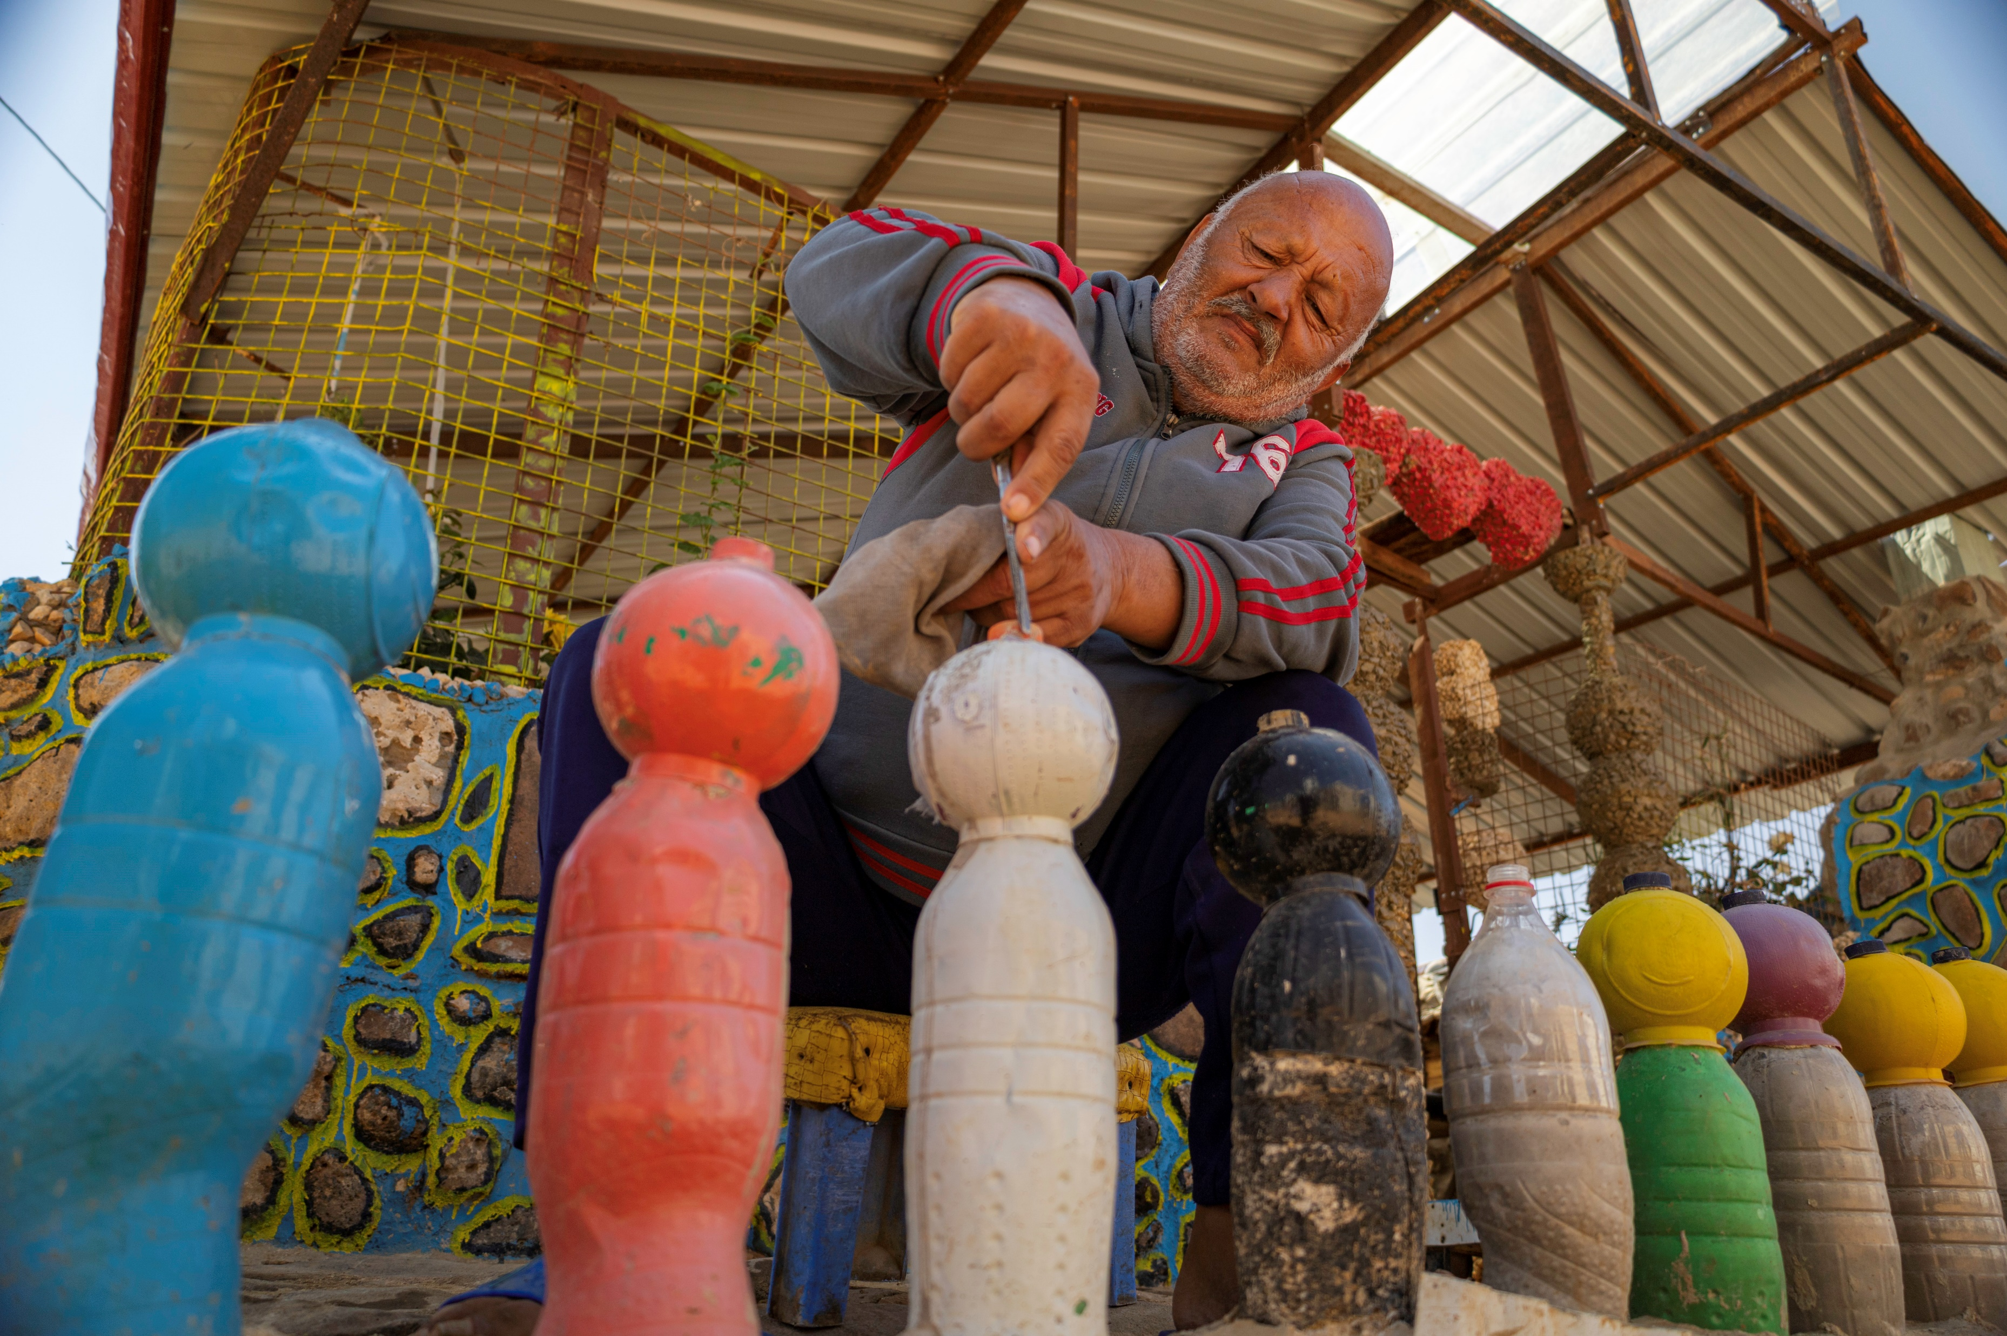
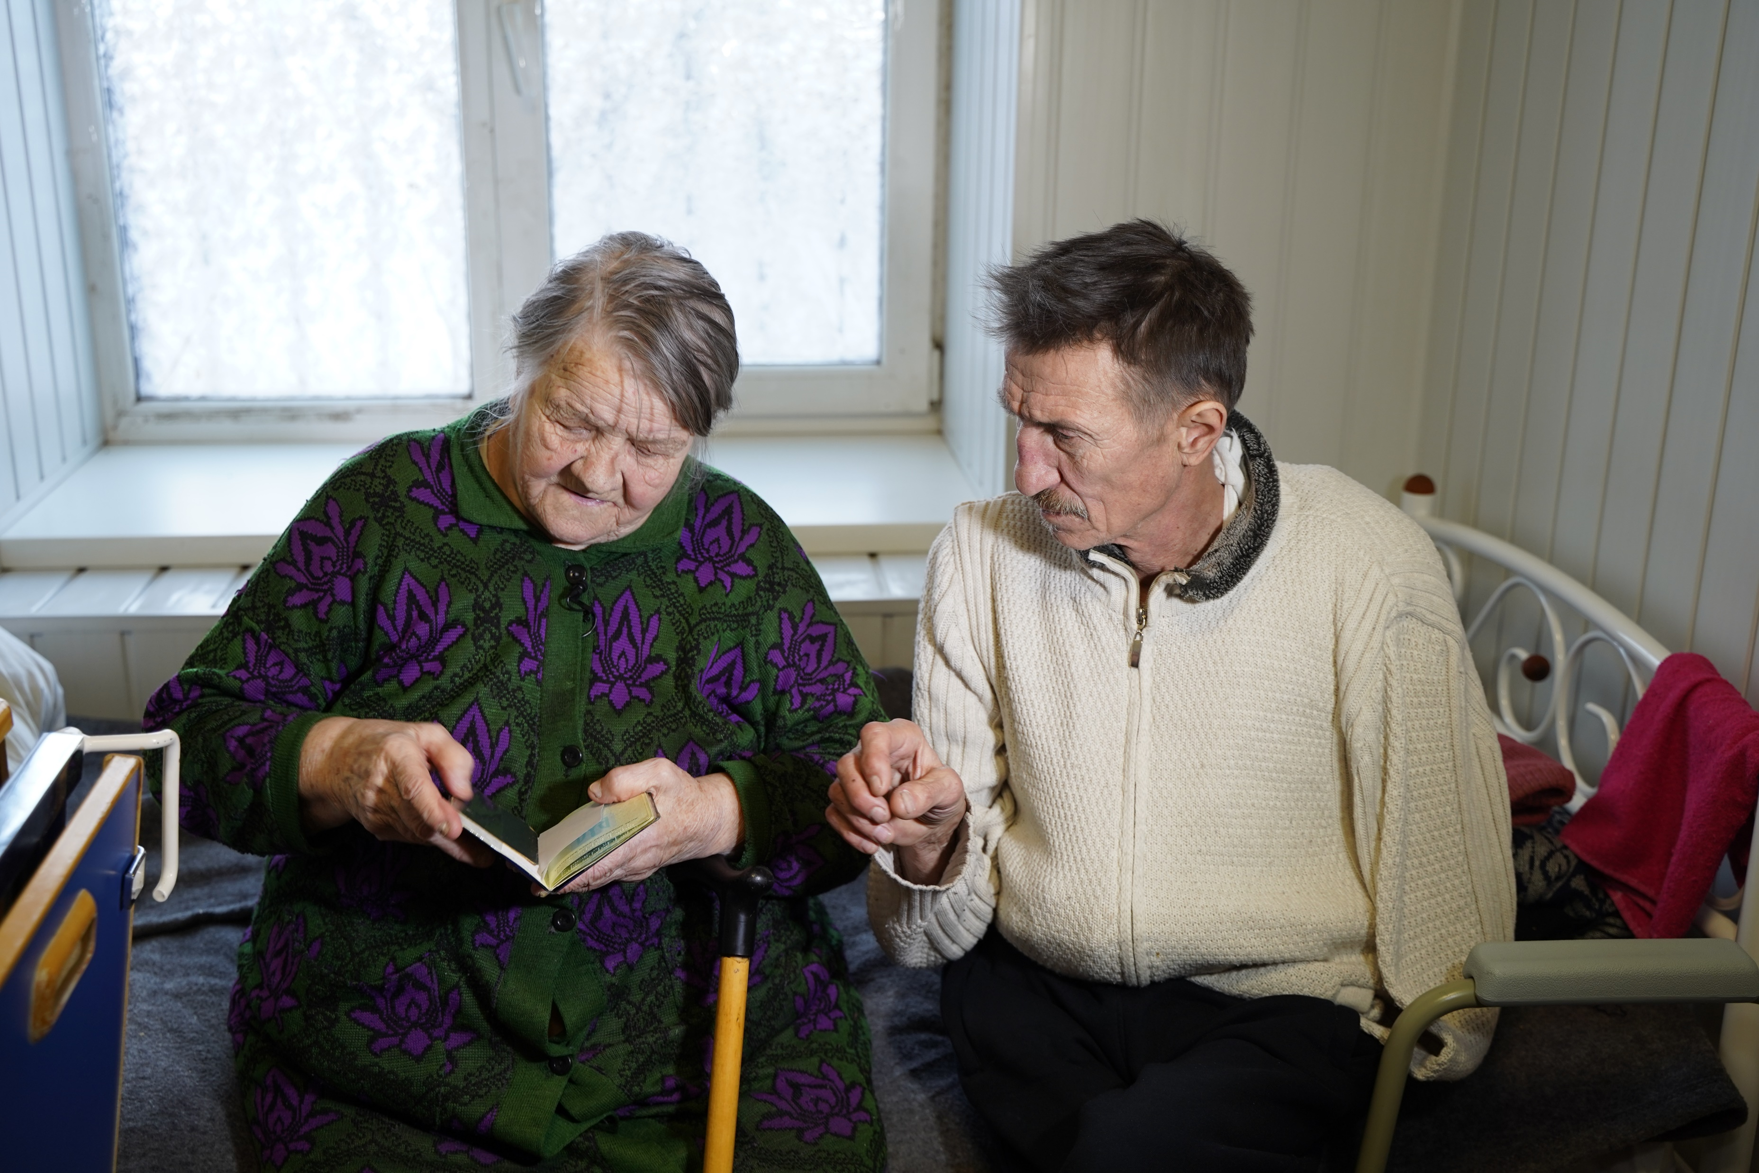
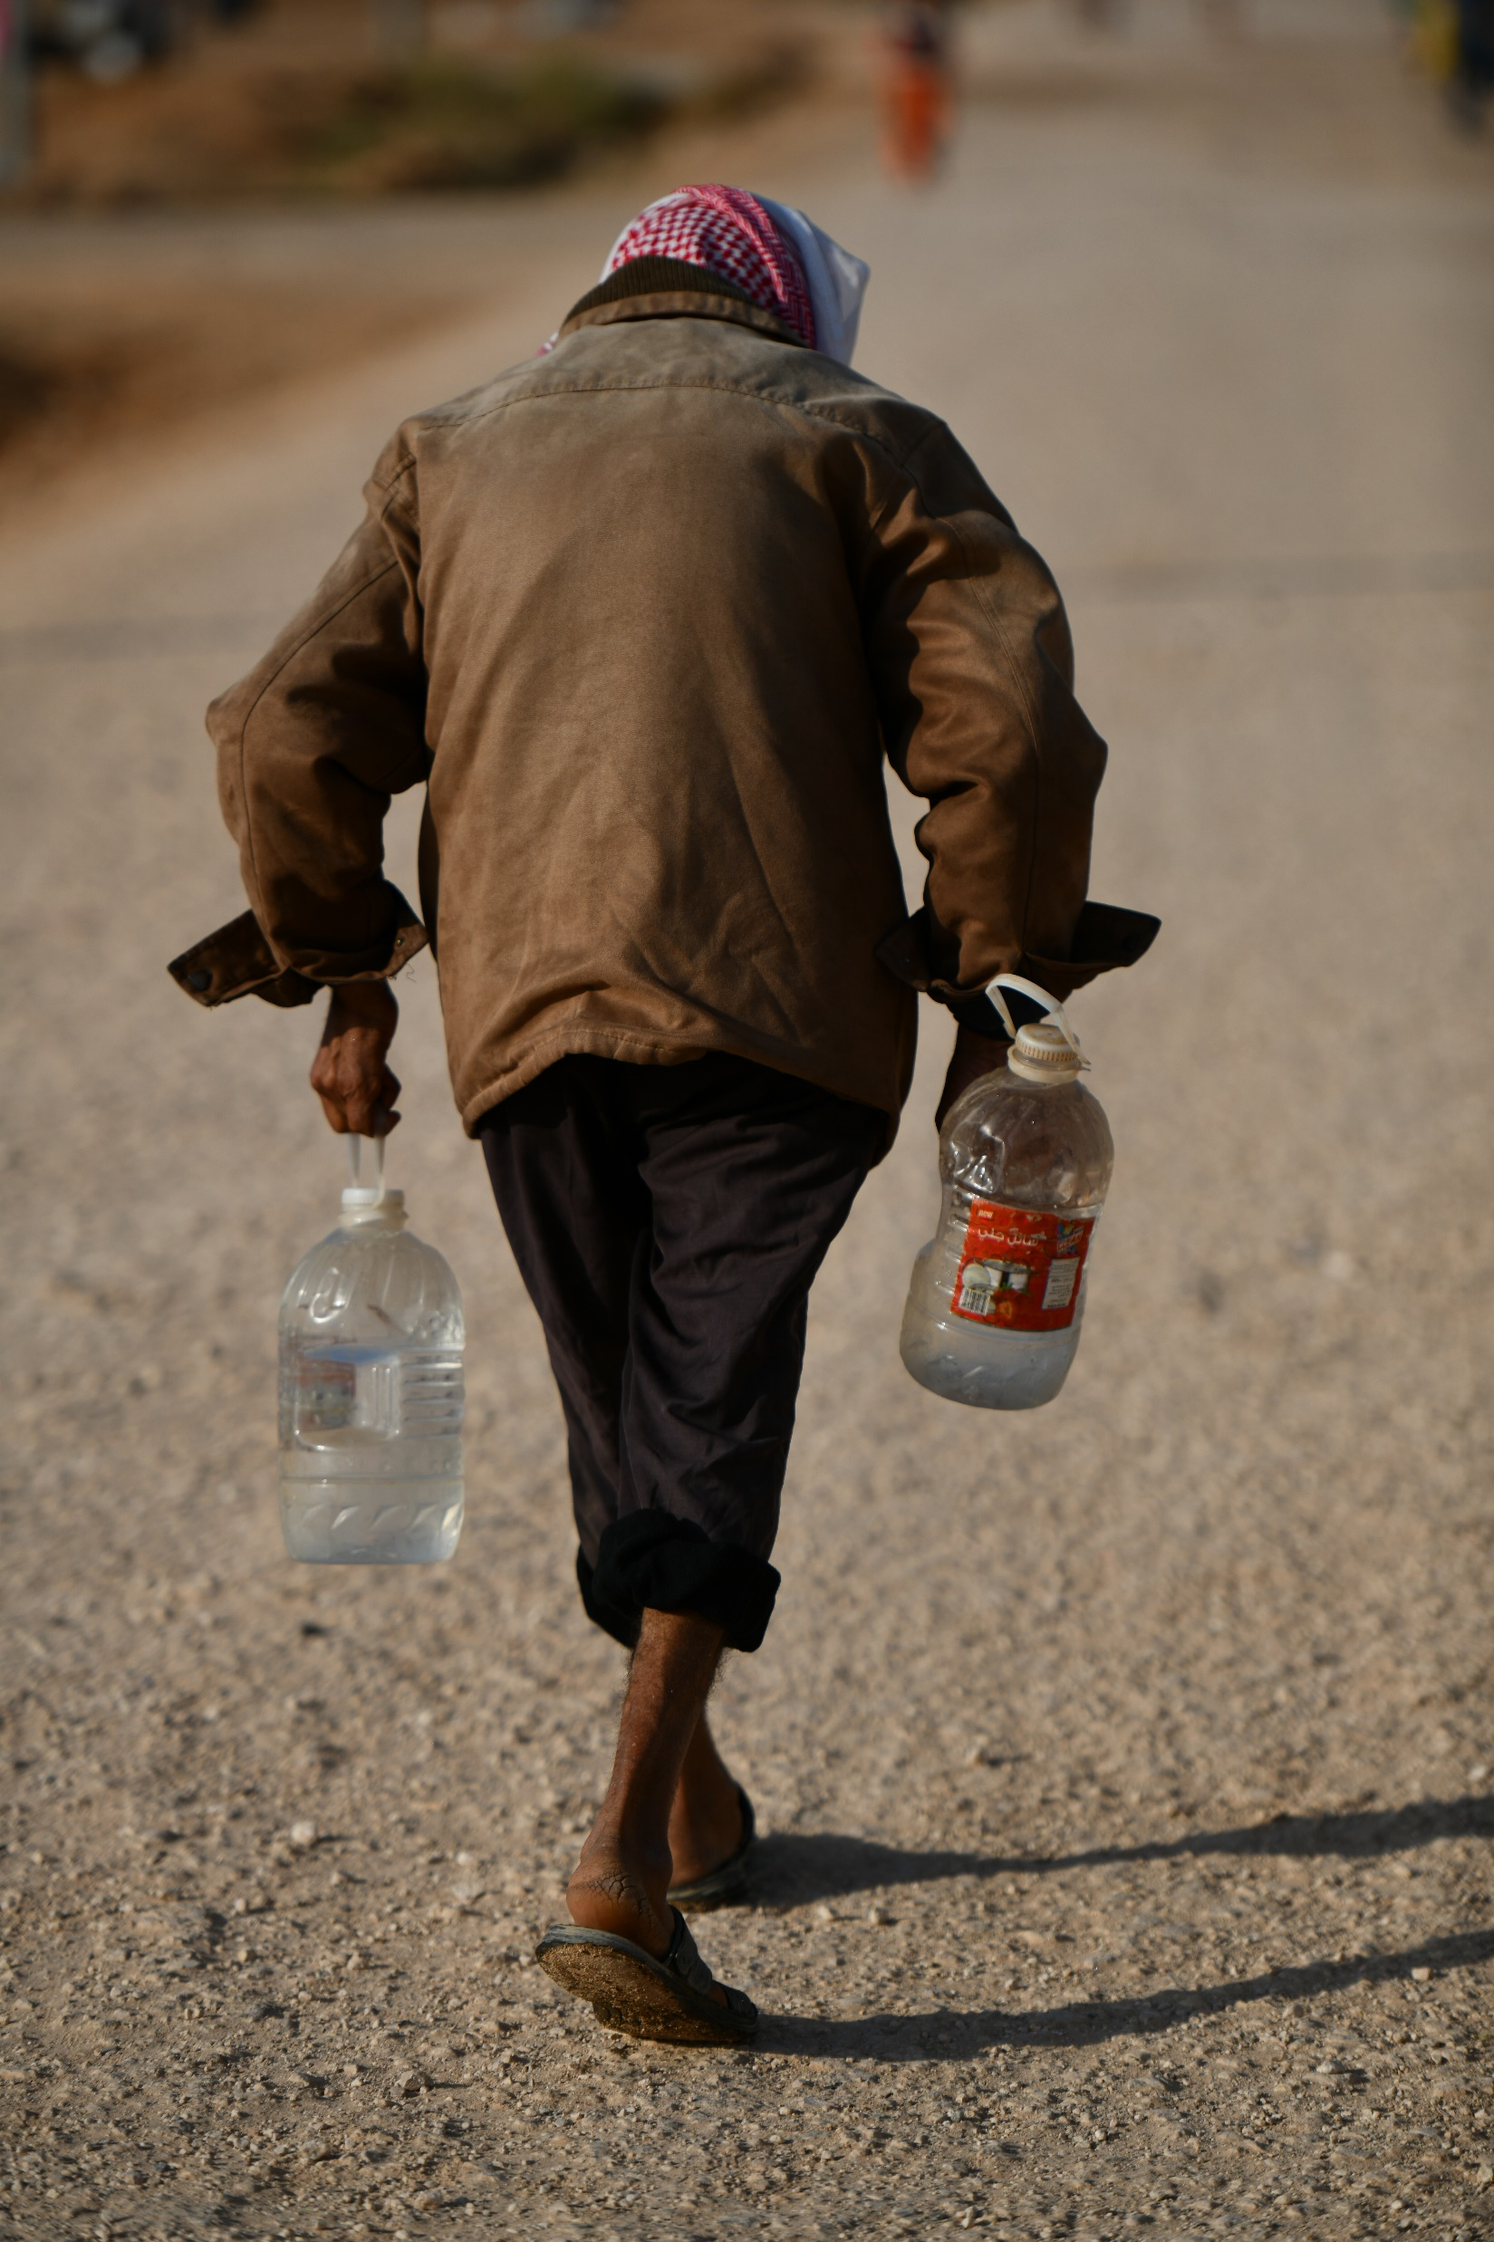
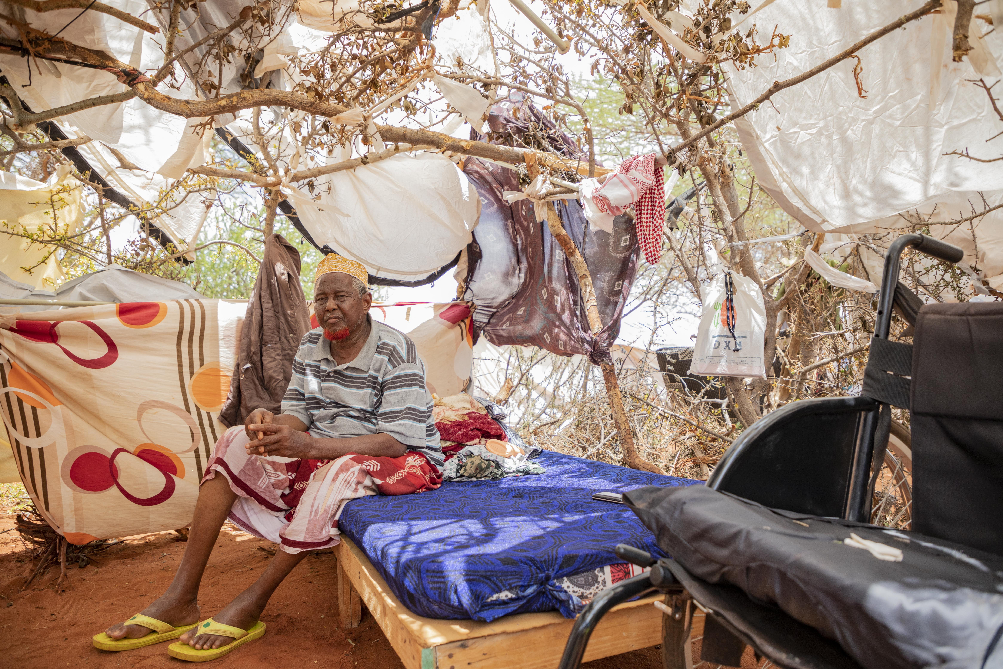
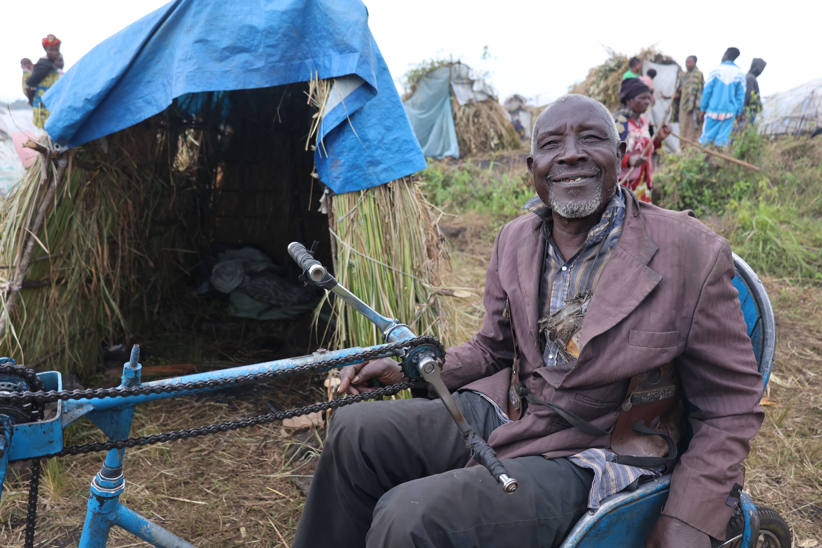
What other characteristics can you identify that describe older persons in forced displacement?
© UNHCR/Shawkat Alharfoush
© UNHCR/Alina Kovalenko
© UNHCR/ Mohammad Hawari
© UNHCR/Diana Diaz
© UNHCR/Blaise Sanyila
Notes:
Tips for facilitators
Tell the participants that the definitions previously shared are very basic.
They will now have a more in-depth look at the components that define older age by analysing the situation of older persons who live in forced displacement.
Accessibility. Ask the participants to volunteer to describe the illustrations on the screen so that all of them are able to contribute, asking them to list four or five words or phrases to describe the key characteristics and roles that they observe in the older persons appearing in the images.
In groups –
Use a flip chart in small groups and write down list of words after 3 min. This might also be done using a word cloud in menti.com or similar platform.
Show the next slide and identify any suggestions that may have been made by the group(s).

Slide 8
Did you identify any of these?
Personal situation – single, married, widow(er) woman or man
Living with family or living alone
Providing care and family support
Living with chronic health conditions and disabilities
Carrying out formal or informal work on a regular basis
Living with anxiety and depression
Able to live independently or dependent on others
Notes:
Tips for facilitators
Ask the participants to identify characteristics that they also listed in their group, e.g. one group can read out their list and then other groups can add words or phrases that are different
Invite the participants to add other suggestions not on the list.
Personal situation – single, married, widow(er), woman or man
Living with family or living alone
Providing care and family support
Living with chronic health conditions
Living with one or more disabilities
Carrying out formal or informal work on a regular basis
Living with anxiety and depression
Able to be actively engaged in daily activities
Able to live independently
Dependent on others to meet their daily needs
Key message: the feedback generated by the six photos of older persons highlights the diversity and intersectionality of older persons and their characteristics; recognizing the importance of identifying diversity in older age is a determining factor in providing inclusive programme support that addresses the wide needs and capacities of older persons.

Slide 9
Key messages
There is no one definition of older persons – it concerns more than just being over 60
Older persons are diverse
Old age is context-dependent and often challenged by negative stereotypes
Notes:
Tips for facilitators
Key messages to take away: there is no one definition of older persons – it concerns more than just being over 60 and it is important to recognize the diversity/intersectionality of older people and their characteristics.
Additional key messages may include:
Older persons are diverse, living with unique and varying states of health, including different levels of functioning, chronic conditions and mortality rates – a heterogeneous group.
Not all older persons are “inherently vulnerable”; many are actively engaged in family and community life.
Old age is commonly challenged by negative stereotypes.
Old age is context-dependent – refugee, IDP, statelessness; changing status and circumstances due to forced displacement.
Remember, an estimated 4 per cent of all displaced persons in the world are older people, although a lack of age-disaggregated data may hide a much higher percentage
In the next activity, we will explore how we can consider this diversity of factors when identifying the protection risks and barriers faced by older persons.

Slide 10
Activity 2 – Using a problem tree analysis to identify protection risks and barriers for older persons in forced displacement
Physical abuse, exploitation, abandonment, profound neglect
Signs: unexplained weight loss, poor hygiene, changes in behaviour, bruising, bedsores, etc.
Branches
What is the impact on older persons?
What are the key protection risks?
Trunk
Elder abuse
Prejudice based on age (ageism)
Limited access to information
Fear of disclosure
Lack of safe reporting channels
Roots
What are the key threats and barriers?
Notes:
Tips for facilitators
Tell the participants that this activity will introduce the use of a “problem tree” analysis to identify protection risks and barriers faced by older persons and discuss actions to mitigate these risks.
Introduce the components of a Problem tree and explain that we will learn how to identify the protection risks (which will appear in the trunk of the problem tree) and to understand the underlying threats and barriers (which will appear in the roots of the tree). This will help us to identify the potential impact of all of these factors on older persons.
Project the slide with the problem tree or draw a problem tree on a flipchart and share an example of a protection risk. The slide represents an example analysis of elder abuse as a protection risk, which will appear on the right of the screen using the PowerPoint Animations function. If the problem tree is drawn on a flipchart, the facilitator can use sticky notes to facilitate inputs (e.g. each sticky note can include a threat, barrier, etc.), or simply write them on the flipchart.
Ask participants about which elements they associate with the concept of “elder abuse”, and gather responses.
Provide feedback on the concept of elder abuse as follows: As reflected on page 30 of UNHCR Need to Know Guidance on Working with Older Persons in Forced Displacement, elder abuse is defined as “a single, or repeated act, or lack of appropriate action, occurring within any relationship where there is an expectation of trust which causes harm or distress to an older person”.
The underlying factors that appear in the roots include prejudices based on ageism (e.g. believing that the lives of older persons have less value or that they are a burden for a household), personal characteristics (e.g. limited literacy restricting access to information, feelings of shame when reporting violence, etc.) and other barriers (e.g. lack of accessible channels for refugees to report violence at home).
The potential impact of such abuse on older persons appears in the branchesExamples include physical injuries, exploitation (e.g. appropriation of financial resources), abandonment and profound neglect, which can potentially even lead to death.
Indicators of elder abuse include unexplained weight loss, poor hygiene, changes in behaviour, bruising or bed sores, etc.
Group exercise:
tell the participants that they will have 10 min to work in groups to identify at least one additional protection risk, its underlying factors and what might be the impact on older persons in forced displacement, and that they will then present their discussion in plenary.
Distribute Handout 2 – Using a problem tree for the protection of older persons. Ask the participants to read the information, and explain the objective of the activity, following the instructions below and noting that they will first identify risks and barriers and then propose strategies to mitigate them.
Group activity: using a problem tree analysis to find out more about their risks and barriers.
Split into groups and draw a problem tree on a flip chart:
Trunk = Key protection risks (problems)
Roots = Key barriers, threats (causes) and personal factors
Branches = Impact on older persons (consequences for the individual and identifiable signs).
In your group, based on your experience:
On red sticky notes write down or describe key protection risks that older persons can experience in forced displacement that pose difficulties as regards accessing support.
Consider protection risks in the home and community setting.
On blue sticky notes, identify and write down the barriers and threats that older persons can face/encounter/experience in forced displacement.
Consider the attitudinal, environmental and institutional barriers facing older persons as regards accessing services and maintaining a level of independence and autonomy
Identify and write down personal characteristics that might increase exposure and impact to environmental risk factors.
On purple sticky notes describe the effects or impacts of these protection risks and barriers on older persons and others.
Include physical and psychological as well as environmental signs (e.g. poor hygiene in the household) that can help to identify the protection risk and its lead causes.
After 10 min, ask one person to share feedback from each group – asking to share their feedback in 2 min to give sufficient time to each group.
In groups – share key points in plenary.
Key messages – The risk of experiencing elder abuse increases for older women and men living alone, and for older women and men who are perceived as a burden by the family, including older women and men with a disability, dementia and other related conditions.

Slide 11
Using a problem tree to find ways to mitigate protection risks and barriers of older persons in forced displacement
How to build resilience in older persons?
Branches
E.g. provide information in accessible formats
What solutions can you suggest to mitigate protection risk?
E.g. establish whistleblowing mechanisms to identify elder abuse
Trunk
What solutions can you suggest to remove barriers?
Roots
E.g. identify barriers to accessing services
Notes:
Tips for facilitators
Now we have an overview from the previous activities that recognizes the risks and barriers faced by older persons; some are similar to other at-risk groups and others are specific to older persons.
In the next step, we will look for strategies to mitigate these risks using a twin track approach: a) mainstreaming support for older persons into ongoing community-focused activities; and b) providing targeted support. This demands a more tailored approach to ensure that we do no harm.
Group activity
Step Two using the problem tree from before, in small groups, please share your experiences in mitigating (reducing) protection risks and barriers of older persons in forced displacement.
Add suggestions to the problem tree used before, on the same flipchart, and place the solutions on the branches, trunk and roots to provide your answers
What solutions can you suggest to mitigate risks? Red stickies
What solutions can you suggest to remove barriers? Blue stickies
How to build resilience in older persons? Purple stickies
Mark solutions that can be mainstreamed “MA” and targeted solutions “TA”
You have 10 min
In the room – share key points in plenary. One person to share from each group – 1 min each
Provide information sheets as prior reading [where are these? They are not mentioned in the main document; “prior reading” = prior to what, given that we are now at the end of this exercise?]
Tips:
1. Identify and mitigate barriers to accessing WASH, Shelter, NFI’s, nutrition and health services.
2. Improve data collection and registration using sex- age- and disability-disaggregated data.
3. Use community-based approaches to ensure that older persons receive care and support as well as social protection services and mental health and psychological support.
4. Recognize and support the capacities of older persons.
5. Strengthen family and community structures.
6. Strengthen accountability mechanisms by making them accessible and responsive to older persons.
7. Enhance case management capacity to prevent and respond to abuse and exploitation of older persons.
8. Provide equal access to durable solutions through accompaniment and support in resettlement, return and integration processes.
9. Consider the use of technology in improving access to services and information.
10. Empower and support communities, particularly older persons and their relatives, to develop their own strategies to reduce exposure and mitigate risks.
Examples of ways to achieve this:
(a) Consult with older persons using a range of approaches and methodologies, taking account of age, gender, disabilities, culture, mobility, language and accessibility;
(b) Facilitate the involvement of older persons in decision-making and leadership structures, recognizing the specific support that older women and older people with disabilities may need in order to access these structures or opportunities;
(c) Involve older persons in designing programmes and in reviewing how the programmes meet their needs to live independently and with dignity.
See NTKG on Older Persons and HelpAge Protection Guidelines https://www.humanitarianlibrary.org/sites/default/files/2019/09/protection-final.pdf

Slide 12
Key messages
Older persons can face additional risks and barriers to accessing protection and assistance.
A combination of underlying factors such as ageism, unintended barriers and individual factors can negatively affect their protection.
Older persons have a wide range of skills and capacities that can enhance their resilience.
Notes:
Tips for facilitators
Share key messages with participants, highlighting that additional work will be built upon these messages in the next activity.

Slide 13
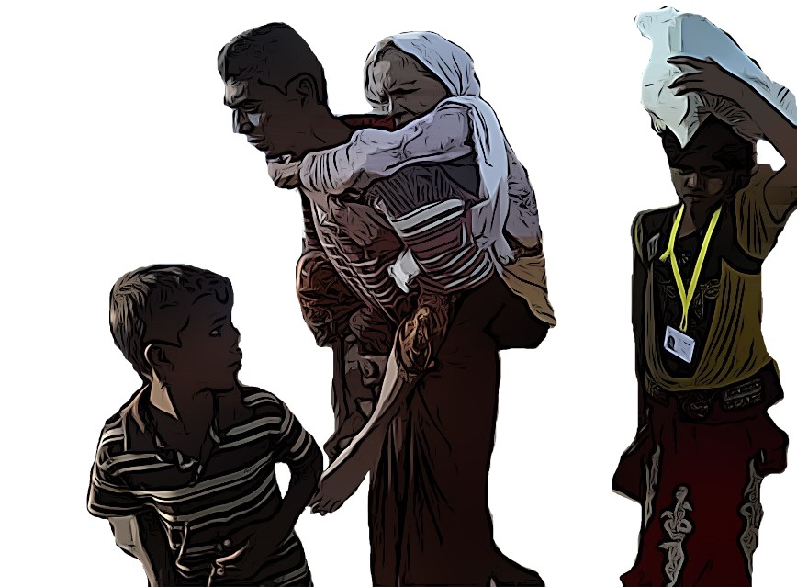
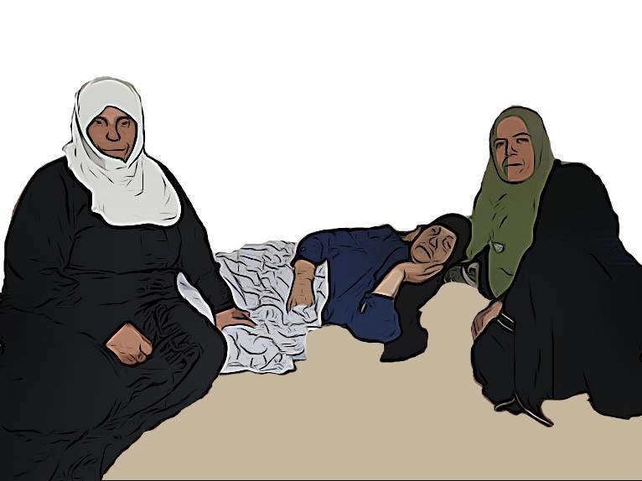
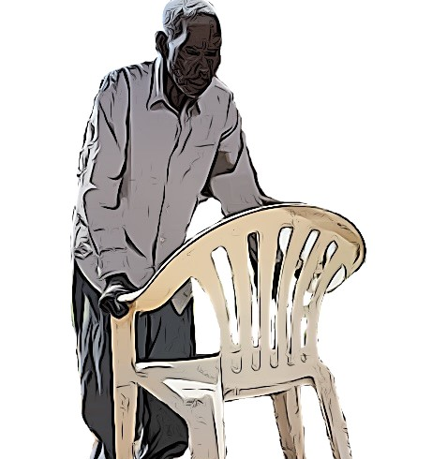
Activity 3 - Strategies to promote the protection of older persons in situations of forced displacement
Aye is being carried by her son from the health centre as staff said she was too old to be treated
Maryam is lying in bed supported by her carers
What protection risks and barriers might these older persons face?
Abdul, his wife and family are upset as Adbul had no clothes go to the distribution centre
Joseph is taking a short walk alone, using a plastic chair as a walking aid
Notes:
Tips for facilitators
Point out to the participants that their experiences will have contributed to learning about the protection risks that older persons may face in situations of forced displacement.
This third activity will further explore the specific protection risks that older persons may face at home and in the community, by hearing the stories of older women and men. While some of the risks and strategies have already been shared, applying them to a case study will make it easier to understand additional and intersecting risks and identify tangible protection actions.
Reflecting on the protection risks discussed in the previous activity, ask participants to identify signs that might indicate the presence of protection risks, the root causes and barriers to ensuring protection and the potential impact on Maryam and Joseph. [so from now on we just forget the other two? The guide appears to imply that all four cases should be discussed]
Group activity – look at home-based protection risks
Meet Maryam and Joseph and consider some of the protection risks and barriers that could have an impact on Maryam and Joseph.
Distribute Handout 3 – Case studies, via email or in print.
Explain to the participants that they will explore protection risks in four specific case studies. The participants will receive a case study reflecting a potential situation of risk faced by an older person and will be asked to identify potential signs of a protection risk, discuss which actions might be appropriate and identify whom they would involve to undertake these actions.
Divide the participants into groups and briefly introduce the cases reflected in Handout 3.
Explain to them that two cases focus on risks faced at home and two cases focus on risks faced in the community; invite them to choose one, based on their own interests and experiences.
Depending on the time available, the facilitator might also select only one case study for open discussion with the entire group.
Accessibility: describe the images on the screen – on the left, Maryam is lying on the floor on a mattress with her two carers in a small room and on the right, Joseph is standing using a white plastic chair looking breathless.
Tell the participants that they will have to consider some of the protection risks and barriers that might have an impact in Maryam and Joseph.
“My name is Maryam, I am 78 years old and I have been displaced due to war to a village close to the border, which we cannot cross as we don’t have passports; I have chronic health issues and now cannot walk as I had a stroke three years ago; I rely on my carers, Fadhillah and Farah, to look after me now, which is very difficult for me to accept. I am getting angry with them as they keep insisting I eat and I have no appetite. I cannot get up to use the toilet chair without their help. It is always cold in this shelter and the rainwater comes through the roof. My carers stay with me daily and they find it hard to look after their families because of me. I have heard them speaking about crossing the border with smugglers, but I do not find it safe”
“My name is Joseph and I am 69 years old, and I am getting weaker and my balance is poor; I cannot see clearly now. I often have difficulty finding the toilet in the dark. The local fighting has forced me back to my village, where most of my neighbours have left and I now live alone. I don’t bother to eat regularly or even wash myself. I find it so hard to get to the market so must pay for help from an older woman, who is also alone. I have heard that some foreigners are giving money to help people, but you need to have one of these cell phones. I don't feel safe here and cannot sleep.”
Using Worksheet to be provide to teams with guided information [what does this mean? Syntax/grammar all over the place!]
Share a final key message on identifying protection risks: many protection risks that older persons face are hidden and listening to their stories is an important way to better understand these risks and barriers.

Slide 14
What protection risks and barriers may Maryam, Aye, Joseph and Abdul face?
What can be done to mitigate risks and barriers for these older persons?
Aye is being carried by her son from the health centre as staff said she was too old to be treated
Maryam is lying in bed supported by her carers
Abdul, his wife and family are upset as Adbul had no clothes go to the distribution centre
Joseph is taking a short walk alone, using a plastic chair as a walking aid
Notes:
Tips for facilitators
Explain to participants that they should follow a similar approach to looking at ways to mitigate specific protection risks and barriers that older persons may face at home.
What can be done to mitigate risks and barriers for Maryam and Joseph?
Ask participants to suggest ways to mitigate risks and barriers to ensure that older persons’ rights to independence, participation, self-fulfilment, dignity and care are upheld without discrimination in the home setting.
to ensure that older persons’ rights to independence, participation, self-fulfilment, dignity and care are met without discrimination in the home setting.
These are actions taken from NTKG
In groups, take the handout of suggested ways to mitigate some of the barriers identified and tick those that you feel would would mitigate the risks for Maryam and Joseph.
Taking a twin-track approach to your chosen options to support Maryam and Joseph, mark actions that could be mainstreamed into regular activities with an “M” and other actions that would require a more targeted approach with a “T”.
Whom would you involve to ensure that these activities can take place? Ask the participants to complete the table with roles and responsibilities for the protection and inclusion of older persons.
Discuss for 10 mins. Make sure that the actions address the risks shared earlier.

Slide 15
Recognising the capacities of older persons is key to inclusion
Older men and women have…
Life-long coping strategies
Caregiver and work experience
Leadership skills and resilience
Knowledge of communities’ cultural and social identities
Capacity to act as mediators, community mobilizers and peacekeepers
How can you enhance these capacities for protection?
© UNHCR/Shawkat Alharfoush
Notes:
Tips for facilitators
Tell the participants that we have been discussing how to identify protection risks and barriers and exploring practical strategies to support older men and women in different settings. Many of the strategies come from ensuring that older persons are actively engaged in the process.
The teams should develop a thorough understanding of the capacities of older persons in displaced populations as well as the risks that they face.
Ask the participants to read about the capacities that older men and woman have, as displayed in the slide, and ask them how they could leverage these capacities to ensure their protection and that of their communities. Collect and share ideas based on, but not limited to, those displayed in the slide:
Provide opportunities for volunteering
Engage them in peer-to-peer support for others in their community
Provide financial or material support to carry out their activities
Engage them as representatives on committees in camp or host communities
Engage them as members of staff with useful knowledge and skills
Key Messages –
Recognize that older persons have a wide range of skills and capacities: be sure to gather this information rather than looking only at their vulnerabilities/risks.
Solutions to reduce the levels of risks can result from building their capacities, allowing them to be part of the solution

Slide 16
Key actions to ensure the inclusion and protection of older persons
Have we collected and used data disaggregated by sex, age and disability?
Have we considered barriers to meaningful participation in our planning and implementation of activities that may require mitigation strategies?
Have we ensured that communication is clear and accessible?
Have we implemented measures to ensure that older persons are deciding for themselves?
Have we mapped skills and responsibilities in the family and the community?
Notes:
Activity: concluding points – to recap the session, it may be useful to have these eight [there are only five] questions in your mind in order to advance the inclusion of older persons in the development of projects and activities. They may help to think through the next steps in making final feedback and action points [what does this mean? Feedback on what? How does one “make feedback and action points”? Is this about the presentation or about interventions in displacement settings?].
Do remember the three stages of inclusion [I find no mention of these, what are they?] so that steps towards ensuring we leave no one behind can be embedded into your work.

Slide 17
Key messages
There is no one definition of older persons – it concerns more than just being over 60
It is important to recognize the intersection of age, gender, disability and other diversity factors in older persons
Older persons have a wide range of skills and capacities
Listening to older women and men’s stories is an important way to better understand the risks and barriers that they face

Slide 18
Key actions – how are you going to integrate them?
Use global data on ageing, gender and disability to inform your work
Identify protection risks and barriers to the inclusion of older persons
Recognize the diversity and capacities of older persons
Use key strategies involving others in the community to promote the inclusion of older persons
Notes:
At the end of this session participants have learned to:
Use global data on ageing, gender & disability to inform their work
Recognize the diversity and capacities of older persons
Identify protection risks and barriers to the inclusion of older persons
Use key strategies involving others in the community to promote the inclusion of older persons
Many thanks for joining the session

Slide 19
Final quiz!
Notes:
1. What percentage of displaced persons are older persons?
4 per cent, 10 per cent or 20 per cent. [Answer: 4 per cent]
2. What percentage of older persons is estimated to have one or more disabilities? 15 per cent, 40 per cent or 46 per cent. [Answer: 46 per cent]
3. There is no one definition of older persons – it concerns more than being over 60. True or False? [Answer: True]
4. What are the recommended age cohorts for collecting data on older persons? Age cohorts of 5 years, persons aged 60+ as one age cohort, age cohorts of 10 years. [Answer: Using age cohorts of 10 years]
5. List some of the signs that can help in identifying a situation of elder abuse. [Potential answers: unexplained weight loss, lack of interest in food, neglect, unusual changes in behaviour and interaction with others, tiredness or listlessness, bruises, burns or injuries, feelings of isolation].
6. List key steps in ensuring the protection and inclusion of older persons. [Potential answers: identifying barriers and risks, using a twin-track approach in programming, engaging the capacities of older persons, ensuring their participation]

Slide 20
United Nations and Older Persons
United Nations Principles for Older Persons at: https://www.un.org/development/desa/ageing/resources/international-year-of-older-persons-1999/principles.html
Madrid International Plan of Action on Ageing at: https://www.un.org/development/desa/ageing/madrid-plan-of-action-and-its-implementation.html
Issues | United Nations For Ageing

Slide 21
UNHCR Policy and Guidance
UNHCR Policy on Age, Gender and Diversity at Age, Gender and Diversity – UNHCR
UNHCR’s Policy on Older Refugees (2000)
Refworld | UNHCR Working with Older Persons in Forced Displacement
Older refugees | UNHCR Integration Handbook
Emergency Handbook - Older persons | UNHCR
A claim to dignity: Ageing on the move
Age, Gender, and Diversity Inclusive Pledges | The Global Compact on Refugees | UNHCR (globalcompactrefugees.org)

Slide 22
Inter-agency efforts and older persons
United Nations Inter-Agency Group on Ageing (IAGA): Strengthening the inclusion of older persons in the work of the United Nations system. | Division for Inclusive Social Development (DISD)
Age and Disability Consortium Humanitarian Inclusion Standards for older people and people with disabilities (2017)
Migration portal https://migrationdataportal.org/themes/older-persons-and-migration

Slide 23
Partner organizations working on the protection and inclusion of older persons
HelpAge International – Promoting the rights of older people. Regional collaborations include the development of studies, awareness-raising materials and training curricula. E.g. A claim to dignity: Ageing on the move
International Rescue Committee – Safe at Home (gbvresponders.org). A resource package that includes resources for preventing and responding to co-occurring violence, including curricula to be used with women’s groups, men’s groups and families as a whole, as well as guidance to enhance response services to better serve families and older persons.
Preventing violence, abuse and neglect of older women and older men in the family.
Guidelines for Integrating an Older-age Lens Into Existing Case Management.

