Slide 1
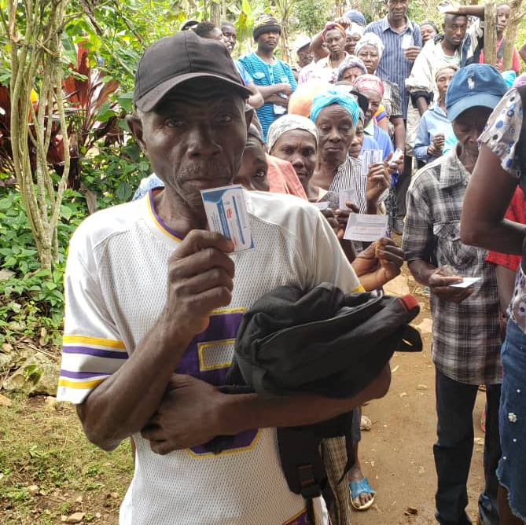
Session 4
Advanced Facilitators tips on using the Humanitarian Inclusion Standards and UNHCR Need to Know Guidance
Notes:
Session 4 Advanced Facilitators tips on using the Humanitarian Inclusion Standards and UNHCR Need To Know Guidance

Slide 2
Objectives of the session
Advanced Facilitators tips on using Humanitarian Inclusion Standards (HIS) and Need-To-Know Guidance (NTKG)
Learning Objectives 1
Understanding key principles of inclusion related to older persons
Learning Objectives 2
Build key tips to facilitate using the Humanitarian Inclusion Standards and the NTKG for older persons
Notes:
Advanced Facilitators tips on using Humanitarian Inclusion Standards (HIS) and Need-To-Know Guidance (NTKG)
Learning Objectives 1
Understanding key principles of inclusion related to older persons
Learning Objectives 2
Build key tips to facilitate using the Humanitarian Inclusion Standards and the NTKG for older persons

Slide 3
Using the HIS and NTKG
Scenario
Field teams carried out a learning needs assessment and prioritised that they would like to have more knowledge and skills to strengthen their inclusion work.
Your team leader has given you the responsibility of promoting the Humanitarian Inclusion Standards and the NTKG of older persons within your team and with partners.
This is your opportunity to work together to share these tools as a starting point to increase their understanding of what can these tools be used for and how to apply them in practice.
Where do we start !!
Notes:
Read out the Scenario – here is the challenge!
Field teams carried out a learning needs assessment and prioritised that they would like to have more knowledge and skills to strengthen their inclusion work.
Your team leader has given you the responsibility of promoting the Humanitarian Inclusion Standards and the NTKG of older persons within your team and with partners.
This is your opportunity to work together to share these tools as a starting point to increase their understanding of what can these tools be used for and how to apply them in practice.
Where do we start !!

Slide 4
Suggested activities
What are the key inclusion principles to build our work on ? Lets share them.
Do we have a common definition of inclusion ? Lets share one.
How can we use Standards and Guidelines? Look a the check list.
How do we use the HIS and NTKG to provide useful guidance ? Lets prepare some scenarios to demonstrate their usefulness.
How do we make it fun? That is always a challenge!
Notes:
What are the key inclusion principles to build our work on ? Lets share them
Do we have a common definition of inclusion ? Lets share one
How can we use Standards and Guidelines? Look a the check list
How do we use the HIS and NTKG to provide useful guidance ?
Lets prepare some scenarios to demonstrate their usefulness
How do we make it fun? That is always a challenge !

Slide 5
Humanity, impartiality, neutrality and independence.
Non –discrimination.
Accessibility.
Respect for the inherent dignity.
Active participation and equality of opportunities.
Respect for diversity and acceptance.
Equality between persons of different genders and age groups.
HIS and NTKG for older persons are underpinned by key Humanitarian Principles for all:
Notes:
We need to remind ourselves of that HIS and NTKG for older persons are underpinned by key Humanitarian Principles
Humanity, impartiality, neutrality and independence
Non –discrimination
Accessibility
Respect for the inherent dignity of older persons
Active participation and equality of opportunities
Respect for diversity and acceptance of older persons
Equality between persons of different genders and age groups
How to achieve inclusive humanitarian action ?
The challenge is how to reach older persons most affected in a crisis with the services, assistance and protection they need, while ensuring their effective participation in the planning and execution of the response.
Failing to reach older individuals who are marginalised and excluded means that humanitarian actors cannot claim to uphold the principle of impartiality, which is at the heart of the humanitarian mission.
Inclusive humanitarian action has been at the centre of a number of policy discussions, commitments and initiatives in recent years, yet in practice responses continue to struggle to deliver it.
Continued evidence that humanitarian responses fail to be inclusive therefore puts into question both the ethical essence of humanitarian action and its effectiveness.

Slide 6
5 key gaps to address using the HIS and NTKG
OUT OF
SIGHT
OUT OF
REACH
OUT OF
THE LOOP
OUT OF
MONEY
OUT OF
SCOPE
The people we
fail to see
The people we
can’t get to
The people we
unintentionally exclude
The people we
don’t prioritize
The people who
aren’t our problem
Notes:
From the work in the region there are 5 clear gaps identified which need addressing
1. Out of sight- The humanitarian sector cannot help people if it fails to see them. Sometimes this takes a significant effort. For example, people whose births are not registered or who lack proof of identity are often effectively out of sight when it comes to receiving the assistance they need and common for older persons
Another problem is that most assessments don’t collect data in a disaggregated manner, and many groups are left out
2. Out of reach- Remote and hard to access population. Factors that render people hard to reach range from physical realities of the natural and built environment to man-made factors, such as insecurity, and regulatory barriers.
3. Out of loop- Data and situational information- SADDD and WGQs
Tailored assistance
Effective communication
Lack of leadership to ensure inclusion
4. Out of money- The massive and growing gap between the funds required and the funds available for humanitarian response is a major factor behind the exclusion of the world’s most vulnerable people.
5. Out of scope- while people may be left behind during humanitarian responses, others are left behind because they fall outside humanitarian scope. Certain types of crisis give rise to humanitarian need but rarely make it onto the agenda of the mainstream. Like irregular migrants, and urban violence
Using the guidance can help to reverse these challenges…

Slide 7
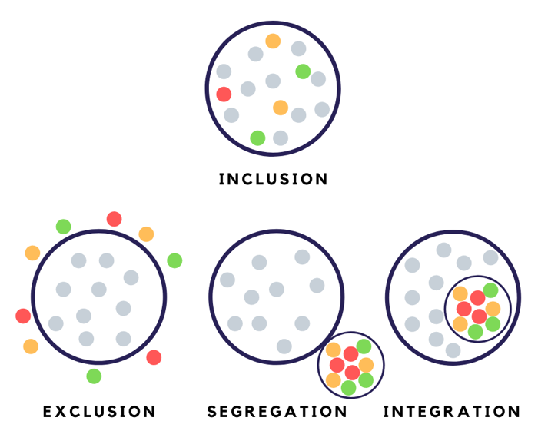
What is inclusion?
The state of being included.
It is about:
valuing all individuals.
giving equal access and opportunity.
removing discrimination and other barriers.
Notes:
To take steps to address these challenges it is useful to recognise the different ways of working and to identify the barriers faced to strengthen inclusion.
In reality , it is often challenging to adopt a fully inclusive approach.
Look at this diagram and recognise these 4 options which we commonly experience in our work.
One aim of an inclusive approach in our work is that everyone has equal and equitable access to services.
Question one - Think of a project you are working on or know about where older persons and others at risk are involved.
Which approach are you using?
Give an example – in the community centre set up to receive migrants they only receive any displaced persons but there are no special health facilities for older persons
Or another example - in the community centre, there are special health services and food supplies for children, adults and older persons
Use prompt questions-
Do you have specific programmes for older people within the community where there is active engagement with others ?
Do you have specific programmes for older people segregated from the others? What are the pros and cons of the ways in developing this approach?
Is there a gap in programmes for older people and they are excluded ?
Discussion in plenary with examples

Slide 8
Using the Humanitarian Inclusion Standards and the NTKG for older persons – complimentary tools
Using standards with others guidance:
Helps to focus where it is most needed.
Helps to identify needs of older persons and to know what to do.
Can inform affected older persons to understand their rights.
Tick which points are applicable in your work.
Handout 4.1
Area of interest:
Guiding principles with activities to keep older persons safe.
Useful resources to plan, implement, and evaluate humanitarian response.
Approaches apply to a wide range of context, mixed migration setting and public health emergencies.
Address multiple risks to build resilience of older persons, their family and community.
Use them to:
Jointly prioritise actions.
Work with governments, communities and partners.
Design, implement and improve a response.
Measure how effective a programme is.
Take steps to leave no one behind.
Prepare before crisis strikes.
Notes:
Take a look at this check list using Handout 4.1
Tick of if you agree with the statements.
In your work – which points from the 3 sections are most useful ?
The Humanitarian Inclusion Standards and NTKG for older persons are complimentary tools which describe the sets of actions needed to ensure that crisis-affected older persons with and without disabilities can enjoy their right.
Each document sets out guiding principles to critical activities to keep older persons safe from abuse, neglect, exploitation and violence and to support their wellbeing
Both are useful resources for practitioners to plan, implement, and evaluate humanitarian response.
Approaches apply across a wide range of context, mixed migration setting and public health emergencies. Older persons often face multiple risks all at once so activities need to be interlinking to build resilience of older persons , their family and community
Using standards with others guidance:
- can create order out of chaos and helps to focus where it is most needed
- helps to identify needs of older persons and to know what to do
- can inform affected older persons to understand their rights
Use them to:
jointly prioritise actions
work with governments , communities and partners
design, implement and improve a response
measure how effective a programme is
take steps to leave no one behind
prepare before crisis strikes
By applying them in preparedness and response operations, humanitarian agencies and practitioners make a commitment to quality and make themselves accountable to the older populations they serve.

Slide 9
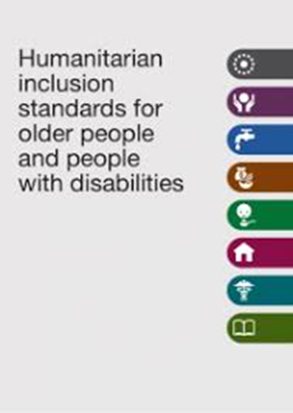
Why use Inclusion Standards?
Suggest ways to:
Include those most at risk during emergencies.
Prevent anyone from being left behind.
Notes:
To find solutions to these challenges, the Humanitarian Inclusion Standards offers some steps towards inclusion.
The standards are divided into 2 section – one looks at Key Inclusion Standards and then applies them to the sectors. There are sectors on Protection, Health, Shelter, Nutrition, Livelihoods, and WASH – all very relevant to the priorities identified in the Ageing on the Move report.
Have a look at this video.

Slide 10
Looking at 3 key areas of inclusion
COLLECTION OF INFORMATION
PARTICIPATION AND RESILIENCE
ADDRESSING BARRIERS
Older people and people with disabilities have their capacities and needs identified and monitored.
Older people and people with disabilities have safe and dignified access to humanitarian services.
Older people and people with disabilities participate meaningfully in humanitarian activities
Notes:
In developing your sessions with the team members, these points are fundamental in taking steps ahead to promote inclusion – they underpin all inclusion activities and identify the diversity and intersectionality of the population at risk.
There are 3 key areas which frame both the key inclusion standards and sector standards.
1. Collection of information:
Older people and people with disabilities have their capacities and needs identified and monitored and we can group the Key Inclusion standards under these heading to inform programming, training and advocacy.
2 Addressing barriers:
Older people and people with disabilities have safe and dignified access to humanitarian services
3 Participation and resilience :
Older people and people with disabilities participate meaningfully in humanitarian activities
Back up notes on barriers – looking at different type
Physical/environmental: For example, transport and buildings that have steps may be inaccessible to people who have difficulty walking or who use a wheelchair.
Communication: Using only written documentation excludes those who are illiterate. Small print or only written materials might be inaccessible to people with visual impairments or lower literacy levels. The language we use can be discriminatory and reinforce social and attitudinal barriers.
Social/attitudinal: People with disabilities can be perceived as helpless or unproductive. Older age can be viewed as an impairment making disability in older age ‘normal’ which, in turn, can prevent people from fully participating in their everyday life.
Institutional/systems: Many laws, policies, strategies or practices that discriminate against people with certain characteristics. For example, employers or credit facilities may specify an upper age limit for job application or credit schemes, or require a person to be able to see, hear or walk, even if this is not strictly necessary for the job. This directly discriminates against older people with disabilities. Gaps in data systems can result in poor quality or a lack of reliable data can mean older people are excluded from processes and programmes. For example, when population data ends at 49 years or if we do not collect data for our programmes, the most vulnerable may not be considered or included.
Economic: Access to services or participation in social activities may require a certain level of resources, for example, an older person may not be able to afford the cost of the bus fare to reach a free health service.
Internalised barriers: People who experience discrimination in society sometimes
On participatory approaches
Collaborate - The accessible focus group discussion of older people with different disabilities and health actors identified barriers together to access health services and decided to set up an outreach services
Consult - RNA data was collected by country teams by doing house to house surveys gathering information from older men and women
Inform - Older men and women were told to get their cash distribution on mobile phones but did not have phones
Empower - Members of the older peoples committee represented their views at the Protection meeting in the camp with NGOs and other actors
Involve - Older women with disabilities were included in the womens’ group meetings to raise their concerns on safety in the host community as refugees
No participation - A loudspeaker went around the settlement near the market and did not go to the rural areas.

Slide 11
Levels of participation
Accessible focus group discussion of older persons with different disabilities and health actors identified barriers together to access health services and decided to set up an outreach services.
Data was collected by country teams by doing house to house surveys gathering information from older men and women.
Older men and women were told to get their cash distribution on mobile phones but did not have phones.
Members of the older persons committee represented their views at the Protection meeting in the community with NGOs and other actors.
Older women with disabilities were included in the womens’ group meetings to raise their concerns on safety in the host community as refugees.
A loudspeaker went around the settlement to tell people of a food distribution in a site 1 hour away.
EMPOWERMENT
Joint decisions led by women and men (including marginalised groups).
COLLABORATION
Joint decision making but risk of elite capture.
INVOLVEMENT
E.g. participatory workshops; results are input to decisions.
CONSULTATION
Getting people’s opinion on an already developed idea: no decisions.
INFORMATION
One way, lack of dialogue.
NO PARTICIPATION
Withholding information; top down process.
5
4
3
2
1
0
Notes:
Lets take a closer look at the participation of older persons – it is the key to embedding inclusion of older persons in a community.
So let’s look at the participation ladder. Are you familiar with it ?
Look at these 6 steps … Now there are a series of statements – read them out and write in the chat where they fit on the rungs of the ladder.
Collaborate - The accessible focus group discussion of older people with different disabilities and health actors identified barriers together to access health services and decided to set up an outreach services
Consult - RNA data was collected by country teams by doing house to house surveys gathering information from older men and women
Inform - Older men and women were told to get their cash distribution on mobile phones but did not have phones
Empower - Members of the older peoples committee represented their views at the Protection meeting in the camp with NGOs and other actors
Involve - Older women with disabilities were included in the womens’ group meetings to raise their concerns on safety in the host community as refugees
No participation - A loudspeaker went around the settlement near the market and did not go to the rural areas

Slide 12
You will be divided into 4 groups to get to know Raul and Agapito.
Group work
Handout 4.2
How can Raul and Agapito and Wilma be better included in planning activities in the community to ensure their Protection needs are addressed ?
What data do you find from the case studies?
What are the main barriers do you identify in this case study ?
Did they participate in any activity ?
Identify a rapporteur
Draft your answer in a PPT for presentation
Your group will have 7 minutes to discuss
Notes:
You will be divided into 4 groups and do a 2 steps activity a) to look at the case studies and then b) to develop activities to increase their inclusion.
2 groups will look at Raul’s story and 2 groups will look at Agapito and Wima’s story
Remember the 3 key areas of Inclusion (Data, barriers and participation) ?
Look at the case studies for Raul and Agapito and Wilma .
What data do you find from the case studies?
What are the main barriers do you identify in this case study ?
Did they participate in any activity ?
Your group will have 7 minutes to discuss one case study.
Identify a rapporteur
Draft your answer in a PPT/ flipchart for presentation
Feedback using slide or flipchart to identify key points – each group to add to the other and if the same to say so.
The aim is to reinforce the 3 key steps of inclusion

Slide 13
Case study – meet Raul
Raúl, a 69-year-old subsistence farmer from El Salvador who was forced to flee his home some years ago due to death threats from local gang members, said he has suffered from the effects of stay-at-home orders.
“It’s harmed us both physically and in terms of our morale,” said Raúl, who lives with his wife, their daughter and a grandchild in a small farming community on the other side of the country from the home they were forced to leave. “Being cooped up inside for such a long time is really hard, especially for older people like us. … Not being able to go out freely makes us suffer, it stresses us out and gives us headaches.”
“It’s like being a prisoner,” said Raúl, adding he has not received treatment for his high blood pressure and asthma since the start of the pandemic.
v
v
Notes:
Now to use this information we will look at 3 case studies taken from the Ageing on the Move report.
Give out Handouts 4.2
Lets use these 3 steps to look at Raul’s situation
https://www.unhcr.org/news/stories/2021/5/60ad7a004/covid-19-worsens-already-difficult-situation-older-refugees-latin-america.html#_ga=2.9733877.1186534790.1636117029-680769755.1624291584
1. What data do you see in the story ?
Answers - male , 69 years, lives with wife and daughter and grandchild
2. What barriers do you see in the story ?
Cannot go home due to death threats
Live on other side of country in El Salvador
Not able to go out – all suffer
Has chronic health issues
3. What levels of participation do you see in the story
None
Lets use this information to develop activities that address the barriers and increase the level of participation in the process
In developing community protection activities – this can be a useful way to strengthen the inclusive approaches

Slide 14
Case Study – meet Wilma and Agapito
Wilma, 79 years old and had sporadic work as a midwife, assisting local women with complicated deliveries, but during Covid , not able to go out of the home.
Agapito is 64 years old , and he can no longer manage the hard physical labour he used to rely on to eke out a living. This, combined with the difficulties refugees often face trying to access the job market, as well as the added financial strain brought on by the ongoing COVID-19 pandemic, means that they both are slipping into destitution.
“There are days when we only eat breakfast… and in the afternoon, we just drink a glass of water,” he said, adding that they have been forced to rely on candlelight since their electricity was cut off due to lack of payment.
Notes:
Now to use this information we will look at 3 case studies taken from the Ageing on the Move report.
Give out handouts
Lets use these 3 steps to look at Reinaldo’s situation
https://www.unhcr.org/news/stories/2021/5/60ad7a004/covid-19-worsens-already-difficult-situation-older-refugees-latin-america.html#_ga=2.9733877.1186534790.1636117029-680769755.1624291584
1. What data do you see in the story ?
Answers - female,79 years, male 64 , living together
2. What barriers do you see in the story ?
Not able to access job market as a refugee
Not able to work
Not enough food
No electricity
3. What levels of participation do you see in the story
None
Lets use this information to develop activities that address the barriers and increase the level of participation in the process
In developing community protection activities – this can be a useful way to strengthen the inclusive approaches

Slide 15
Group work
How can Raul and Agapito and Wilma be better included in planning activities in the community to ensure their Protection needs are addressed ?
What data do you need to collect to use to design the activity?
What are the main barriers to address to support them?
How can we improve their participation in the planning ?
You will be divided into same 4 groups to find some solutions.
Your group will have 7 minutes to discuss
Identify a rapporteur
Draft your answer in a PPT for presentation
Notes:
You will be divided into 4 groups and use the same handout 4.2 with the 3 examples of Key inclusion standards
Look at the case studies for Raul and Agipito and Wilma
How can Raul and Agipito and Wilma be better included in planning activities in the community?
e.g what data do need to collect ?
What are the main barriers they are facing?
How can we improve their participation in the planning ?
Your group will have 7 minutes to discuss one case study.
Identify a rapporteur
Draft your answer in a PPT/ flipchart for presentation
Feedback using slide or flipchart to identify key points – each group to add to the other and if the same to say so.
The aim is to reinforce the 3 key steps of inclusion

Slide 16
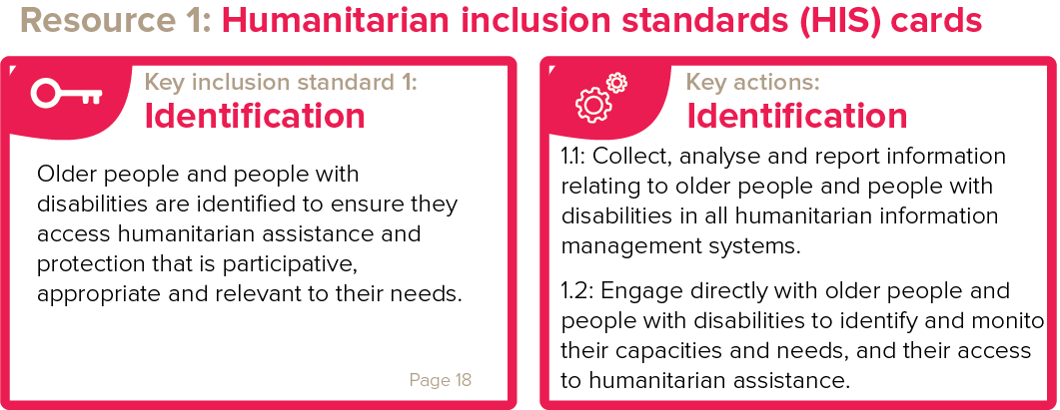
Use the guidance from the Humanitarian Inclusion Standards – 3 are selected
Notes:
The 3 key inclusion standards on the slide are in the handout.
Lets look at them before starting the exercise.
Identification, Safe and Equitable access and Knowledge and participation.

Slide 17
Presentation by participants
Report on solution based on your case study :
Each rapporteur – 4 mins to present
Q&A- 2 minutes
Notes:
Listen to the presentations.
At the end, reinforce that by using 3 of the 9 Key Inclusion Standards, this can provide an initial package for inclusion. The other key inclusion standards will also address the organisational structures that we work in to make them more inclusive.
For the facilitator:
Now do you think the participants understood the 3 principles of inclusion ?
Do you think they will use the 9 Key inclusion Standards ?
Feedback to the participants on their findings and reinforce that the importance of addressing all 9 is important to make sure teams and participants work together to ensure inclusion is a reality.
If time or later – it would be good to have a follow up discussion

Slide 18
Getting to know the NTKG for older persons
Handout 4.3
There are 4 parts in the guidelines
Overview about older persons and displacement.
Key guiding principles for including older persons.
Key activities to identify risks and barriers and ways of supporting older persons on 17 topics.
Key resources and links.
Notes:
Using the Handout 4.2 with case studies if needed and 4.3 to provide new information on the NTKG.
The guidance in the NTKG for older persons provides sets of actions to select to support the needs and capacities such as of Raul and Renaldo, Agipito and Wilma.
There are 4 parts in the NTKG for older persons – https://www.refworld.org/cgi-bin/texis/vtx/rwmain?page=search&docid=4ee72aaf2&skip=0&query=need%20to%20know%20guidance%20older%20people
1. Overview about older persons and displacement – this is important to put this into context in the location of the training
2. Key guiding principles for including older persons – this is useful to recognise the polices and guidance in the region
3. Key activities to identify risks and barriers and ways of supporting older persons on 17 topics – these will provide the content to design an inclusive programme approach
4. Key resources and links – these can give follow up information as required

Slide 19
Using the NTKG for older persons
Look at:
Action 7 Provide safe and equitable access to social protection services.
Action 8 Recognise and support the capacities of older persons to remain self sufficient.
Action 9 Strengthen family and community structure and networks.
Action 12 Prevent and Respond to abuse and exploitation of older persons.
Notes:
Now look at Handout 4.3 to guide the next activity.
You will be in 4 groups and can use the NTKG to prepare a set of activities that you see can improve their lives.
Make sure you have the hand out with the actions to use to develop your feedback for this activity
You have 15 mins to discuss these points and feedback 2 points only, and move to next rapporteur.
As part of the pre- reading - look at:
Action 7 - Provide safe and equitable access to social protection services
Action 8 - Recognise and support the capacities of older persons to remain self sufficient
Action 9 - Strengthen family and community structure and networks
Action 12 – Prevent and Respond to abuse and exploitation of older persons
Provide one or two examples from the actions in the NTKG for Action 7, 8, 9 and 12
Start with one group and then ask others to add to the responses.
Facilitator to note which actions are common to the group and which ones also may be important. Remember from previous session s- developing integrated or
Specific activities ( module 3)
Add other suggestions
As facilitator make sure you guide the learner that the 3 case studies refer to protection risks related to :
No documentation
Lack of appropriate health care
Job losses
Poor housing
Abuse especially older persons with disabilities
Lack of social activities
Isolation
Also there could be issues of no access to humanitarian assistance as on the move

Slide 20
Present back to plenary
Using the NTKG for older persons to provide direction to develop more inclusive community focused activities using the topics from the 4 Actions.
Each rapporteur – 3 mins to present.
Q&A- 2 minutes.
Notes:
Listen to the feedback form the use of the NTKG for older persons
For the facilitator:
Do you feel the participants have a better understanding of the HIS and the NTKG ?
Did they cover the 4 key areas - Provide safe and equitable access to social protection services
Recognise and support the capacities of older persons to remain self sufficient
Strengthen family and community structure and networks
Prevent and Respond to abuse and exploitation of older persons
Summarise the presentations using these 4 guides.
Good to ask them , how they will follow up and use them and if they need support.

Slide 21
Recap - Quiz?
Participants – choose a question that you want to test us with !
Hear 4-5 and get answers.
Notes:
To conclude – can do a quiz with suggestions coming from the participants.
Get each person to develop a question to ask the group.

Slide 22
Do we have a starting point to develop the activities?
Tick or Cross if we have achieved the objectives of the session:
We have a common definition of inclusion.
We have identified the key inclusion principles to build our work on.
We are getting to know and use the Standards and Guidelines to support older persons.
If so – then we are ready to carry out our task!!!
Notes:
Your team leader has requested a meeting next week to share training plans on the Humanitarian Inclusion Standards and NTKG of older persons and the within your team and with partners.
Share this slide with the participants and ask then to tick or cross how they feel at the end of this session.
Reinforce that for further support to contact HelpAge
Recap to see if the participants are now ready to plan their task as we discussed in the beginning of the scenario.
Can ask – who feels ready to take on this role ?
End of session

