Slide 1
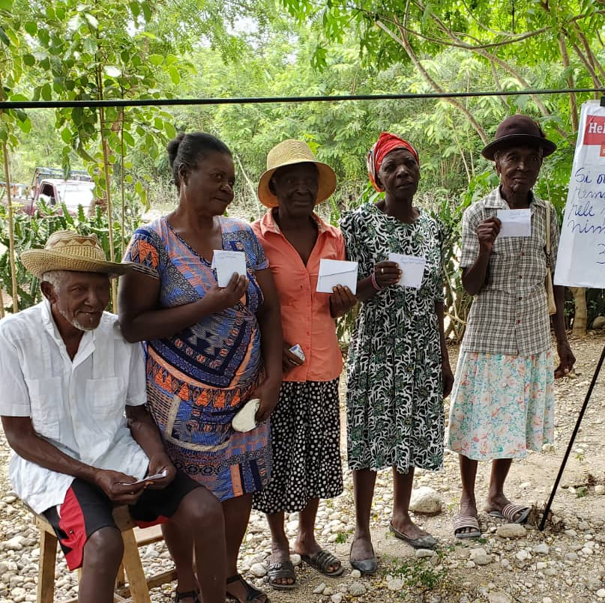
Module 3
Practical session on working with older persons in Protection Case Management

Slide 2
Practical session on working with older persons in Protection Case Management
Objectives:
Identify key ways to ensure effective communication.
Identify 5 steps plans for effective case management with older persons.
Promote a twin track approach to strengthen protection programming to ensure older persons are included.
1
2
3
Notes:
In Module 2, the objectives were to look at protection risks that older persons face in the region.
This module will look at ways to strengthen protection activities in our work.
This is a practical session on working with older persons on building skills to ensure a safe and responsive Protection Case Management approach.
Objectives
Identify key ways to ensure effective communication
Identify 5 steps plans for effective case management with older persons

Slide 3
What are the challenges in communicating with older persons?
Make a list ( word cloud or mentimeter )
61 year-old colombian woman displaced by internal violence.
Ph: Adalberto Montes Peña
Older woman, 71 years, migrant from Venezuela, has alzheimer.
Ph: Pedro Pinilla Seijas
Older man, 69 years, colombian displaced by internal violence.
Ph: Daughter of Adalberto Montes Peña
Notes:
Ice breaker for the session
In making a case management plan , it is useful to consider what are the challenges in communicating to make sure we understand each other.
What are the common challenges / barriers in communicating with older persons ?
Make a list ( word cloud or mentimeter )
If F2F – can work in 2’s and then go around the room to get input without duplication
Collect feedback and move to next slide for top feedback points

Slide 4
Common Barriers in communicating with older persons
Jargon
Terminology
Not looking at the person
Not listening to the person
Notes:
Common barriers to consider
Accents/ dialects: Strong accents and different dialects can make it problematic for people to communicate.
Jargon/slang: An older person may not understand the jargon that a volunteer uses, and this can cause a complete breakdown in communication. Situations also occur when difficult words are used and people may not understand what is meant.
Environmental / emotional: Older people can sometimes feel uncomfortable in their surroundings and are unable to communicate effectively what they need.
Factors such as lighting, background noise and seating should always be considered.
Sometimes older men and women may feel scared or mistrusting in certain situations.
Physical: most people like to communicate face-to-face, however, this may not be possible if there are doors, limited space and nowhere to sit together that impede this.

Slide 5
What are some top tips in communicating with older persons?
Make a list ( word cloud or mentimeter )
61 year-old colombian woman displaced by internal violence.
Ph: Adalberto Montes Peña
Older woman, 71 years, migrant from Venezuela, has alzheimer.
Ph: Pedro Pinilla Seijas
Older man, 69 years, colombian displaced by internal violence.
Ph: Daughter of Adalberto Montes Peña
Notes:
Ice breaker for the session
In making a case management plan , it is useful to consider how we communicate to make sure we understand each other.
What are the top tips in communicating effectively with older persons ?
Make a list ( word cloud or mentimeter )
If F2F – can work in 2’s and then go around the room to get input without duplication
Collect feedback and move to next slide for top feedback points

Slide 6
Tips in talking with older persons
Be visual
Use clear language
Check that you understand each other.
Be careful of your body language and tone
Observe, make eye contact
Learn to listen
Notes:
Some top tips to consider
It may be difficult to communicate with an older person if they have a physical health condition i.e., they have a hearing difficulty or an eyesight problem.
Developmental disorders affecting the brain such as Alzheimer’s disease or stroke could also pose problems.
It is important to ask the older person and their carer on what is the best way to communicate – e.g speaking, giving written questions and asking older person to write the answer or give pictures or a selection of answers to respond to.
Evaluating how to communicate and care for an older person with communication challenges is crucial.
Consider tone of voice, how you speak, your body language and gestures as these are imperative to communicating clearly.
Observe the older person , make eye contact
Give the person your full attention and ignore background distractions, but ensure that you are aware of the older person’s reactions as not all communication is verbal.
It is vital that you do not speak for them and that you allow them to try and respond whichever way they can.
Communicating with the older men and women can also pose problems, so it is important you speak slowly, clearly and loudly.

Slide 7
Exercise:
Communicating with Older persons
Below are few case studies which have been referred to you for assessment.
Based on your field experience, share:
Three things which will facilitate effective communication with the older person in the case study
How will you build trust with this older person?
How will you know if you understand each other ?
E.g. what sort of questions would be useful to ask.
Notes:
Below are few case studies which have been referred to you for assessment. ( this can be a handout if F2F or on slide in plenary ) – 3-4 min per slide
Based on your field experience and information shared, give your suggestions:
Ask them to individually read the case studies and list ( put in chat box)
1. Three things which will facilitate effective communication with the person in the case study
2. How will you build trust with this older person?
3. How will you know if you understand each other ? e.g. what sort of questions would be useful to ask
Virtual- If the session is virtual, as them to write their response in the message box as you show them the case study. Hold the case for 2 minutes for each question, in total 6 minutes for each case slide. Use number of cases based on time available to you for discussion
In person training- for in person session ask them to write approaches/activities on a sticky note and put on the common wall for other to read.
Once the activity is over, ask them to go through all the responses mentioned by other participants to read and see how others are proposing to deal with it.

Slide 8
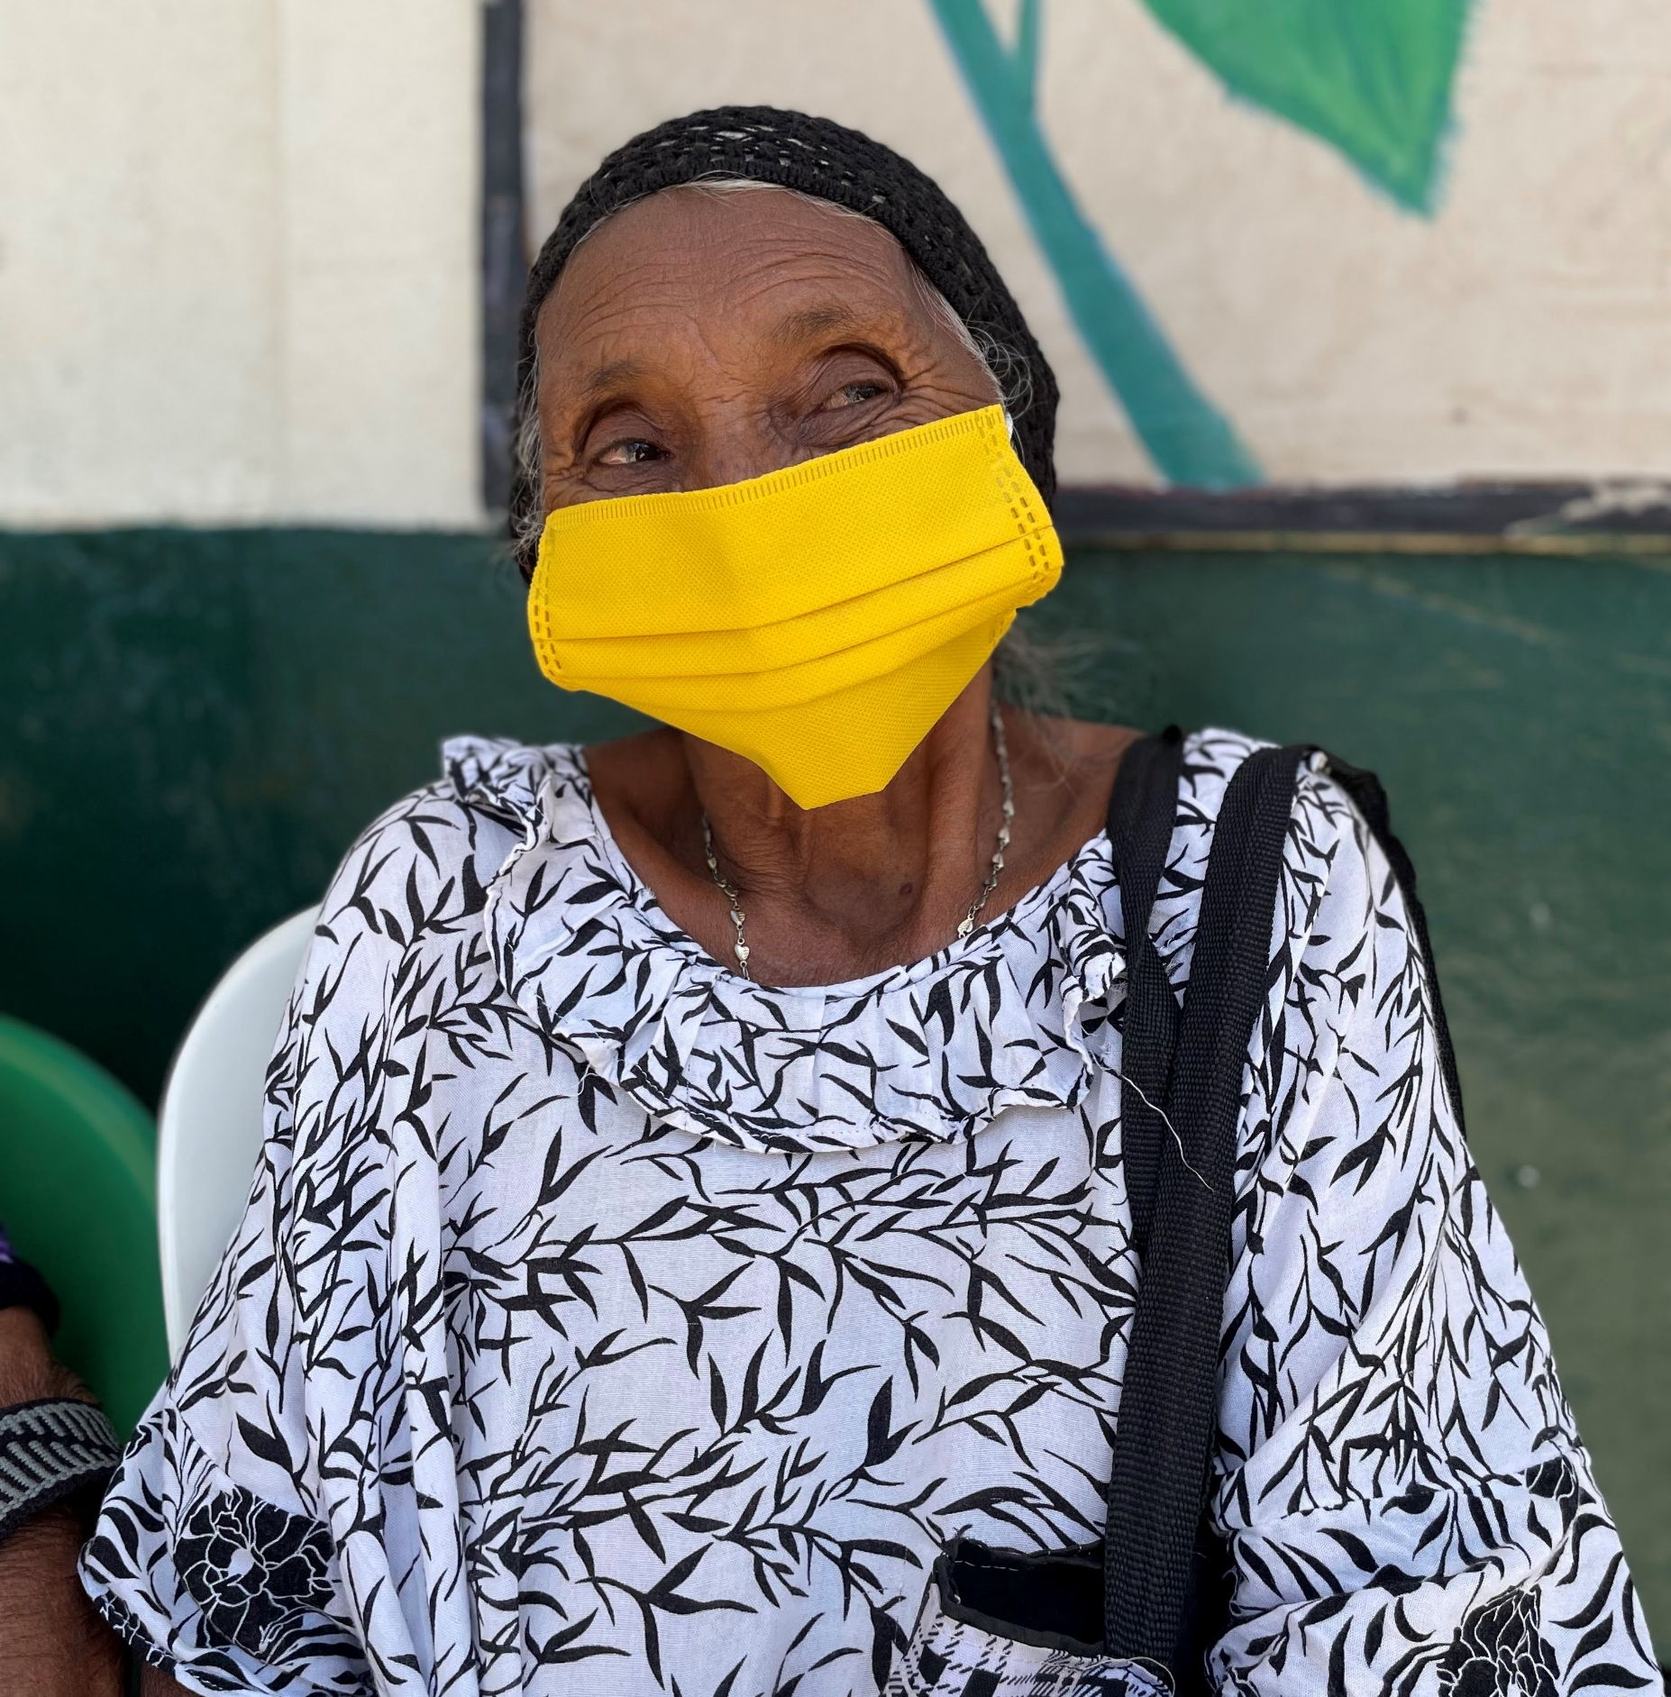
Case 1
An older female migrant has not seen a doctor for 3 years and now developing health issues linked to her age and her increasingly deteriorating life style. She is lying in bed all day and the carer is not there in the day.
She cannot hear properly.
She has no registration and afraid to go out of her home.
Older Indigenous woman in la Guajira, she doesn’t speak spanish.
Ph: Valentina Pardo
Notes:
Case 1
An older female migrant has not seen a doctor for 3 years and now developing health issues linked to her age and her increasingly deteriorating life style.
She cannot hear properly.
She has no registration and afraid to go out of her home.

Slide 9
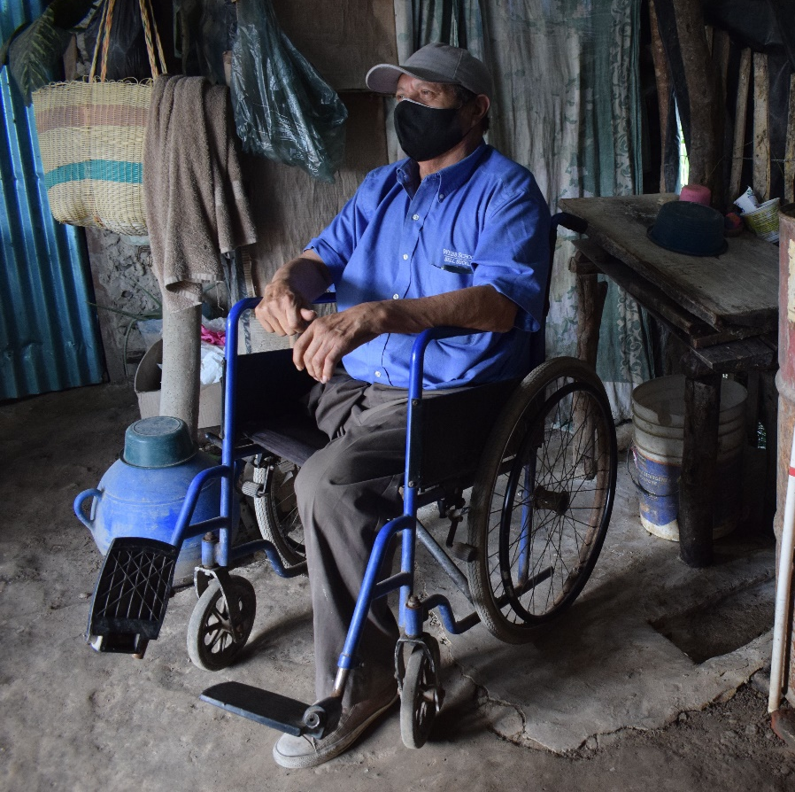
Case 2
An older cross border male migrant, with papers; he has difficulty seeing and has recently lost his wife and now living alone. He is a wheelchair user, having an amputation of his right leg
He is becoming depressed and neglectful in his old shack; he has no income and now has no motivation to work.
No one in the community is supporting him.
Dissabled older men from El Salvador, 61 years old
Ph: Eduardo Lemus
Notes:
Case 2
An older cross border male migrant, with papers; he has difficulty seeing and has recently lost his wife and now living alone. He is a wheelchair user, having an amputation of his right leg.
He is becoming depressed and neglectful in his old shack; he has no income and now has no motivation to work.
No one in the community is supporting him.

Slide 10
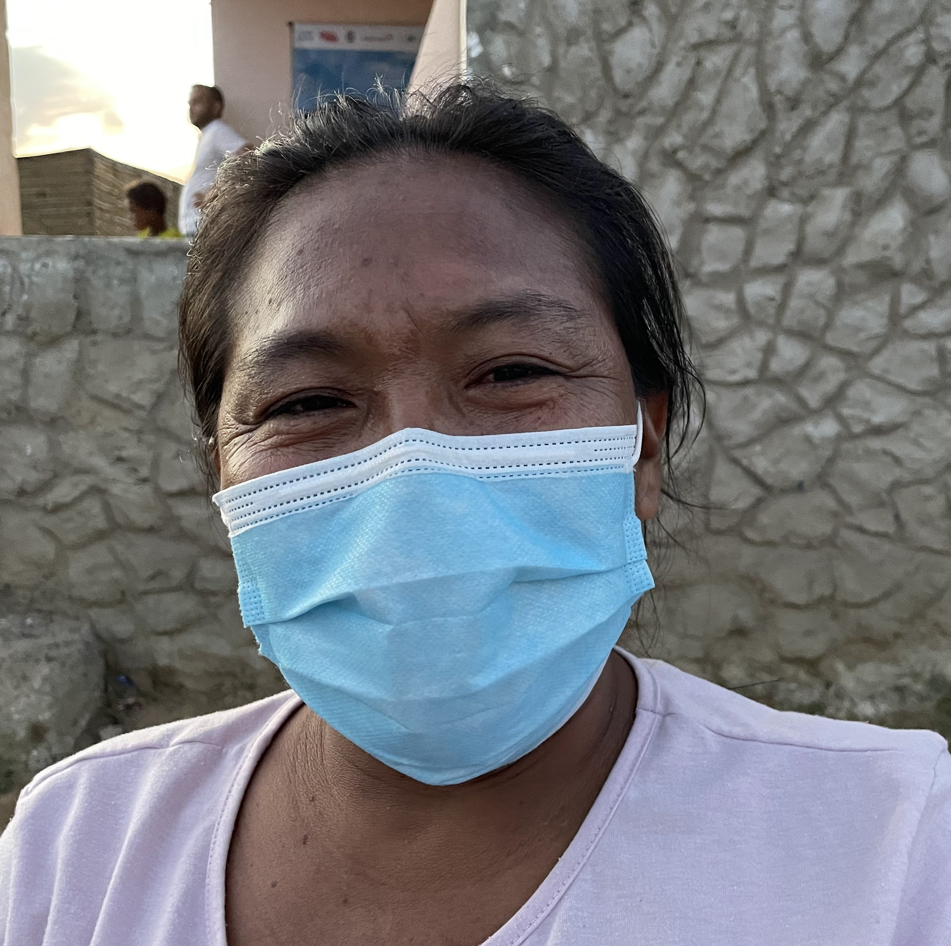
Case 3
You are told that an older transgender migrant who is recently attacked and robbed, lives in your area of work.
The community doesn’t interact with her and she is not registered for any support as no one had recognized her when registration was going on.
Now she has not come out of her shack for last two days, and people fear that after being attacked she may have not received any medical support and might be unwell.
Older colombian woman, mother of three.
Ph: Valentina Pardo
Notes:
Case 3
You are told that an older transgender migrant who is recently attacked and robbed, lives in your area of work.
The community doesn’t interact with her and she is not registered for any support as no one had recognized her when registration was going on.
Now she has not come out of her shack for last two days, and people fear that after being attacked she may have not received any medical support and might be unwell.

Slide 11
Case 4
You have come to know that there is one older women above 80 years of age.
Neighbours have heard her crying but they have not seen her for over 3 months now.
She is locked in a small dark room without window by her family.
Neighbours are always told that she is too old to come out and not interested in seeing anyone, but people fear that she is not given proper treatment and food, and also beaten sometimes.
Older woman, 71 years, migrant from Venezuela, has alzheimer.
Ph: Pedro Pinilla Seijas
Notes:
Case 4
You have come to know that there is one older women above 80 years of age.
Neighbours have heard her crying but they have not seen her for over 3 months now.
She is locked in a small dark room without window by her family.
Neighbours are always told that she is too old to come out and not interested in seeing anyone, but people fear that she is not given proper treatment and food, and also beaten sometimes.

Slide 12
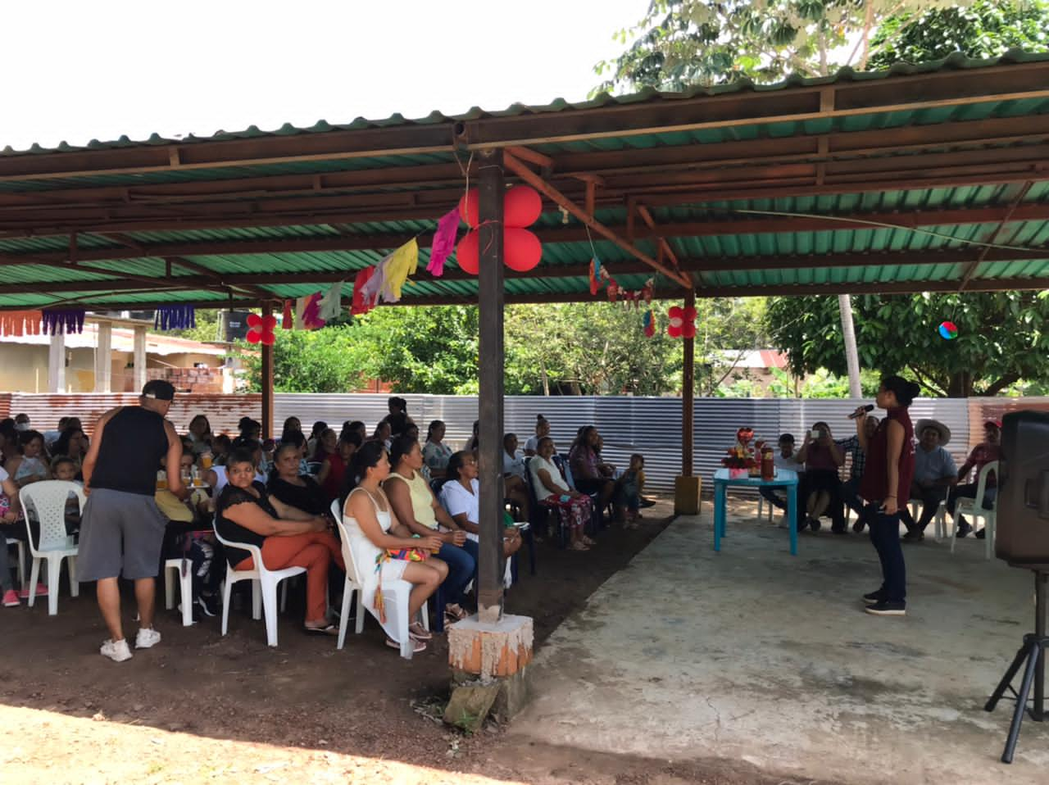
Feedback from the discussions
Notes:
Give time – 5 mins to get any comments from the participants on the exercise – it is aimed to highlight the importance of finding appropriate ways to communicate. It is often easier to talk to others in the family, if there is a challenge to communicate using voice … consider using charts, pictures, diagrams. Make sure every conversation has a conclusion and not leave the older persons without a next step. Is it possible to give a positive message? If an older person is emotional, take time together to console and then , when he or she is ready to continue the discussion … move ahead ( this is common and manageable in most cases) .

Slide 13
Protection Case Management for older persons
Making a case plan
Notes:
We have looked at the importance of effective communication to ensure we understand each others. So lets looks now at the Case Studies shared in Module 2 , to discuss making a case plan. There is a lot of experience to build on as we go through this activity.
Lets use these point in talking to Betty and Garcia.

Slide 14
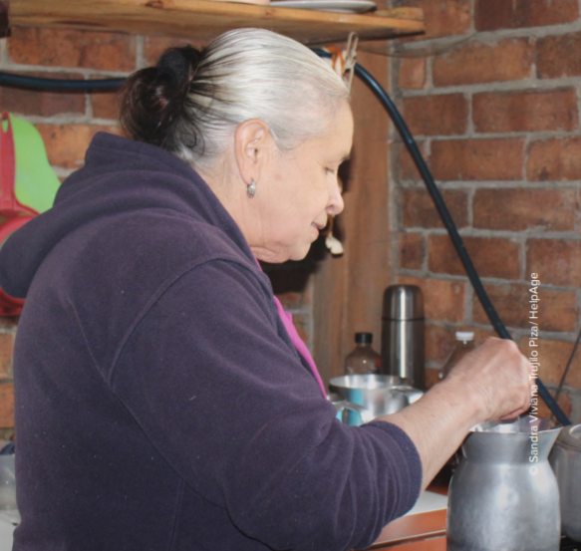
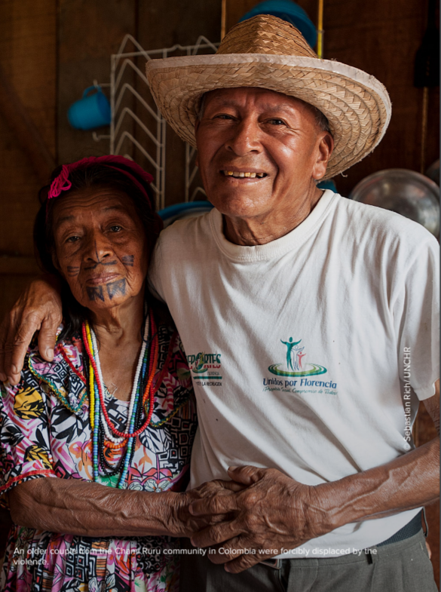
Remember Betty and Garcia and his wife, Leti?
Use Handout 3.1
A 70-year-old colombian woman that was displaced by internal violence.
Ph: Sandra Viviana Trujillo Piza
An older couple from the Chami Ruru community in Colombia were forcibly displaced by the violence.
Ph: Sebastian Rich/UNCHR
Notes:
Look at these pictures of older persons from the LAC region who live in different displacement settings. We discussed their protection risks and now we need to put a case management plan in place. Use handout 3.1 with case studies to refresh you of their stories
Do we all have the same understanding of a case management approach ?
Do we all have the same understanding of the role of the case worker?
Look at the next slides and give your comments in the chat box / or F2F hands up …

Slide 15
Protection case management (PCM)
agree or disagree?
v
A structured and sustained method for providing responsive and remedial support to help older persons to manage, and claim their rights, leading to their safety, dignity and ensuing resilience.
An empowering and collaborative process, where the older person is supported to connect to services needed, to take control of their personal life, that can help them to recover and respond to new risks.
v
Notes:
Protection case management (PCM) is a structured and sustained method for providing responsive and remedial support to a person at heightened risk of a rights violation to help them to manage, and ultimately claim, their rights, leading to their safety, dignity and ensuing resilience.
It is an empowering and collaborative process drawing on the strengths of the client, where the client is supported to connect to services needed, to take control of their personal life, to learn new ways of thinking about their situation, and to adopt new behaviours that can help them to recover and respond to new risks.
A client is supported by an assigned caseworker, who provides a safe environment for them and develops a healing relationship built on trust.

Slide 16
Role of Case worker
agree or disagree?
Provides a safe environment for the older person and develops a healing relationship built on trust.
Supports the older person to assess their situation, and to recognize and strengthen the protective factors in their life.
Informs the older person of all the options available and assists them in identifying personal goals and working with service providers.
Takes responsibility for linking the older person to these services in a coordinated way.
Notes:
Provides a safe environment for the client and develops a healing relationship built on trust.
Supports the client to assess their situation, and to recognise and strengthen the protective factors in their life.
Informs the client of all the options available and assists them in identifying, and then reaching, personal goals by leveraging their strengths and working with service providers.
Takes responsibility for linking the client to these services, advocating for actions needed, and following up those actions in a coordinated way.

Slide 17
What would be a good case management plan for Betty and Garcia and his wife, Leti?
A 70-year-old colombian woman that was displaced by internal violence.
Ph: Sandra Viviana Trujillo Piza
An older couple from the Chami Ruru community in Colombia were forcibly displaced by the violence.
Ph: Sebastian Rich/UNCHR
Notes:
We discussed their protection risks previously and now we need to put a case management plan in place.

Slide 18
Group work
Protection case management
Key steps
1
Identify patterns of abuse.
Responsive Action – stop violation and remove from imminent violation.
Restore older persons dignity and ensure adequate living conditions.
Environment building by creating safe space to live in.
At all stages ensure a referral mechanism is in place to access relevant services.
2
3
4
5
Notes:
In groups look at a case study – either Betty or Garcia and Leti
Read through the case study and a) list patterns of abuse
b) Decide if there are immediate life saving action to respond to
c) Decide on ways to support the older persons to rebuild their lives
d) Decide on ways to make their environment safer
e) What are the possible referral mechanisms needed ?
Here are more details for the Facilitator
1. Identify patterns of abuse – list against protection risks – neglect , abuse , violence etc
2. Responsive action is any immediate activity undertaken in connection with an emerging or established pattern of violation and is aimed at preventing its recurrence, putting a stop to it, and/ or alleviating its immediate effects. Responsive activities have a sense of real urgency (but can last for many years) and aim to reach a particular older persons suffering the immediate horrors of a violation. They are primarily about stopping, preventing or mitigating a pattern of abuse.
Example: Develop activities and or referral services that have specific times for different groups to ensure Betty and her daughter are included in food distributions that reduce the risk of harrassment Example: Providing firewood as part of an NFI distribution, so older women and adolescent girls, who have been harassed or threatened, do not have to travel outside an IDP camp
3. Remedial action is aimed at restoring person ’s dignity and ensuring adequate living conditions subsequent to a pattern of violation, through rehabilitation, restitution, compensation and repair. Remedial activities are longer term and aim to assist older person living with the effects of abuse. This might include the recuperation of their health, tracing of their families, livelihood support, housing, education, judicial investigation and redress.
Example: Education in health centres to prevent stigmatisation of older survivors of sexual violence, who are not recognised as needing services
Example: Livelihood training and psychosocial support for older men and women living alone or separated from their family as part of a livelihoods program
4. Environment-building action is aimed at creating and/or consolidating an environment – political, social, cultural, institutional, economic and legal – conducive to full respect for the rights of the individual. Environment-building is a deeper, more structural process that challenges society as a whole by aiming to change policy, attitude, belief and behaviour. It is likely to involve the establishment of more humane political values, improvements in law and legal practice, the training of security forces and local security teams, and the development of an increasingly non-violent public culture.
Example: Providing information to an older person within a WASH project about the Code of Conduct by which NGO and UN staff are expected to abide
Example: Advocating for prohibitions on sexual violence to be included in domestic legislation that recognises older persons
Example: Advocating for the Guiding Principles on Internal Displacement to be adopted as national policy and included older persons
Remember • Not all humanitarian agencies operate in all three phases of case management. • No single organisation is able to provide the comprehensive range of services required to protect the entire affected population in time of emergencies. Thus it is important to put a referral system in place

Slide 19
Group work
Read through the case studies and use Handout 3.1 for reference :
List patterns of abuse.
Decide if there are immediate life saving action to respond to.
Decide on ways to support the older persons to rebuild their lives.
Decide on ways to make their environment safer.
What are the possible referral mechanisms needed ?
a
In 4 groups look at a case study – assign groups to either Betty or Garcia and Leti
b
c
d
e
You have 10 minutes to discuss
Notes:
In groups taking one case study and use handout 3.1 for reference – and make a list of suggestions
In groups look at a case study – either Betty or Garcia and Leti
Betty - Read through the case study and a) list patterns of abuse e g harassment and theft outside of the home, feeling insecure
b) Decide if there are immediate life saving action to respond to – e g not at this point – to monitor
c) Decide on ways to support the older persons to rebuild their lives – listen to Betty story and meet the people living near her and her daughter to identify community networks and possible support from others
d) Decide on ways to make their environment safer –e.g look at times of distribution and link with NGO’s’ to better address these safety concerns – e g provide escorts, different timing etc,
e) What are the possible referral mechanisms needed ? – access to work for Beti and her daughter , food banks, health care
For Garcia
a) List patterns of abuse e g lack of access to safe housing and toilets , lack of information in accessible format
b) Decide if there are immediate life saving action to respond to e g not at present – to monitor
c) Decide on ways to support the older persons to rebuild their lives – address physical accessibility – as cannot walk – provide AP ; provide alternative toilet – toilet chair ; provide link to NGO’s by developing a complaints mechanism that is accessible to all
d) Decide on ways to make their environment safer e g make access to toilets segregated by gender and give set times and make toilets safer and more accessible
e) What are the possible referral mechanisms needed ? Access to shelter services
Go into groups to discuss for 15 mins and come up with a plan around these 5 questions

Slide 20
Betty’s case plan
Harassment and theft outside of the home, feeling insecure.
Monitor security in area with local community; provide protection kit.
Listen to Betty story and meet the people living near her and her daughter to identify community networks and possible support from others.
Look at times of distribution and link with NGO’s’ to better address these safety concerns – e g provide escorts, different timing etc.
Access to work for Beti and her daughter , food banks, health care and livelihood activities.
List patterns of abuse.
Decide if there are immediate life saving action to respond to.
Decide on ways to support the older persons to rebuild their lives.
Decide on ways to make their environment safer.
What are the possible referral mechanisms needed?
Notes:
These are an example to share and then others can add to the discussion – 10 mins feedback time for both cases
a) List patterns of abuse e g harassment and theft outside of the home, feeling insecure
b) Decide if there are immediate life saving action to respond to – e g to monitor security in area with local community to identify gangs etc and gernal attitude towards older persons in the community
c) Decide on ways to support the older persons to rebuild their lives – listen to Betty story and meet the people living near her and her daughter to identify community networks and possible support from others of different ages
d) Decide on ways to make their environment safer –e.g. look at times of distribution and link with NGO’s’ to better address these safety concerns – e g provide escorts, different timing etc
e) What are the possible referral mechanisms needed ? – access to work for Beti and her daughter which are age friendly , links to accessible food banks, access to appropriate health care

Slide 21
Garcia and Leti’s case plan
Lack of access to safe housing and toilets , lack of information in accessible format.
Not at present – to monitor.
Address physical accessibility – as cannot walk or see – provide assistive products ; provide alternative toilet or toilet chair ; provide link to NGO’s by developing a complaints mechanism that is accessible to all.
Make access to toilets segregated by gender and give set times and make toilets safer and more accessible.
Access to shelter services and legal support.
List patterns of abuse.
Decide if there are immediate life saving action to respond to.
Decide on ways to support the older persons to rebuild their lives.
Decide on ways to make their environment safer.
What are the possible referral mechanisms needed?
Notes:
These are an example to share and then others can add to the discussion – 10 mins feedback time for both cases
a) List patterns of abuse e g lack of access to safe housing and toilets , lack of information in accessible format
b) Decide if there are immediate life saving action to respond to e g not at present – to monitor general community tensions to see if older persons are more at risk with other groups
c) Decide on ways to support the older persons to rebuild their lives – address physical accessibility – as cannot walk or see – provide assistive products to help move in the community ; provide alternative toilet or toilet chair to reduce toileting challenges as older persons may need to use the toilet more frequently especially men; provide link to NGO’s by developing a complaints mechanism that is accessible to all and ensure there is a follow up on the complaint
d) Decide on ways to make their environment safer e g make access to toilets segregated by gender and give set times and make toilets safer and more accessible
e) What are the possible referral mechanisms needed ? Access to shelter services

Slide 22
Examples of twin tracked protection activities for older persons
Use Handout 3.2
MAINSTREAMED
TARGETED
Community protection activities with WASH sector.
Accessible health center with different medical services.
Outreach food distribution.
Adapted NFI for older persons.
Specialized home-based care for home bound older persons.
Targeted psychosocial support – peer to peer groups.
Notes:
In 4 Groups lets go to the last activity to make sure we have considered how to ensure Betty and Garcia are given the appropriate protection and support to rebuild their lives. You have 10 mins
We have discussed a case management plan for Betty and Garcia, there are 2 steps to recall in building the project activities. Remember in Module 2 , the importance of identify a twin tracked approach to working with older persons?
Considering the discussions on the case studies, list down 2-3 Mainstream activities and 2-3 Targeted activities, that you see useful to develop to better support Betty and Garcia. Use Handout 3.2 to provide suggestions and use your experiences as well
Share suggestions on a) a mainstream approach b) targeted approach
Design activities that use a twin track approach, mainstreaming older persons in sector activities and or developing targeted plan for more specialised services

Slide 23
Feedback in plenary
Go around the group and share one example of mainstreaming and one targeted approach with the group.
Other group members to agree or disagree.
Notes:
Go around the group and share one example of mainstreaming and one targeted approach with the group.
Other group members to agree or disagree
Facilitator to guide the discussion and manage the responses.
Use examples from the handout if the discussion is not active.

Slide 24
Key points Module 3
1
Take time to ensure effective communication in developing a Protection case plan
Use a 5 steps plans for effective case management with older persons to respond to their immediate and longer term needs and put in place and monitor referral mechanisms to support the older person
Design activities that use a twin track approach, mainstreaming older persons in sector activities and or developing targeted plan for more specialised services
2
3
Notes:
To end the session – lets recap on the 3 key points and takeaways.
Take time to ensure effective communication in developing a Protection case plan
Use a 5 steps plans for effective case management with older persons to respond to their immediate and longer term needs and put in place and monitor referral mechanisms to support the older person

Slide 25
End of Module 3
Notes:
Provide summary of the 3 modules, and ask what ae some takeaways from the 3 sessions that the participants feel they can use in the future.

