Slide 1
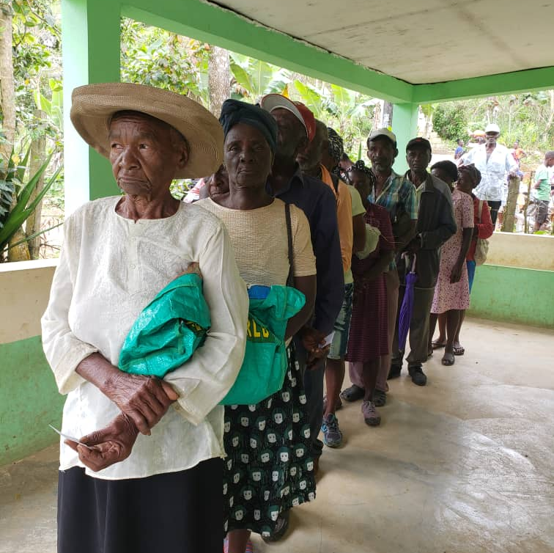
Session 2
Identifying Protection Risks
Of older persons on the move

Slide 2
Learning Objectives
Describe key linkages related to older age in the definition of protection
Understand the key players in the protection of older persons
Identify main protection concerns of older men and women
Identify sets to identify and address protection risks in programme approaches.

Slide 3
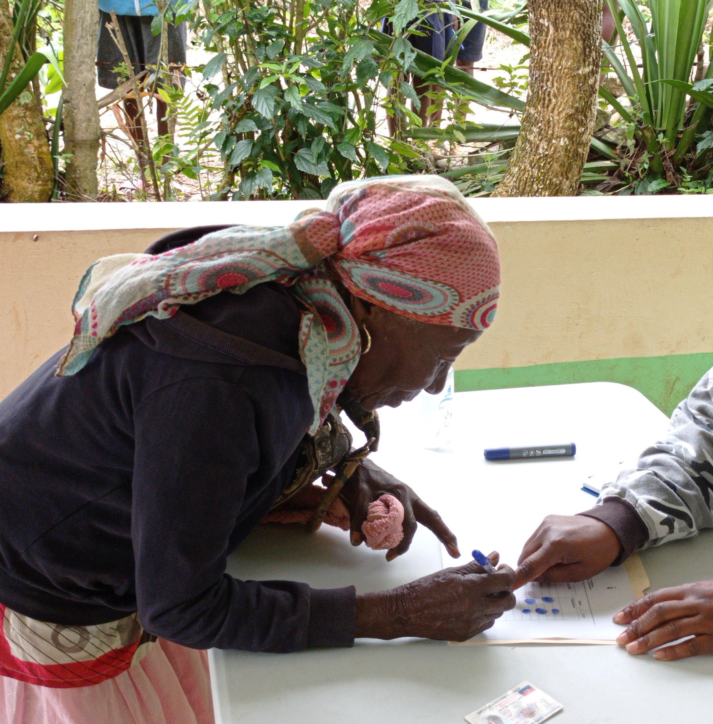
Write words to describe protection risks for older persons?
Notes:
To start the session, it is interesting to know what protection risks for older person you have already identified or considered in your work.
Ask participants to say one word which relates to protection risks for older persons .
Create a word cloud of words relevant to protection as they write on mentimeter or any other cloud creating sheet.
Recap on common words and outliers , that recognises that older persons face diverse protection risks and one size does not fit all.

Slide 4
What is protection for older persons?
All activities aim to obtain full respect for the rights of the individual, which include older persons, in accordance with the letter and spirit of the relevant bodies of law
Specific principles target older persons, such as UN Principles for older persons
Notes:
Read the definition loud for participants and explain how it is important for securing rights of people at risk as detailed below. Ask them how would it may apply to older persons.
And then provide a short example of protection such as - collection of age, sex and disability disaggregated data, ensuring participation of older people in assessments and meetings, improving access without threat to aid, etc
The definition of protection, which was originally developed over a series of ICRC sponsored workshops involving some fifty humanitarian and human rights organizations, has been adopted by the IASC. See Protection of Internally Displaced Persons, Policy Paper Series, No. 2 (2000) and Strengthening Protection in War: A Search for Professional Standards (ICRC, 2001)
Stress that humanitarian actors share a common definition of Protection. Several international organizations, namely OHCHR, UNHCR, UNICEF and ICRC, have specific protection mandates. All UN and partner agencies however have a responsibility to integrate human rights into their work and to approach their work with due regard to protection issues.
The right to protection is enshrined in the sovereign responsibility of states to protect their populations, in international law, and in resolutions of the United Nations and other intergovernmental organisations.
International human rights law (IHRL)
International humanitarian law (IHL)
The 1951 Convention Relating to the Status of Refugees
The UN Principles for Older Persons
The Madrid International Plan of Action on Ageing, principles for Older Persons
The Sphere Humanitarian Charter and Minimum Standards in Humanitarian Response

Slide 5
Who is responsible in protecting older persons in our work?
The State.
The International community.
Mandated agencies.
Other humanitarian actors.
Communities' role in their own self-protection.
All.
a
b
c
d
e
f
Notes:
Q and A to the participants – write in chat box letter or letters
Who is responsible in protecting older persons?
Reinforce feedback with details below.
a) The State
b) The International community
c) - Mandated agencies
d) - Other humanitarian actors
e) Communities role in their own self-protection
f) All
Ask for feedback from 2-3 participants
Top up feedback with information below:
Traditionally protection was viewed as the responsibility only of sovereign governments and mandated agencies.
Mandated agencies = those agencies that have been assigned a specific protection role by a recognized international body or legal instrument. For example UNHCR has responsibility for the protection of refugees under the Refugee Convention. ICRC has responsibility for the protection of prisoners and non-combatants during armed conflicts under the Geneva Conventions.
NOTE: In all cases the primary responsibility and mandate for protection lies with the State
Increasingly, specialist protection agencies have taken a stronger lead role.
Specialist protection agencies = those agencies that have dedicated protection expertise in specific protection areas such as rule of law and access to justice. For example, UNICEF is a specialist protection agency for the protection of child rights. Norwegian Refugee Council (NRC) is another example.
In the last ten years it has been recognized that all humanitarian actors have a role to play in protection. In 2013 the Inter-Agency Standing Committee (IASC) made a formal commitment to placing protection at the centre of humanitarian action. Humanitarian organizations contribute to humanitarian protection through supporting and strengthening “self-protection” and holding governments and other authorities to account
There is still a gap in fully including marginalised groups , such as older persons as well as persons with disabilities, specific ethnic groups and LGBTQI Communities

Slide 6
At level of state, armed and international actors
Safety and security
Housing, land and property rights:
Documentation:
Humanitarian principle of impartiality:
Which are the most common protections risks faced by older persons in your context?
At individual, family level and community level
Violence:
Neglect and deprivation:
Isolation and dependency:
Family structures and family separation:
Others:
Tick them
Notes:
Building on the previous discussion - ask the participants which are the most common protection risks faced by older persons in their context .
After completing, share examples of older persons experiences as written below: and give time for feedback on other examples :-
Discuss as follows and ask participants to give example from their experiences:
Safety and security: Physical risk or harm as a result of natural disasters or conflicts. Older person’s reduced regenerative capacity and mobility challenges place them at greater risk of injury and make them more vulnerable to longer-term impacts resulting from an injury.
Housing, land and property rights: Interference or discrimination regarding the right to enjoy one’s house, land and other property, and possessions. Older person who have lost or never possessed ownership documents, and older women and widows who are not always recognised in inheritance law, face challenges in proving ownership of land or homes. They may also be at high risk of forced eviction.
Documentation: Loss or destruction of personal documentation (such as ID, birth certificate or marriage certificate) and difficulty replacing it. In some cases older person may have never been issued with relevant, up-to-date documentation. Freedom of movement: Restriction on the rights to travel, reside in, or work in any part of the state, as well as to leave that state and return at any time.
Humanitarian principle of impartiality: Humanitarian assistance is not provided according to need and without discrimination. The failure to ensure access and accessibility of services for older person poses a major violation of the central principle of impartiality.
Violence: The act or threat of physical, sexual or psychological abuse. Cycles of dependency, discrimination and isolation may place older person at risk of abuse within the family. Within the community older person may become victims of attack because of perceived vulnerability.
Neglect and deprivation: Older person may be prevented from accessing the goods and services they need. This can be unintended or may be the result of deliberate discrimination.
Isolation and dependency: Lack of access to support and social relationships compounds the isolation felt by older person, as does the high level of help required in daily activities and reliance on their caregivers
Family structures and family separation: Family structures, for example older person headed households, female or widow headed households, and households with large numbers of dependent children create specific protection risks for older person and their families. Involuntary family separation affecting older person increases their levels of isolation and reduces levels of support, making it harder for older person to access the goods and services they require If participants see this slide as they are asked bout risks, they will answer what is in the screen.
Suggest including one screen with the question / or a placeholder for a link.
It may be easier and quicker as well to provide multiple choice questions: Which are the most common risks faced by older persons in your context? And provide these risks as multiple choice.

Slide 7
Key messages for Activity 1
The right to protection is enshrined in the sovereign responsibility of states to protect their populations, in international law, and in resolutions of the United Nations and other intergovernmental organisations.
Although primary responsibility of securing protection rights is of sovereign governments and mandated agencies, humanitarian actors have a strong role to play in protection
Older Persons on the move are at exposed to increased protection risks equal to other vulnerable groups
Notes:
Ask participants to recap the first activity:
The right to protection is enshrined in the sovereign responsibility of states to protect their populations, in international law, and in resolutions of the United Nations and other intergovernmental organisations.
Although primary responsibility of securing protection rights is of sovereign governments and mandated agencies, humanitarian actors have a role to play in protection
Older Persons on the move are at high risk of protection due to:
- Threat to safety and security, Poor housing, land and property rights, Poor documentation, Threat of violence, Humanitarian assistance is not provided according to need, Neglect and deprivation, Isolation and dependency and Family structures and family separation

Slide 8
Safety and non - discrimination
Handout 1.3
According to the surveys, the main threats in terms of security risk for older persons are the following:
ONE
out of
TWO
persons have felt discriminated mainly by their age
41%
9-10%
20-30%
4-6%
Isolation, loneliness, deprivation of resources, services and opportunities
Financial abuse, emotional abuse and lack of community spaces
Physical and sexual abuse
Armed violence
Notes:
To follow the discussions here (handout 2.1 provided as pre reading) , we are providing some findings from the study about older persons on the move. Explain to the participants the following information and ask them to check later from the research on older persons on the Move to check rate of abuse in their country.
Key points - Fifty percent of older persons on the move have felt discriminated against. The main form of discrimination is age, with an average of 25%; however, there is a difference of more than 10 points between women and men, with the latter feeling more discriminated against with 30% compared to 19%. Another notorious gender difference is discrimination by disability, where women report feeling discriminated against by 5%, compared to 10% for men.
The overall rate of abuse in the countries before the pandemic was 38%, with a marked difference between persons with disabilities (48%) and those without (29%). In the countries of northern Central America, the percentage of abuse among older persons is 63%, with a significant difference between persons with disabilities (87%) and those without (40%). The gender difference is 11 points, with 65% for men compared to 57% for women. In the Andean region, abuse is lower, affecting a quarter of the population (26%), with a marked gender difference for women, with 34% compared to 20% for men.

Slide 9
Safety and non-discrimination
Perpetrators of abuse
36% of the surveyed older people who live in the northern region of Central America, consider that the place where they live is not safe, due to internal violence generated by gangs.
A third of the people deported in the same region (33%) did not feel safe to return to their place of origin, mainly due to threats, violence or persecution.
Armed actors, transportation, landlord
74%
Friends / neighbors
7%
Government officials public force
7%
Relatives
11%
0%
20%
40%
60%
80%
Notes:
Here, we are providing more findings on safety and discrimination from the study older persons on the move. Explain the below information to participants and ask them to check the perpetrators of abuse in their country from the research older persons on the move (Table 18,page 136)
Among the perpetrators of abuse, 11% were family members; 7% were government officials, including the security forces; 7% were friends or neighbours; and 74% were other persons, for example, armed actors, gangs, persons on the street, on public transport, or the owners of the homes which they rented or where they lived.

Slide 10
Participation, information and empowerment
Onboarding training productive life, job and entrepreneurship
7%
Training / Rights for older persons
6%
Training / Rights for displaced persons on the move
7%
No access to information / rights education
84%
Persons with disabilities without participation
70%
Men without participation
67%
Women without participation
71%
0%
10%
20%
30%
40%
50%
60%
70%
80%
90%
Notes:
Here, we are providing more findings on participation from the study older persons on the move. Discuss the role of participation, information sharing and empowerment with the participants.
A summary of the study “Ageing on the Move” on participation, information and empowerment is given below. For country specific information, ask participants to refer the report
Participation, information and empowerment
More than two thirds of the sample had no activities to share or to socialise with others, with this average being even higher for some flows such as the mixed movements in the Andean region. Women presented a higher percent- age of non-participation than men, with 71% compared to 67%. In situations of disability, 70% stated that they did not have any participation opportunities or activities. Eighty-four per cent of older persons have not attended talks or participated in training and awareness-raising activities concerning their rights. Only 7% have received training on their rights as persons on the move, 6% on their rights as older persons, and 7% on how to become productive through work or entrepreneurship.
In summary of these 3 slides- the data findings show there are gaps in the inclusion of older persons in their respective community, and without better identification and recognition of their protection risks, the older persons will be excluded from accessing their rights and support.
Do you have comments from your own country findings to share ?

Slide 11
Group work
Task
You will be working in 4 groups
Each group is asked to talk about protection risks based on the findings shared in Handout 2.1
Based on your field experience:
Define protection risks for older persons ?
Identify stakeholders who have a role in protecting and mitigating risks for Older Persons
You have 15 minutes
Write your findings in a PPT
Identify a rapporteur
Notes:
Using the information shared previously , divide participants in 4 groups; use the handout to help guide the discussion to identify where they see the protection risks. Then identify stakeholders who have a role in protecting and mitigating risks for Older Persons
This exercise is to learn from each other. There is no fixed answers as there will be a more in-depth discussion with case studies later.
Go to each group (virtually shift between groups, or if physical training, move to groups) and see whether discussion is going in the right direction, or else give some example and lead the discussion for maximum one minute.
In virtual trainings, breakout rooms would be needed 4 groups for 15 mins

Slide 12
Presentations from the groups
You will have 4 minutes to make your presentation
Notes:
Allow participants for a 4 minute presentation each, and after every presentation allow for other group members, or other participants to provide their experiences/observations (in brief) for a maximum of 2 minutes. Total time should be limited to 4 minutes per presentation.
Highlight in the feedback the focus on addressing the risks with a lens on safety and discrimination, participation, information and empowerment. Encourage participants to also feedback.

Slide 13
Key messages for Activity 2
v
Older Persons on the move are at threat of abuse, neglect and safety and discrimination.
Older Persons are not systematically involved in community and humanitarian response.
Lack of participation and lack of information of humanitarian organization result in older persons not been able to design appropriate response programme.
Recognition of older persons lead to better engagement to support to secure their rights
v
Notes:
Ask participants to recap the second activity:
Almost 50%, one in two persons have felt discriminated.
Age, gender and disability, along with isolation and loneliness are common factors for protection risks. Ask participants how and provide some examples from the case studies used in the group work
All stakeholders have a role in ensuring protection of older persons. Define stakeholders with the participants in assuring protection of older persons

Slide 14
Group work
In your groups look at 2 questions:
How is the safety of the older person in your case studies compromised ?
(Consider Access to information, Community integration and Participation and empowerment)
Who are perpetrators of abuse in the cases?
Identify the protection risks in these case studies
Work in 4 groups with one case study each (one of four)
Handout 2.2
Notes:
Activity
In breakout groups – 15 mins and feedback 4 mins
Share (pre share) the handout 2.2 with 4 case studies with the participants- 1 case study per group.
1. Identify a person to feedback and guide the discussion and collect feedback.
2. Ask them to individually read the case studies and list what you immediately see how safety of the older person/s is /are compromised.
3. Also list who are the perpetrators of abuse?
While asking them to do the assignment, consider 3 areas, with others, to impact on the levels of risk 1) Access to information 2) Community integration 3) Participation and empowerment
The aim is to bring together all the information on protection risks and ask participants to build on their own experiences and the information shared in the session to share their response.
Virtual- If the session is virtual, as them to write their response in the message box
In person training- for in person session ask them to write approaches/activities on a sticky note and put on the common wall for other to read
Once the activity is over, ask them to go through all the approaches and activities mentioned by other participants to read and see how others are proposing to deal with it.
Facilitator to reinforce good feedback based on the session and also examples from their experiences.
Participants are encouraged to also feedback to the group with comments and other examples.

Slide 15
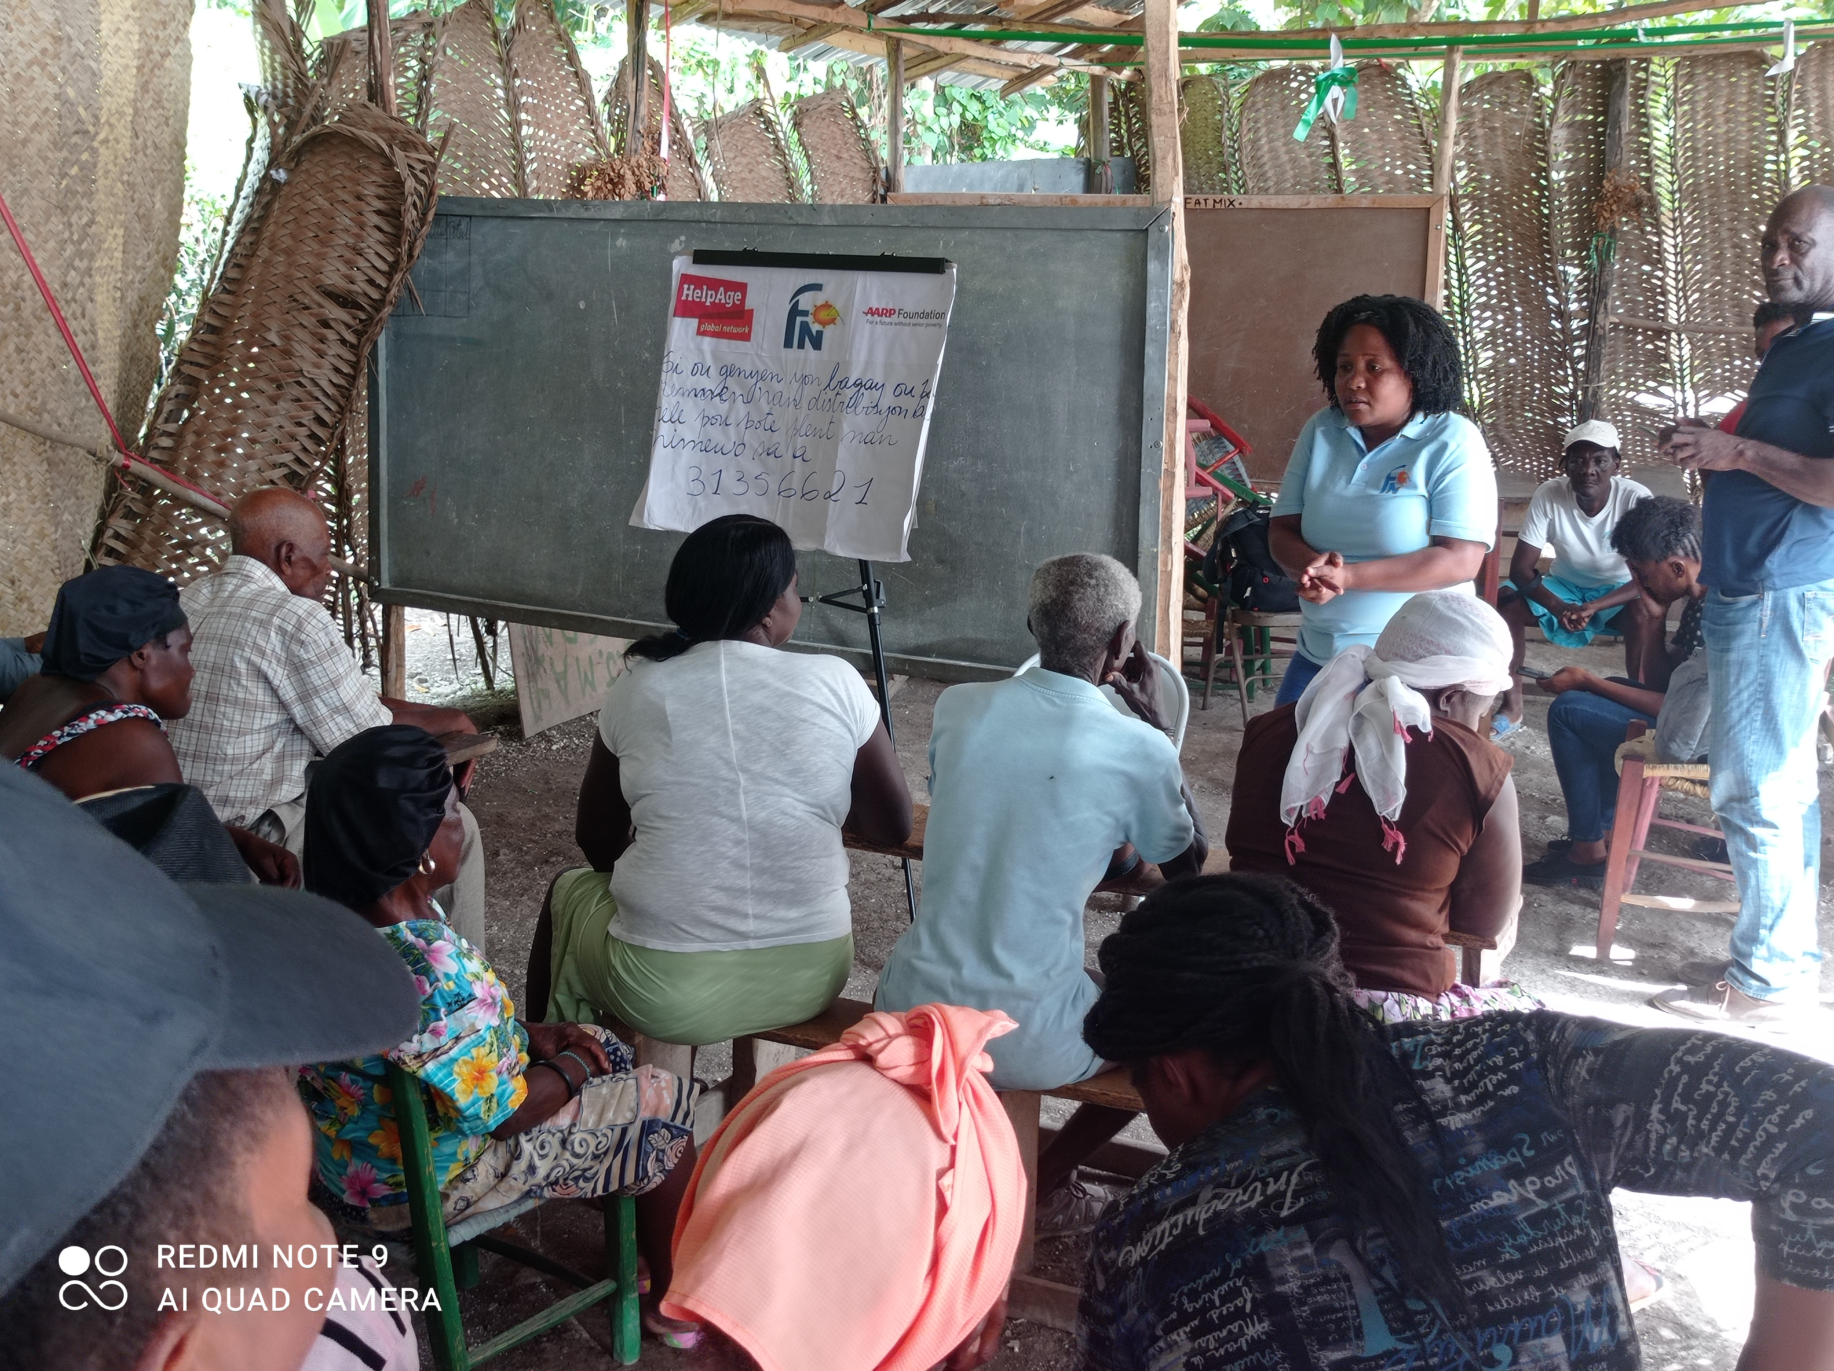
Feedback

Slide 16
“Protection of all persons affected and at risk must inform humanitarian decision-making and response... It must be central to our preparedness efforts, as part of immediate and life-saving activities, and throughout the duration of humanitarian response and beyond.”
IASC Principals Statement on Protection in 17 December 2013
Notes:
To summarise the work covered in this module, this statement highlights that all persons, including older persons, affected and at risk are included.
A statement issued in December 2013, at the Inter-Agency Standing Committee (IASC) affirmed that all humanitarian actors have a responsibility to place protection at the centre of humanitarian action.
As part of preparedness efforts, immediate and life-saving activities, and throughout the duration of a crisis and beyond, it is thus incumbent on Humanitarian Coordinators, Humanitarian Country Teams and clusters to ensure that “protection of all persons affected and at-risk [informs] humanitarian decision-making and response, including engagement with States and non-State parties to conflict.” The IASC has committed to a systemwide and comprehensive response to conflict and disasters. This response is driven by the needs and perspectives of affected persons, with protection at its core.

Slide 17
Dimensions of Protection
Protection as an objective
Protection as a legal responsibility
Protection as an activity
Notes:
It is important to see how person perceive protection as: an activity, an objective or a legal responsibility.
(It is an important slide especially to showcase protection as an activity to link with Module 3) Discuss for about 5 minutes on what they think and then describe as below:
Protection is an objective, which requires full and equal respect for the right of all individuals, without discrimination, as provided for in national and international law. Protection is not limited to survival and physical security but covers the full range of rights, including civil and political rights, such as the right to freedom of movement and to political participation, and economic, social and cultural rights, including the rights to education and health.
Protection is a legal responsibility, principally of the State and its agents. In situations of armed conflict, that responsibility extends to all parties to the conflict under international humanitarian law, including armed opposition groups. Human rights, humanitarian, and development actors play an important role as well, when States and other authorities are unable or unwilling to respect their protection obligations.
Protection is an activity because action must be taken to ensure the enjoyment of rights.
The three types of protection activities can be carried out concurrently:
1. responsive – to prevent or stop violations of rights;
2. remedial – to ensure a remedy to violations, including through access to justice and reparations;
3. environment-building – to promote respect for rights and the rule of law.
(we will look at this in more detail in module 3)
In our work
Protection requires working with all relevant stakeholders, including populations at risk, local communities and the authorities, to: prevent violations of rights from occurring or recurring; stop ongoing violations;
provide remedies, through reparation and rehabilitation, if violations have occurred; and foster an environment conducive to respect for the rights of women, men, girls and boys in accordance with the law.

Slide 18
Approaches to protection for older persons
MAINSTREAMED
TARGETED
Incorporation of protection objectives into to sector-specific responses.
Requires some protection knowledge/expertise.
A sector in itself.
Protection is the primary objective.
Delivered by actors with protection expertise.
Notes:
Explain:
If we remember the graphs above, where Safety and Participation were identified as key concerns to address and the feedback from the case studies – how do we move ahead ?
There are 2 useful approaches to address this.
1. When identifying protection risks and providing protection and assistance, adopt a twin-track approach to addressing the needs of older persons and older persons with disabilities, ensuring that responses are age inclusive (mainstreaming approach) and that responses address the specific barriers and needs experienced by older persons (targeted approach).
2. Where protection is the primary objective and is mainly designed and implemented through Protection advisors/ officers. For example, protection assessment to understanding abuse, discrimination, and other specific issues with the person at risks, and finding ways to mitigate these risks.
3. Base the interventions on an analysis of sex, age and disability disaggregated data.
4. Design all responses to be inclusive and accessible to older women and men with and without disabilities, identifying and mitigating potential barriers they may face.
Ask participants to quote few examples where older persons are or can be better included .
UNHCR has a mandate to do no harm and addressing protection concerns is fundamental to develop appropriate and supportive programming for older persons. Community protection programmes are the most relevant areas to develop an inclusive approach where older persons are better identified, their barriers better recognised and then actively included in the design and implementation of activities to support their protection needs.
NOT SURE NEED THIS in italics --is done where as an organization you are mandated to work to fulfil some larger objective, like WaterAid, working primarily on water issues, or Doctors for You works for medical aid. Here primary goal is something else and protection is integrated
E.g., a shelter programme where information is given about rights. Or threat to receivers of cash is evaluated in advance to make sure that they are not at threat. Or even designing a feedback mechanism also helps in ensuring our accountability towards person at risk and addressed protection.
Ask participants about examples, and explain that you will be talking about it in details in next module 3.

Slide 19
Key messages for Activity 3
Protection of older persons affected and at risk must inform humanitarian decision-making and response to ensure the enjoyment of rights.
Protection is an objective, which requires full and equal respect for the right of all individuals; and also a legal responsibility.
When providing protection and assistance, adopt a twin-track approach to addressing the needs of older persons and older persons with disabilities, ensuring that responses are age inclusive (mainstreaming approach) and that responses address the specific barriers and needs experienced by older persons (targeted approach).

Slide 20
Key messages for session
Older Persons on the move are:
at increased threat of abuse, neglect, safety and discrimination.
not systematically and effectively involved in community and humanitarian response.
not being involved in the design of appropriate responses due to limited participation and lack of information.
key actors to be involved effectively and supported in securing their rights.
Notes:
Ask participants to recap the second module:
Examples to trigger feedback -
Almost 50%, one in two persons have felt discriminated.
Age, sex and disability, with gender, along with isolation and loneliness are common factors for protection risks.
Provide some examples from the case studies used in the group work
All stakeholders have a role in ensuring protection of older persons.
Define stakeholders with the participants in assuring protection of older persons

Slide 21
Looking forward to Module 3

