Slide 1
Activity 3 ANALYSING AND USING DATA FOR THE INCLUSION OF PERSONS WITH DISABILITIES
Notes:
Notes for facilitator:
- Welcome participants to the activity.

Slide 2
Ground rules and accessibility
Say your name when speaking
Allow time for interpretation
Use captions if available
Describe images
Notes:
Notes for facilitator:
Accessibility. Describe the image displayed in the slide: Logos of different types of accessibility features to facilitate equal access for persons with hearing, visual, cognitive, physical and other disabilities.
Ask participants which ground rules they would like to have during the workshop to make it a conducive learning environment for everyone. Write them down on a flip chart and say them out loud.
If they are not covered, also share a series of minimum accessibility agreements that will ensure that everybody can participate on an equal basis. Some of the requirements can include:
Always say your name before speaking. This will allow everybody to learn to recognize your voice and name.
Speak slowly and clearly, avoiding jargon or acronyms. This will give time to sign language interpreters and other interpreters to convey information in a clear way.
In face to face workshops, please leave clear all corridors from bags, so everybody can circulate around the tables without finding obstacles.
In virtual workshops, remember to activate captions (if available), and check potential misspellings of key words that could lead to misinterpretations or missing key messages.
Always provide a brief description of images displayed in the screen or a poster, so everybody can access and understand the purpose of using those images.
We will have frequent breaks, including both short breaks (called sensory breaks) and longer breaks. Please respect these breaks.
Reminders will be made about these ground rules when needed. Everybody could have a yellow card in the form of a square –to be recognizable by tact as well- that can be used when they want the presenter to slow down, and a red card in the form of a triangle, when the presenter should stop due to an accessibility issue (e.g. the interpreter needs to stop, or content is being missed). For digital workshops, other codes can be used (emojis, green ticks or red crosses).
Ask participants to share other ground rules and accessibility tips to ensure that everybody can participate in an equal basis. Take note of these and write them on a flip chart posted on the wall somewhere visible in the room to refer to them when required. If the activity being delivered is virtual, use a virtual white board to do this exercise.

Slide 3
What we will cover today
How to enhance the accessibility of data collection processes?
How to provide additional support to allow equal access to data collection processes?
Which actions can be put in place for disability inclusion?
Notes:
Notes for facilitator:
- Introduce participants to the overall objectives of the training module: This module will introduce you to the basic of using data for the inclusion of persons with disabilities, including how to enhance the accessibility of data collection processes, how to provide additional support when required, and which actions can be put in place for disability inclusion.

Slide 4
APPLYING STRATEGIES FOR THE INCLUSION OF PERSONS WITH DISABILITIES USING DATA COLLECTED
Part 3

Slide 5
Accessibility of information
Accessibility of communication
Universal design
Notes:
Tips for facilitator:
Share with participants that we will re-visit some of the strategies to enhance accessibility and to provide adjustments, using materials from UNHCR - Working with Persons with Disabilities in Forced Displacement Facilitator's Guide
Ask participants about measures they know to enhance the accessibility of information and communication: How can you increase the accessibility of information and communication?
Accessibility. Describe the illustrations on the slide. Icons representing hearing and visual disabilities, and icons representing, from left to right, sign language interpretation, subtitles/captioning, audio, and braille formats. Three boxes containing “accessibility of information”, “accessibility of information” and “universal design”. Universal Design Principles | RL Mace Universal Design Institute (udinstitute.org)
Accessibility is not only about ramps, handrails and other appliances to facilitate access to the physical space. The concept of accessibility applies as well to means of providing information and facilitating communication, and it follows the principles of Universal Design, where products and services are designed to be usable by the widest part of the population possible, without the need for specialized design.
For example, in the illustration we see that using captioning / subtitles and audio in a video is, in itself, a way of promoting accessibility, as this video will be easier to access for many more people than if it did not have those features: for example, non-native speakers of a language can benefit from subtitles, and having audio as well can help people with visual impairments to still access the messages provided.
In addition, there are other ways of extending even more the accessibility of a message; this can be done by using languages and formats particularly accessible for persons with disabilities, such as sign language or Braille.
When these solutions are planned and provided in advance without a previous request from persons with disabilities, they are part of accessibility solutions. When these are provided in reaction to a request or a situation of inaccessibility, these solutions are called adjustments or “reasonable accommodations”, as they are temporary and provided on an individual basis.

Slide 6
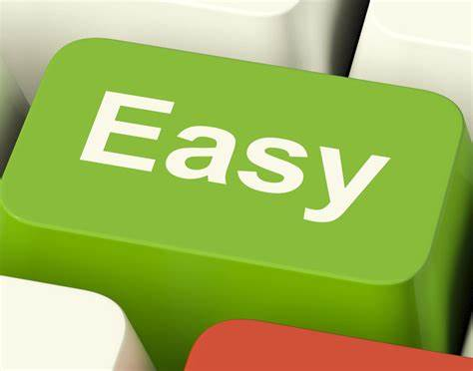
Accessibility of information
Easy-to-read information is clear and easy to understand.
It is written using everyday words and it is supported with pictures.
This is an example of easy-to-read!
Notes:
Notes for facilitator:
Tips for facilitators. Describe the illustrations: an easy-to-read example of text.:
Easy-to-read information is clear and easy to understand.
It is written using everyday words and it is supported by pictures. The illustration represents a key in a keyboard for the word "Easy"
This is an example of easy-to-read! The illustration represents a person reading a report written in easy read
Other formats include easy-to-read text which uses easy words and illustrations.
These formats are also more accessible to people with low literacy, people with intellectual disabilities and people who use minority languages.

Slide 7
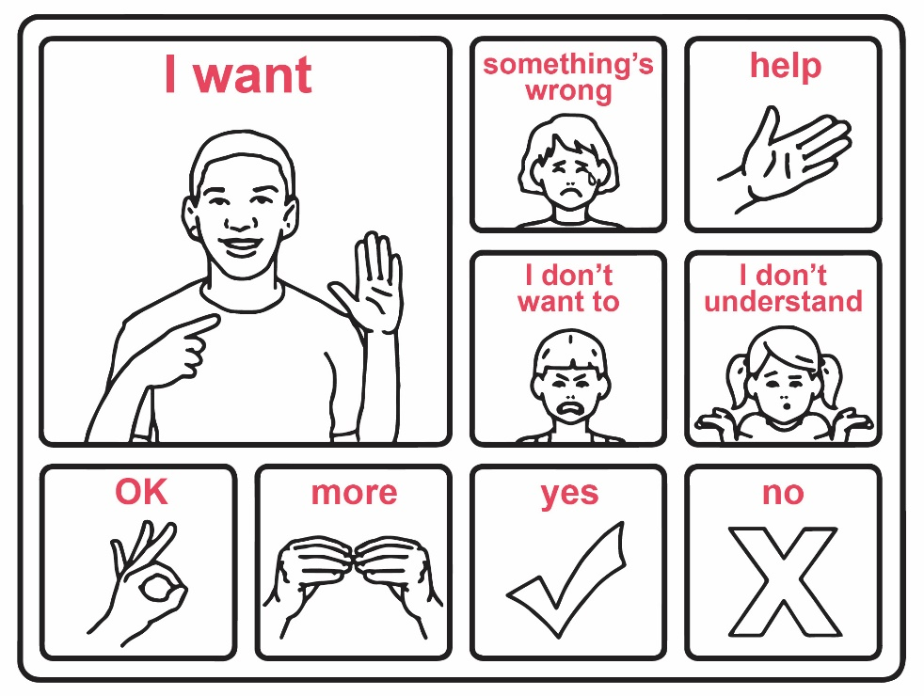
Accessibility of communication
Figure 6: Communication board
Source: UNICEF
Notes:
Notes for facilitator:
Tips for facilitators. Describe the illustrations: a communication board including illustrations and key words to facilitate information and communication, respectively.
Other formats include communication boards, with key words and illustrations.
These formats are also more accessible to people with low literacy, people with intellectual disabilities and people who use minority languages.
Source of communication board: UNICEF (2017), Including children with disabilities in humanitarian action – Protection. Available at: https://sites.unicef.org/disability/emergencies/protection.html

Slide 8
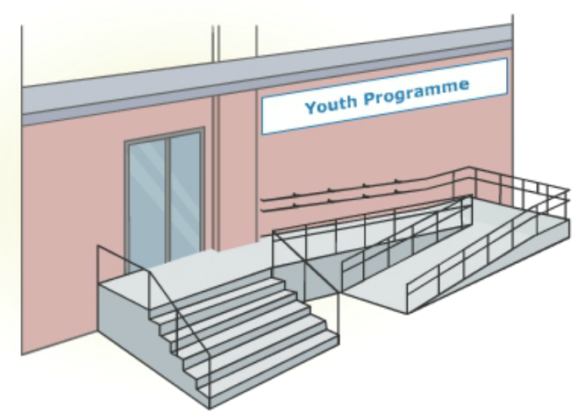
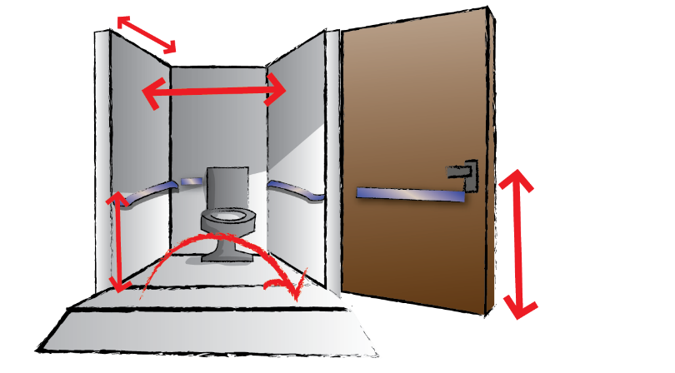
Physical accessibility
Notes:
Notes for facilitator:
Describe the illustrations: on the left, the entrance of a building used for a youth program is made accessible by installing ramps and rails. On the right, an illustration represents an accessible toilet.
As it happens with the accessibility of communication and information, the accessibility of the physical environment is a precondition for the participation of persons with disabilities. If buildings and facilities within them are not accessible, persons with disabilities will not be able to fully access and use them, and the same happens with roads and transportation.
This may happen in registration sites and community services.
As discussed with information and communication as well, accessible spaces follow the principles of Universal Design, and benefit all in this regard: an accessible building is safer as it has less hazardous, and it is easier to evacuate in an emergency as exits are adequately signed, doors are wide and without obstacles, etc.
Accessibility standards are developed and available at national and international level, and very often organizations of persons with disabilities are aware of the accessibility standards applicable in their country.
Building accessible new infrastructure does not require lots of additional costs, it is estimated than only an additional 1% of the overall costs. However, retro-fitting is more expensive.
Accessibility features may also require time to be implemented; that is why the Convention on the Rights of People with Disabilities proposes an alternative solution, applicable in situations of inaccessibility: reasonable accommodation.

Slide 9
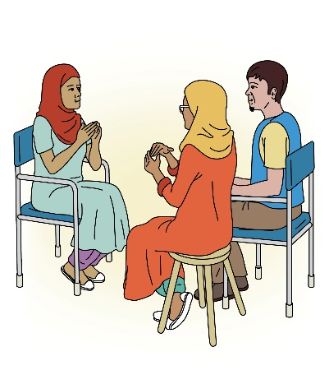
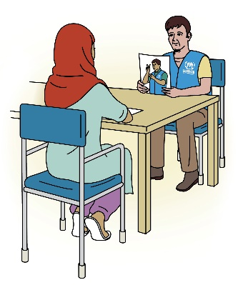
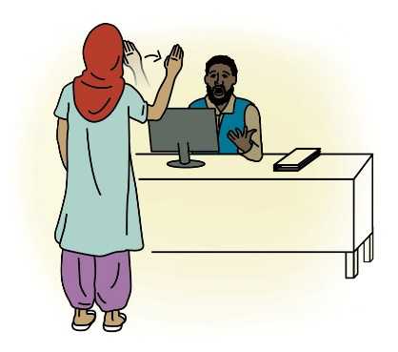
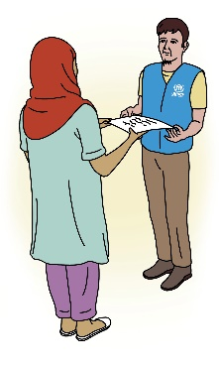
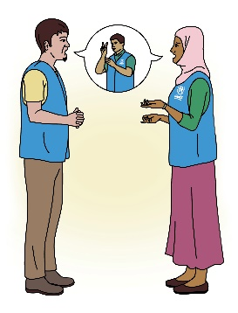
Targeted support/ adjustments
Ask the person
Evaluate options and resources
Offer a solution
Verify with the person
Outreach services / transportation allowances, etc.
Inaccessible situation
Notes:
Notes for facilitator:
Accessibility: describe the illustrations in the slide. A red sign marks an inaccessible situation, for example for a woman with a physical disability requiring access to a health service that cannot be reached by her due to the inaccessibility of public transportation. A process is put in place where a dialogue is undertaken with the person to evaluate options and resources, offer a solution and verify with the person that this solution meets the purpose of the support required.
When persons with disabilities find obstacles to participate or access services and situations on an equal basis with others, a process called “reasonable accommodation”, outlined by the Convention on the Rights of People with Disabilities, should be put in place.
This process requires identifying what the person requires to participate through an interactive dialogue, and providing a solution relevant for the person, and achievable within the resources available (including time, skills, services, financial, etc.). If a solution is not found, a justification should be provided.
In the illustration, a process for the provision of reasonable accommodation is represented; for example a woman with a physical disability finds a physical barrier to access a Sexual and Reproductive Health referral she requires, as the public transportation that connects her community with that hospital is not accessible. In discussions with the Health services providers, a transportation allowance is provided to access the required services; alternative ways of facilitating access could be providing outreach visits.
These solutions facilitate immediate access but may be less durable in time.

Slide 10
Bridging the gap between accessibility and individual adjustments
Accessibility | Reasonable accommodation
Can be implemented over time | Has to be provided immediately, otherwise there is discrimination
Is a general solution | Is an individual solution
Applies regardless of the need of persons with disabilities to access infrastructure, services or information | Applies from the moment that a person requires access to a non-accessible situation
Is guided by general principles of universal design | Is tailored to the person and designed together with the person concerned
Is ruled by accessibility standards (issued in country, or applicable from other countries) | Is ruled by a proportionality test: is it relevant, available or affordable by the project?
Notes:
Notes for facilitator:
Accessibility. Present the contents of the table. This table represents how both accessibility and reasonable accommodation complement each other, and which are the main differences between these two solutions, which may be sometimes overlapping.
While accessibility can be implemented over time, as it requires planning and resources, reasonable adjustments should be provided in the short-term to avoid discrimination. This requires planning and flexibility in budgeting as well. Prioritization will likely be needed.
Accessibility benefits wide extents of the population; reasonable adjustments are provided as individual solutions.
Accessibility should be always planned and implemented, in all infrastructures, services or information, as persons with disabilities will be always accessing these places. Adjustments are implemented from the moment that a person requires access to a non-accessible situation, even if that place was made accessible: it is a way of accounting for the wide diversity of experiences within persons with disabilities and ensuring equal access.
Accessibility is guided by Universal Design principles and national or international standards; reasonable accommodation is built into dialogue with the person, and should be relevant and affordable for the project.

Slide 11
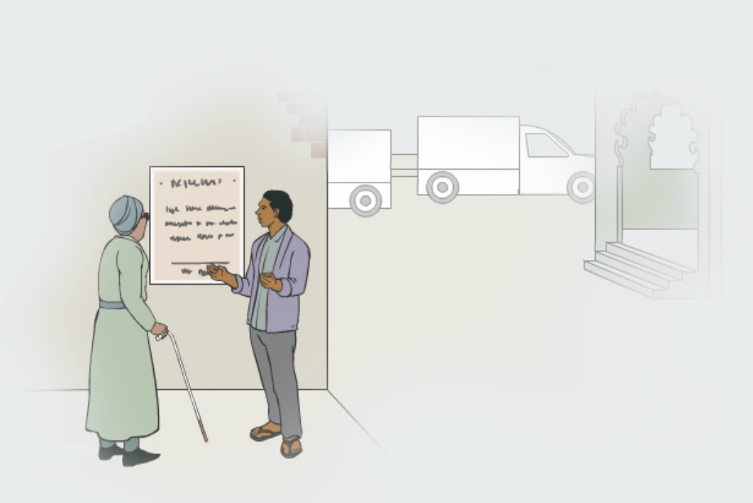
Test: Which strategy is being used?
Accessibility of information
Accessibility of communication
Targeted support/ adjustments
Notes:
Notes for facilitator:
This short test can be used to verify that participants can identify the difference between short term solutions or adjustments, and long-term solutions that promote the independence of the individual accessing spaces and information.
Ask participants to shortly describe what is represented: A man is explaining information from the street announcement to a woman with a visual impairment.
Ask participants which strategy is being used in this particular situation.
While many participants may answer that his represents an action of accessible information, reasonable accommodation would be more adequate, as the information is still not accessible for this woman (or any other person with a visual disability) if the man is not there providing that information.

Slide 12
Strategies in action – Individual data
Read a case study of a person with a disability
Discuss accessibility and support requirements
Select and apply actions for disability inclusion
What would be the expected impact on the protection of this individual?
Notes:
Notes for facilitator:
Explain to participants that in this exercise, we will focus on individual cases and apply actions for the inclusion and protection of persons with disabilities both through data collection processes and to act upon data collected.
Distribute Handout 7, and ask participants to select a case study.
To distribute case studies, participants can be assigned to different groups; alternatively, they can be selected by participants based on their own interests after the facilitator gives them an overview of the cases.
Ask participants to discuss the following points, reflected in the handout:
How could we make information accessible to this person?
What types of strategies would be more applicable to enhance their access to protection and assistance?
Consider that some actions will take more time and resources. Mid-term actions
Other actions can require less resources or only slight adaptations of existing resources. Short-term actions.
Participants can access a menu of actions included in the handout, and/or apply actions based in their own experience.
Finally, ask participants to prepare a short presentation of their choices, including answers for the question: What would be the expected impact on the protection of persons with disabilities?
Give groups 20 minutes to discuss in their groups, and share that they will have approximately 5 minutes to present in plenary their work.
Provide an example (next slide)

Slide 13
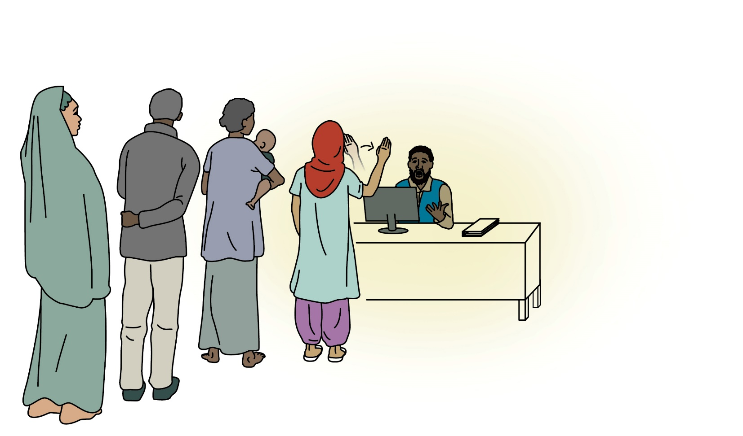
Example – Maryam
Notes:
Notes for facilitator:
Share with participants that we will discuss a short example.
Accessibility. Describe the illustration in the slide: A staff is working on a Registration facility. Maryam, a woman with a hearing disability, is accessing the office where she wants to access Registration.
Maryam uses sign language to communicate. The Resettlement Officer seems very surprised when Maryam signs “Hello” using sign language.
Share the two strategies with participants, and ask them to discuss which one would be more appropriate.
Strategies can be shared using a Microsoft Form, a poll, or reading them.
Which of the following strategies would you undertake if you were the Registration Officer in this situation?
Strategy 1. The Resettlement Officer could find an alternative way to communicate with Maryam (e.g. in writing, using a communication board, trying lipreading), collect basic information to register Maryam and plan an additional interview with Protection staff, sharing that a sign language interpreter will be present in the next interview. Feedback: This would be a great strategy. However, the Registration Officer should ensure that a next interview with a Sign Language Interpreter, trained in working in displacement issues, is planned and communicated to Maryam. This action may require time if UNHCR had no Sign Language Interpreters identified.
Strategy 2. The Resettlement Officer could provide information to Maryam about partner organizations providing services for persons with disabilities, such as assistive devices and rehabilitation. Feedback: While Maryam could be interested in accessing services specialized for persons with disabilities, her interest at this stage is in registration information and processes. Referring her to other unrelated services could be based on assumptions abound persons with disabilities not having the same needs and rights than persons without disabilities.

Slide 14
Plenary
How could we make information accessible?
What types of strategies would be more applicable?
Which would be the expected impact on the protection of this case?
Notes:
Notes for facilitator:
Ask participants to share the strategies they have identified for each case.
Feedback on each of the individual cases is available in the Facilitators’ Guide.
Feedback should focus on identifying and mitigating barriers and enhancing the impact on the protection of the individuals.

Slide 15
Monitoring disability inclusion
Monitor access
Inform indicators
Disability “marker” in COMPASS
Published reports
Discapacidad y Movilidad Humana
The power of inclusion- Mapping the Protection Responses for Persons with Disabilities Among Refugees in MENA
UNHCR Global Report 2020 - UNHCR Flagship Reports
Notes:
Notes for facilitator:
Share with participants that, as highlighted in previous activities, a variety of data can be collected around persons with disabilities: data on barriers, data on disability status, but as well data on their access to assistance and protection.
Capturing this data and monitoring their access can be key to ensure their visibility, and highlight additional barriers.
UNHCR regularly publishes reports where persons with disabilities can be highlighted, and having up to date data is very important to inform these reports.
proGres v4 and COMPASS provide avenues to share this data, for example by using data collected to inform dedicated indicators, and by using the disability “marker” included in COMPASS.
The slide includes good practices from different regions, and UNHCR’s Global Report, which includes a dedicated section to our progress on the inclusion of persons with disabilities.
Ask participants about reports they have worked on and that included references to persons with disabilities.

Slide 16
Key messages
Interventions should focus on mitigating barriers.
Persons with disabilities have a variety of needs.
There are actions that can be put in place even without data.
Notes:
Notes for facilitator:

Slide 17
Evaluation
Notes:
Notes for facilitator:
See Annex – Course Evaluation

Slide 18
Resources
The Washington Group on Disability Statistics - Home
UNHCR Guidance – Identification of persons with disabilities at Registration and other data collection efforts
Disability Statistics in Humanitarian Action | Humanity & Inclusion (e-learning)
Resettlement Assessment Tool – Refugees with Disabilities
Supporting participation of persons with disabilities across all cycles of participatory assessments
IASC Guidelines, Inclusion of Persons with Disabilities in Humanitarian Action, 2019 | IASC
Refworld | Need to Know Guidance: Working with Persons with Disabilities in Forced Displacement (EN-AR-FR-SP)
UNHCR - Working with Persons with Disabilities in Forced Displacement Facilitator's Guide
Guidance on strengthening disability inclusion in Humanitarian Response Plans - World | ReliefWeb
Notes:
Notes for facilitator:
Share the following resources on data on persons with disabilities (on the left) and on disability inclusion (on the right).

