Slide 1

Module 4
STRATEGIES TO FOSTER THE INCLUSION OF PERSONS WITH DISABILITIES
Notes:
Tips for facilitator:

Slide 2
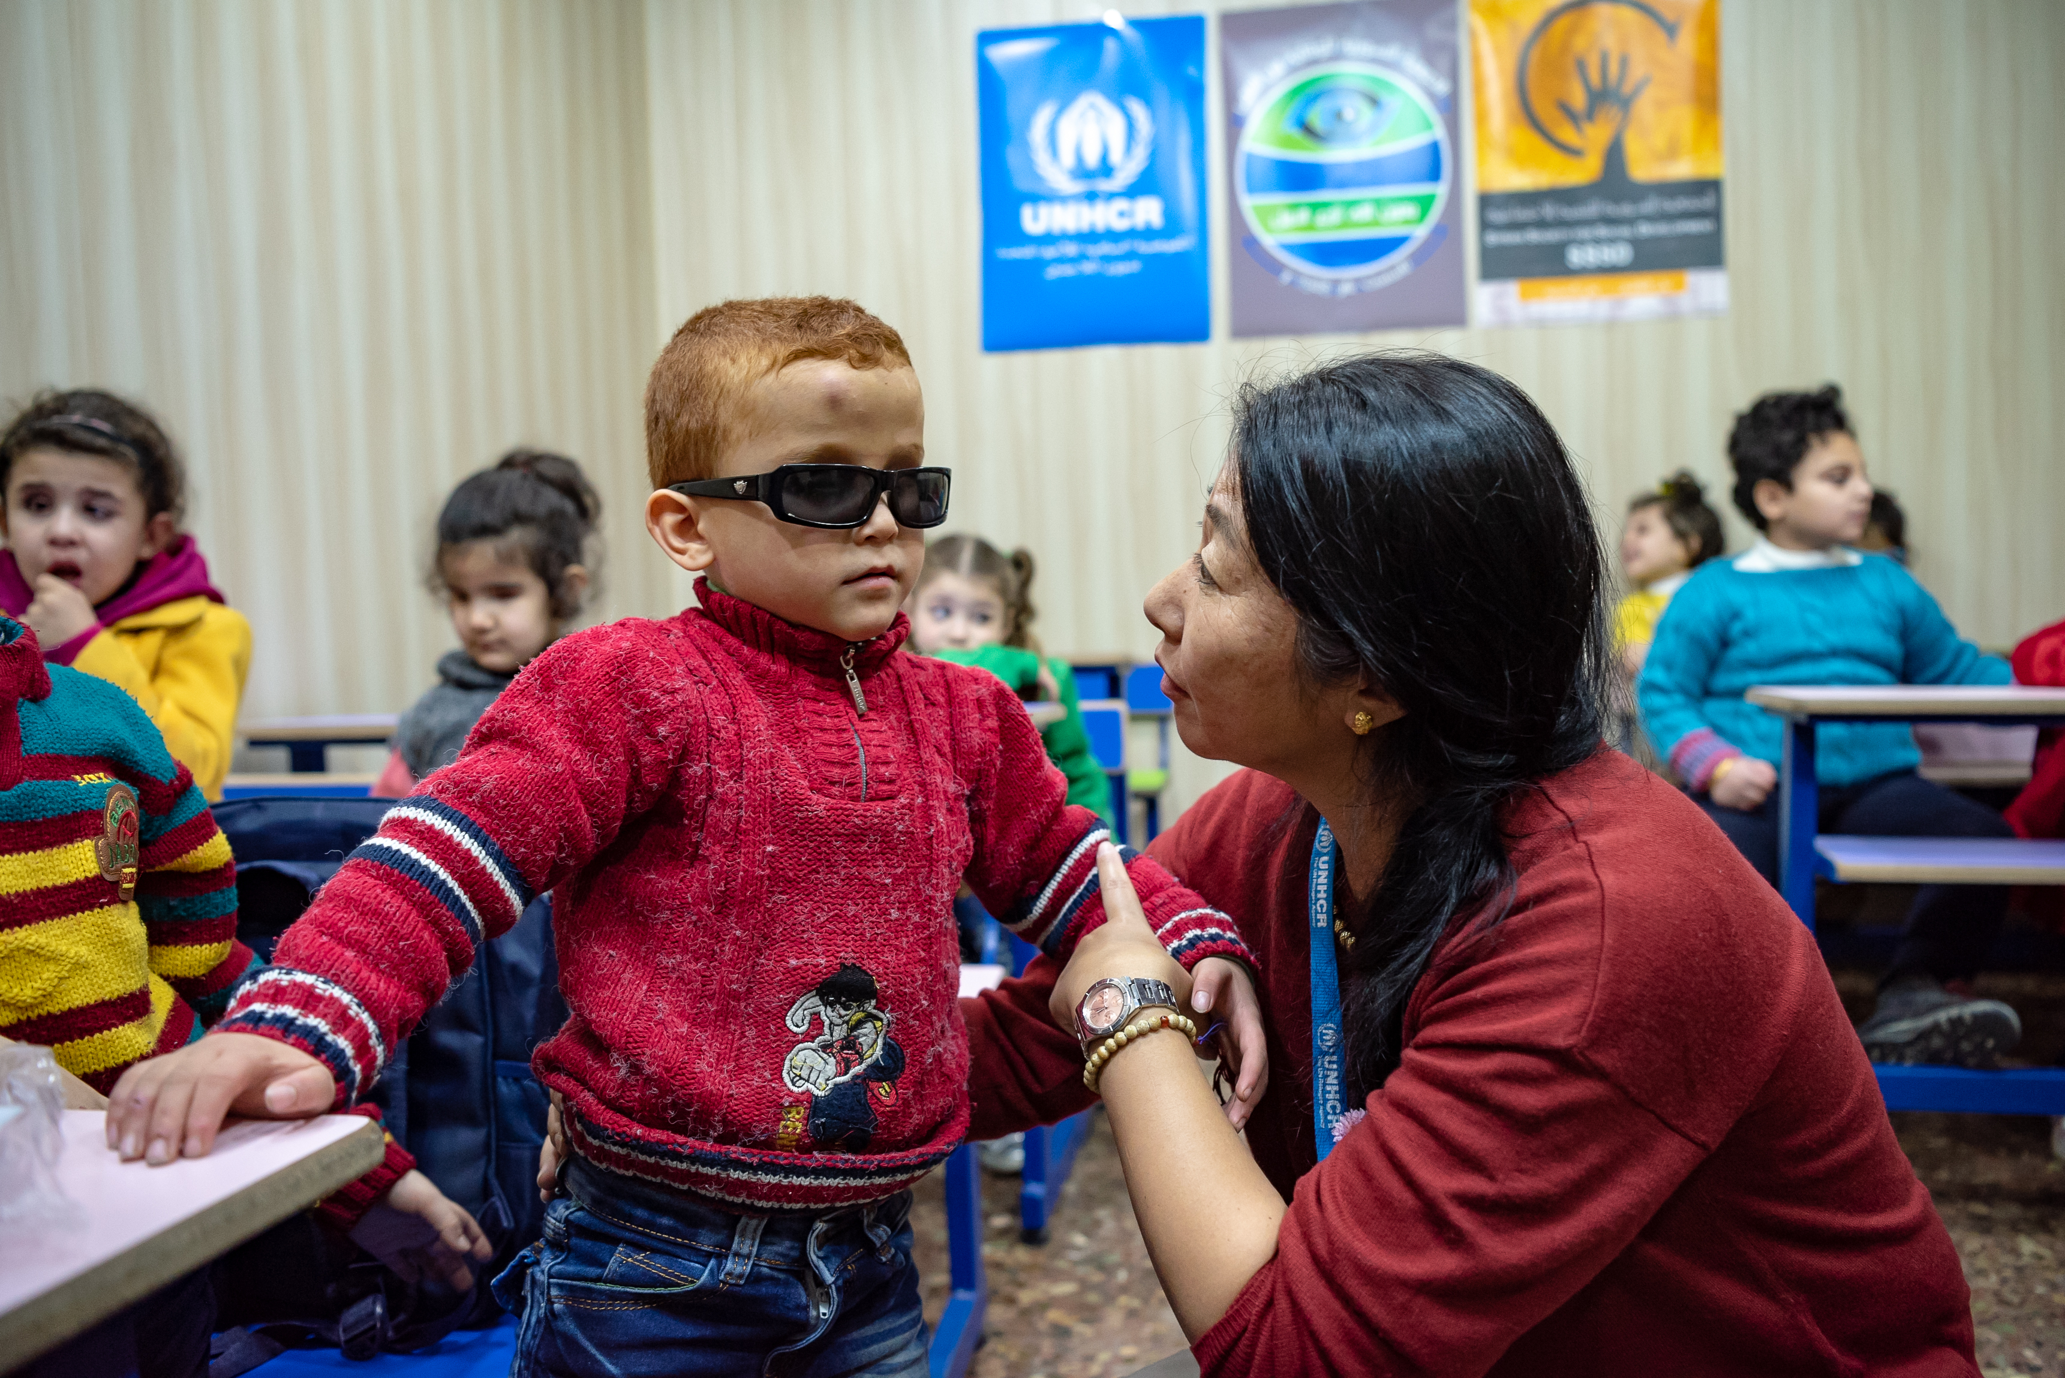
What we will cover today:
Key principles & strategies from the Convention on the Rights of Persons with Disabilities
Strategies to foster inclusion of persons with disabilities
Photo: © UNHCR/Antwan Chnkdji
Notes:
Tips for facilitator:
Accessibility: Provide a brief description of the picture. Sample description: UNHCR’s Head of Sub-Office in Aleppo, Takashima Yumiko discuss with Subhi, a seven-year-old who is visually impaired, at a centre the Sabil neighbourhood of Aleppo.
By the end of this session participants will be able to:
Explain the key definitions and key principles surrounding our work with persons with disabilities
Identify 3 ways to strengthen a community-based approach in working with persons with disabilities in your operation
Combine these strategies to mitigate protection risks and promote the inclusion of persons with disabilities in UNHCR programming.

Slide 3
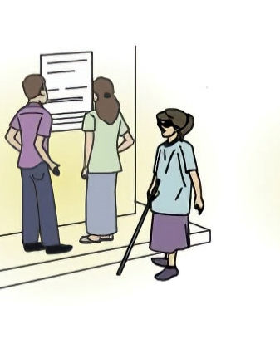
Recap from previous learning…
What are the risks that this woman may face if she does not receive information?
What are the causes of her not receiving information?
Which strategies can be put in place to mitigate these risks?
Notes:
Tips for facilitator:
Accessibility: Read the questions and describe the content and illustration in the slide. “A woman and a man are reading a street COVID-19 announcement on the wall while a woman with visual impairment walk passed the street announcement without knowing it.”
Solicit answers from participants and, if required, provide a final analysis completing any missing information: this woman can be further exposed to COVID-19 if she does not access key information displayed in the poster; her disability is realized when information is not made accessible to her by using, for example, other means of disseminating this information, such as audio and radio announcements, SMS campaigns, etc.
This recap exercise is not about bringing back all the barriers and risks, but to support keeping the focus on environmental factors.
Key message: we have learned how the environment, including ourselves and the services we provide or support, can be very important in the lives of persons with disabilities. We will learn in this module a series of strategies to strengthen the protection and resilience of persons with disabilities, and we will learn how to apply these strategies at different levels, including the individual her/himself.

Slide 4
Strategies across all the spheres
^{Policies}
^{Laws and regulations}
^{Community}
Social networks, services, organizations
^{Equal access}
^{Awareness-raising}
^{Interpersonal}
^{Families, friends}
^{Optimal health}
^{Accessibility}
^{of information}
^{Individual}
^{Knowledge attitudes skills}
^{Individual autonomy}
Notes:
Tips for facilitator:
Accessibility: describe the content of the graphic representation.
Concentric circles representing the socioecological model, the inner circle represents the individual (with knowledge, attitudes and skills), a next circle represent interpersonal relations (families, friends, social networks), a next level represents the community (services, organizations), and a final level represents policies (laws and regulations).
The circles are surrounded by two mauve boxes on the left representing strategies (awareness-rising and accessibility of information) and three aquamarine boxes on the right representing outcomes (equal access, optimal health and individual autonomy).
Most participants may have seen the central graphic in other trainings, others may be seeing it for the first time. Ask participants about what this graphic represents (the Socioecological Model) and why is it important in analysing strategies in the prevention and response of risks may help them activating and sharing previous learning. The socioecological model is a dynamic way of presenting the factors that influence a person’s protection and resilience.
Asking participants to provide a concrete example of one of the strategies, or providing that example, may help to understand how these strategies can apply to different levels, and generate different outcomes.
For example, using the illustration in the previous slide: rising the awareness of community service providers about the need of providing information in more formats than just written information may result in improved accessibility of information, and in this woman having equal access to key messages (for example through radio, or SMS), accessing that information independently (and reducing her dependence on others), and keeping her health at an optimal level by reducing her exposure to COVID-19. If policies and laws enforce this type of action, awareness-rising would be less and less required in this regard.
Key message: This slide represents only two of the multiple strategies that can foster the inclusion of persons with disabilities. In this module, we will explore different strategies that can apply to multiple levels, from the individual to public policies, with a particular focus on communities.

Slide 5
Strategies across all the spheres
^{Policies}
^{Laws and regulations}
^{Skills development for staff}
^{Data collection}
^{Community}
Social networks, services, organizations
^{Accessibility}
^{of information}
^{Participation}
^{Interpersonal}
^{Families, friends}
^{Accessibility of communication}
^{Targeted support/ adjustments}
^{Physical accessibility}
^{Individual}
^{Knowledge attitudes skills}
Access to assistive devices/ rehab
^{Awareness-raising}
^{Individual empowerment}
Notes:
Tips for facilitator:
Accessibility. Describe the slide, highlighting that additional strategies have been added around the socioecological model: individual empowerment, access to assistive devices/rehabilitation, targeted support/adjustments, participation, skills development for staff, awareness rising, physical accessibility, accessibility of communication and information, and data collection.
Key messages:
These strategies are built in following the principles outlined by the Convention on the Rights of People with Disabilities, which have informed as well UNHCR’s policies and guidance.
Multiple strategies will be required to address immediate risks, including situations of discrimination, and some of them will require different timing and resources.
Participants will be introduced to these strategies through case studies. Different situations of risk will be presented, together with different strategies that could help to prevent, mitigate or respond to particular risks. Participants will be invited to reflect on which of these strategies they think would be more adequate for the situation presented. Additional details on each strategy will be shared throughout the case studies.

Slide 6
BUILDING THE PATH TO INCLUSION
Notes:
Tips for facilitator:
Participants will be introduced to the strategies briefly presented in the previous activity through case studies.
Different situations of risk will be presented; participants will be asked to select which of the statements would better express the risk or barrier that the individual is facing in this situation, with a focus on using rights-based terminology that focuses on the environment.
Once the risk is identified, participants will select between a “menu” of interventions that could help to prevent, mitigate or respond to particular risks. Participants will be invited to reflect on which of these strategies they think would be more adequate for the situation presented.
Additional details on each strategy will be shared throughout the case studies, and are outlined in the Handout – Overview of strategies to foster disability inclusion.

Slide 7
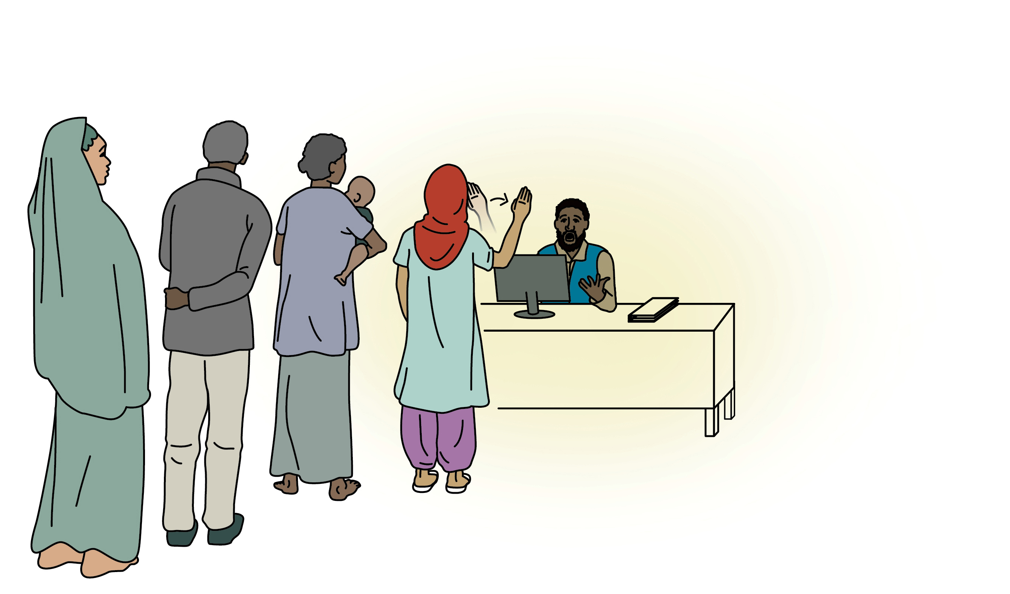
Case study 1 – Maryam
Notes:
Tips for facilitator:
Accessibility. Describe the illustration in the slide: A staff is working on Resettlement Programme. A woman is carrying a baby, queueing at the counter. A man and a woman are queueing behind her. Maryam, a woman with a hearing disability, is accessing the office where she has a resettlement interview.
Share the case study’s handout in printed and/or digital versions with participants, and ask them to work individually or in groups to answer the questions highlighted below.
In your operation, resettlement is used as a durable solution for a small number of refugees at high risk. During the screening and resettlement interviews, identified refugees are counselled and informed about the process and possible outcomes. Maryam, a woman with a hearing disability, receives an invitation for an interview. On the day of the interview, the Resettlement Officer seems very surprised when Maryam signs “Hello” using sign language.
Which of the following statements would most accurately reflect Maryam’s situation?
Statement 1. Maryam is facing a situation of discrimination on the basis of her disability. Feedback: Maryam is not having the same opportunities as other refugees to access information about resettlement; this situation could indeed amount to discrimination. The response of the Resettlement Officer could change the way this situation started; we will see three different strategies in a moment.
Statement 2. Maryam can’t hear, that is why she cannot have access to her resettlement interview. Feedback: This statement reflects only Maryam’s impairment, and does not recognize the responsibility of UNHCR to provide equal access to resettlement opportunities for Maryam.
Statement 3. Maryam is facing communication barriers to access her resettlement interview. Feedback: Maryam’s disability is realized by encountering a situation where the Resettlement Officer will not be able to share information in a way she can understand. Both Maryam and the Resettlement Officer are facing a communication barrier.
Which of the following strategies would you undertake if you were the Resettlement Officer in this situation?
Strategy 1. Maryam could be automatically included in the resettlement submission as part of her family unit, as she will need additional support in the destination country which her family could provide. Feedback: Resettlement as a family unit may be an option that adults with disabilities wish to take. However, adults with disabilities should also have information about other options available to them, including the possibility of being processed and submitted on a separate file and/or options that maintain their peer support networks. That’s why it is critical to consult directly with adults with disabilities about their solutions options and preferences, rather than automatically including them in the resettlement submission as part of their family unit.
Strategy 2. The Resettlement Officer could find an alternative way to communicate with Maryam (e.g. in writing) and postpone the interview, sharing that a sign language interpreter will be present in the next interview. Feedback: This would be a great strategy. However, the Resettlement Officer should ensure that a next interview with a Sign Language Interpreter, trained in working in displacement issues, is planned and communicated to Maryam. This action may require time if UNHCR had no Sign Language Interpreters identified.
Strategy 3. The Resettlement Officer could cancel the interview and provide information to Maryam about partner organizations providing services for persons with disabilities, such as assistive devices and rehabilitation. Feedback: While Maryam could be interested in accessing services specialized for persons with disabilities, her interest at this stage is in resettlement information and processes. Referring her to other unrelated services could be based on assumptions abound persons with disabilities not having the same needs and rights than persons without disabilities.

Slide 8
Select the statement that best describes the situation
Statement 1. Maryam is facing a situation of discrimination on the basis of her disability.
Statement 2. Maryam cannot hear; that is why she cannot have access to her resettlement interview.
Statement 3. Maryam is facing communication barriers to access her resettlement interview.
Notes:
Tips for facilitator:
It is important how do we analyse a situation of risk, and which terminology do we use to define it. Using rights-based terminology will support to point at different factors of risk, beyond the individual characteristics of the person, and identify rights-based strategies to address or mitigate risks
Which of the following statements would most accurately reflect Maryam’s situation?
Statement 1. Maryam is facing a situation of discrimination on the basis of her disability. Feedback: Maryam is not having the same opportunities as other refugees to access information about resettlement; this situation could indeed amount to discrimination. The response of the Resettlement Officer could change the way this situation started; we will see three different strategies in a moment.
Statement 2. Maryam can’t hear, that is why she cannot have access to her resettlement interview. Feedback: This statement reflects only Maryam’s impairment, and does not recognize the responsibility of UNHCR to provide equal access to resettlement opportunities for Maryam.
Statement 3. Maryam is facing communication barriers to access her resettlement interview. Feedback: Maryam’s disability is realized by encountering a situation where the Resettlement Officer will not be able to share information in a way she can understand. Both Maryam and the Resettlement Officer are facing a communication barrier.

Slide 9
Select the best strategy in this situation
Strategy 1. Maryam could be automatically included in the resettlement submission as part of her family unit, as she will need additional support in the destination country.
Notes:
Tips for facilitator:
Which of the following strategies would you undertake if you were the Resettlement Officer in this situation?
Strategy 1. Maryam could be automatically included in the resettlement submission as part of her family unit, as she will need additional support in the destination country which her family could provide. Feedback: Resettlement as a family unit may be an option that adults with disabilities wish to take. However, adults with disabilities should also have information about other options available to them, including the possibility of being processed and submitted on a separate file and/or options that maintain their peer support networks. That’s why it is critical to consult directly with adults with disabilities about their solutions options and preferences, rather than automatically including them in the resettlement submission as part of their family unit.

Slide 10
Select the best strategy in this situation
Strategy 2. The Resettlement Officer could find an alternative way to communicate with Maryam (e.g. in writing) and postpone the interview, sharing that a sign language interpreter will be present in the next interview.
Notes:
Tips for facilitator:
Which of the following strategies would you undertake if you were the Resettlement Officer in this situation?
Strategy 2. The Resettlement Officer could find an alternative way to communicate with Maryam (e.g. in writing) and postpone the interview, sharing that a sign language interpreter will be present in the next interview. Feedback: This would be a great strategy. However, the Resettlement Officer should ensure that a next interview with a Sign Language Interpreter, trained in working in displacement issues, is planned and communicated to Maryam. This action may require time if UNHCR had no Sign Language Interpreters identified. The interpreter could as well explore ways of communicating with Maryam (e.g. through writing) and asking her about her preferences in finding a solution for this situation.

Slide 11
Select the best strategy in this situation
Strategy 3. The Resettlement Officer could cancel the interview and provide information to Maryam about partner organizations providing services for persons with disabilities, such as assistive devices and rehabilitation.
Notes:
Tips for facilitator:
Which of the following strategies would you undertake if you were the Resettlement Officer in this situation?
Strategy 3. The Resettlement Officer could cancel the interview and provide information to Maryam about partner organizations providing services for persons with disabilities, such as assistive devices and rehabilitation. Feedback: While Maryam could be interested in accessing services specialized for persons with disabilities, but her interest at this stage is in resettlement information and processes. Referring her to other unrelated services could be based on assumptions around persons with disabilities not having the same needs and rights than persons without disabilities.

Slide 12
Which strategies would be more relevant here?
^{Policies}
^{Laws and regulations}
^{Skills development for staff}
^{Data collection}
^{Community}
Social networks, services, organizations
^{Accessibility}
^{of information}
^{Participation}
^{Interpersonal}
^{Families, friends}
^{Accessibility of communication}
^{Targeted support/ adjustments}
^{Physical accessibility}
^{Individual}
^{Knowledge attitudes skills}
Access to assistive devices/ rehab
^{Awareness-raising}
^{Individual empowerment}
Notes:
Tips for facilitator:
Accessibility. Describe the slide if required, highlighting: individual empowerment, access to assistive devices/rehabilitation, targeted support/adjustments, participation, skills development for staff, awareness-raising, physical accessibility, accessibility of communication and information, and data collection.
Which of the strategies would be more relevant in this particular situation? To which levels would it apply?
In this particular situation, the most immediate strategies would apply to the provision of UNHCR services and could include accessible information and communication through targeted support, in the form of a Sign Language Interpreter.
Additional strategies could be applied to be better prepared and prevent potentially discriminatory situations from happening in the future; these will be discussed in group in the next segment of this activity.

Slide 13
Which additional strategies could ensure complete information about resettlement options?
^{Policies}
^{Laws and regulations}
^{Skills development for staff}
^{Data collection}
^{Community}
Social networks, services, organizations
^{Accessibility}
^{of information}
^{Participation}
^{Interpersonal}
^{Families, friends}
^{Accessibility of communication}
^{Targeted support/ adjustments}
^{Physical accessibility}
^{Individual}
^{Knowledge attitudes skills}
Access to assistive devices/ rehab
^{Awareness-raising}
^{Individual empowerment}
Notes:
Tips for facilitator:
Which of the following strategies would you undertake to ensure that persons with disabilities receive complete information about resettlement options available to them?
Participants can reflect on groups and share back short statements explaining the strategies they would put in place to ensure equal access.
Note that some participants may propose unrealistic strategies, such as providing rehabilitation or medical interventions so she can start hearing, or planning for Sign Language Interpreters for any interview. The facilitator should guide participants towards solutions that are relevant and implemented in time.
Once feedback is collected and analysed, the facilitator can share additional strategies that could be considered:
Participation:
UNHCR could conduct public information sessions to individuals and family members with disabilities to share information about the resettlement programme and process.
Young adults with hearing disabilities could be consulted about their communication preferences during interviews to facilitate planning in advance (e.g. facilitating Sign Language Interpretation), and share what additional information they would like to receive to fully understand all aspects and potential outcomes of the resettlement submission of their case.
Awareness-raising of UNHCR staff would be required in case the response of the Resettlement Officer was not adequate and her/his actions did not focus on addressing the barriers faced by Maryam.
Skills development for staff: Staff could be trained on how to plan for the accessibility of persons with disabilities during interviews, and on collecting and sharing additional information about destination countries, including details about support and services available for persons with different types of disabilities.

Slide 14
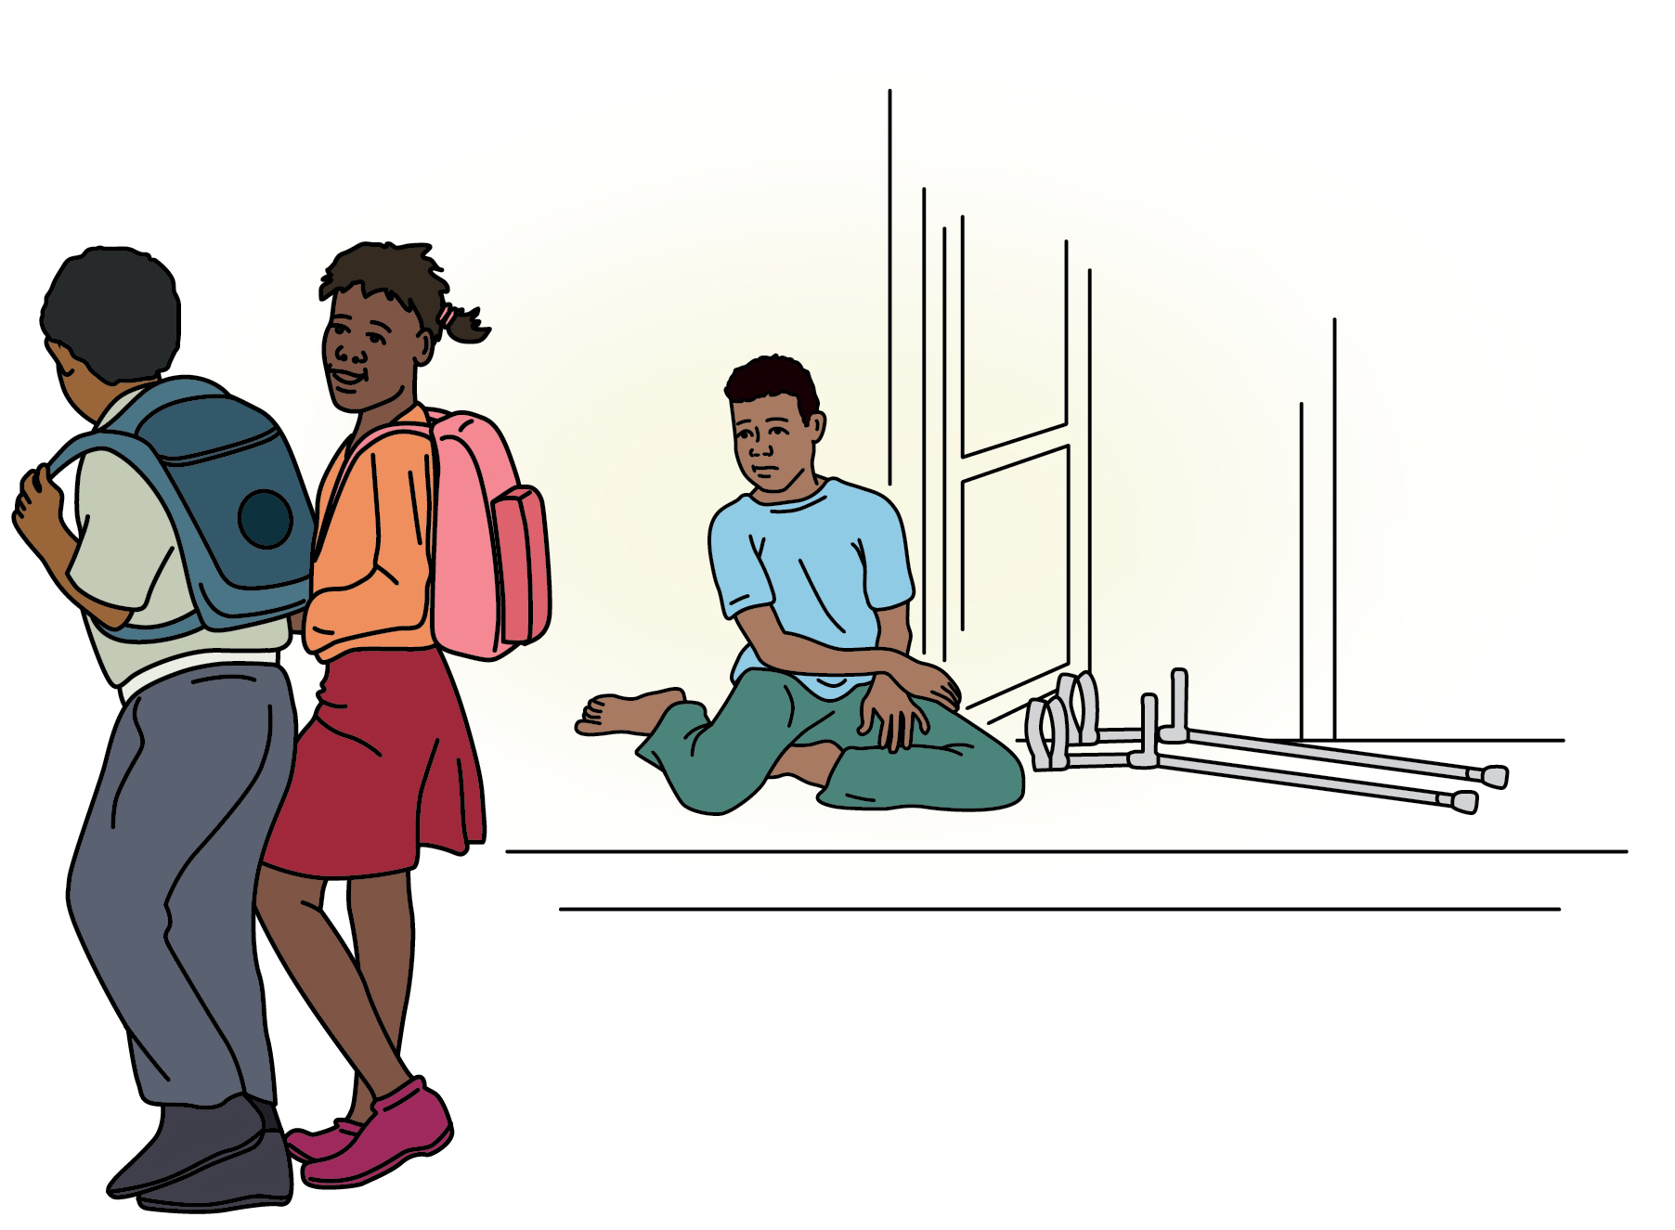
Case study 2 – Jamir

Slide 15

Case study 2 – Jamir
Barrier Card
1
Jamir
physical disability
Jamir is always at home, as he can only walk short distances using his crutches.
Notes:
Tips for facilitator:
Accessibility. Describe the image on the screen: Jamir is a young boy with physical disability. He sits in front of his house watching two children passing by to attend to school.
Share the case study handout and ask participants to work in groups to discuss the barriers Jamir faces and identify adequate strategies to foster her inclusion into school.
Explain that in this second case study, participants will discuss the potential strategies to address the multiple barriers faced by Jamir in his path to return to school. Instead of proposing a short selection of strategies for each situation, as done in case study 1, the participants will have to select from a longer menu of actions, to help them experience a situation closer to the reality. As an option, participants can be asked to propose a situation before being offered with a menu of strategies.
Some of these strategies will be more centred in Jamir (e.g providing a wheelchair), while other actions target discrimination on the basis of disability (e.g raising awareness), and other actions will benefit many children and not only Jamir (e.g. improve the road to the school).
The objective of the activity is to support participants to select adequate strategies at a given time and understand that a combination of strategies will be required to address complex situations. This way of combining strategies that mainstream inclusion in the environment and support a particular individual or individuals at heightened risk by tackling the roots of discrimination is usually called “the twin-track approach”. This information can be shared using key messages at the end of the activity.
Which strategy or strategies could be put in place?

Slide 16
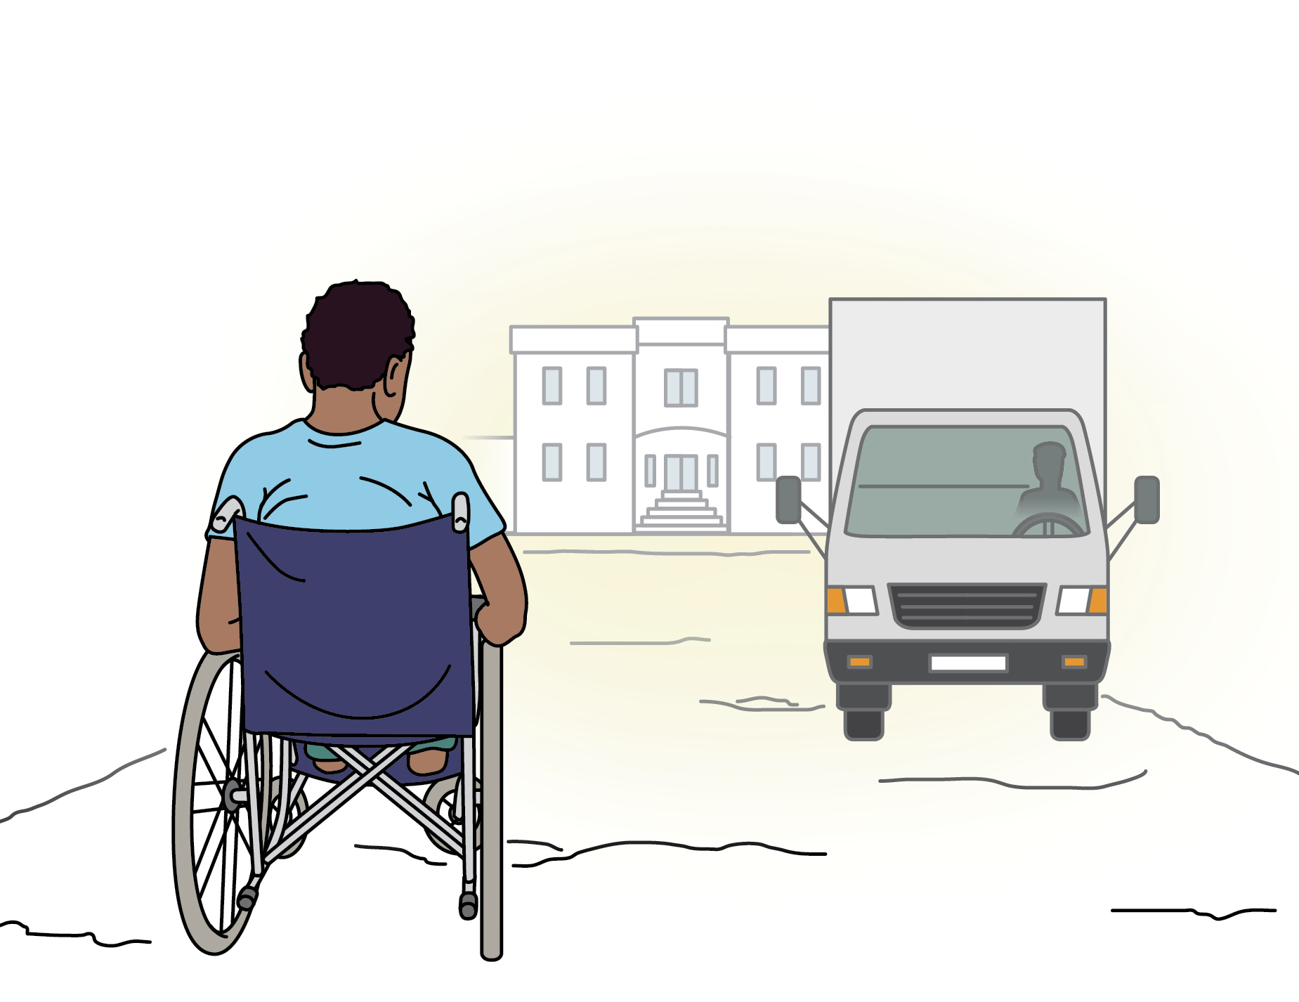
Case study 2 – Jamir
Barrier Card
2
Jamir
physical disability
Several incidents with children going to school have been reported, as the road to the school is uneven and unsafe. In addition, the school is too far for Jamir to push his wheelchair up to the school.
Notes:
Accessibility: Describe the illustration on the slide. Sample description: Jamir is in his way to the school, but the road is uneven, there is no sidewalk, and there is intense traffic.
Barrier 2: Several incidents with children going to school have been reported, as the road to the school is uneven and unsafe. In addition, the school is too far for Jamir to push his wheelchair up to the school.
Ask participants: Which strategy or strategies could be put in place?

Slide 17
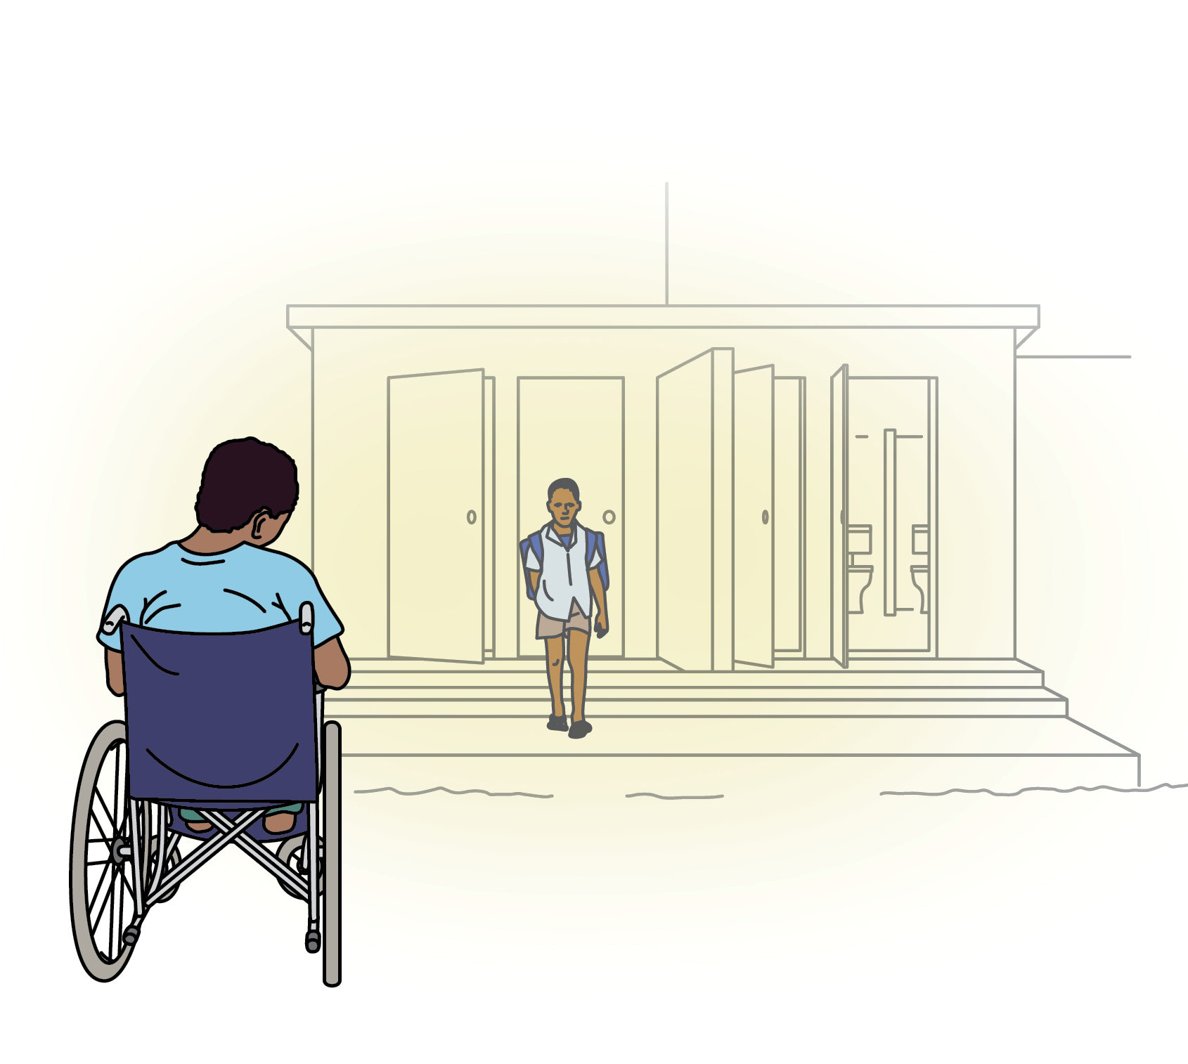
Case study 2 – Jamir
Barrier Card
3
Jamir
physical disability
When Jamir gets to school, he can access the school buildings, but doesn’t yet have the skills to move around independently in his wheelchair. In addition, the toilets have narrow doorways, steps and no lockers, so it is not possible to access them with his wheelchair.
Notes:
Accessibility: Describe the illustration on the slide. Sample description: Jamir is in front of the toilets of the school, but there are stairs and narrow doors to access them.
Barrier 3: When Jamir gets to school, he can access the school buildings, but doesn’t yet have the skills to move around independently in his wheelchair. In addition, the toilets have narrow doorways, steps and no lockers, so it is not possible to access them with his wheelchair.
Ask participants: Which strategy or strategies could be put in place?

Slide 18
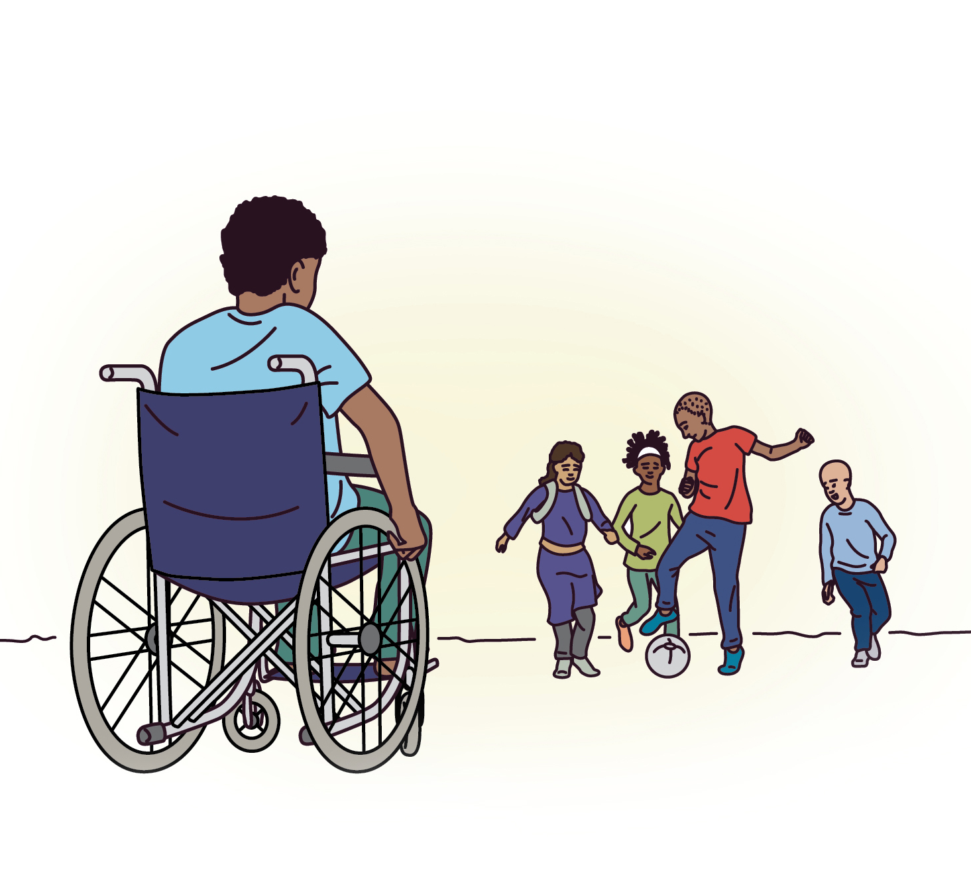
Case study 2 – Jamir
Barrier Card
4
Jamir
physical disability
Other children tease him as he is the only child with a disability in the school, and he wants to drop out.
Notes:
Accessibility: Describe the illustration on the slide. Sample description: Jamir is in the school yard, and children are playing football without noticing him.
Barrier 4: Other children tease him as he is the only child with a disability in the school, and he wants to drop out.
Ask participants: Which strategy or strategies could be put in place?

Slide 19
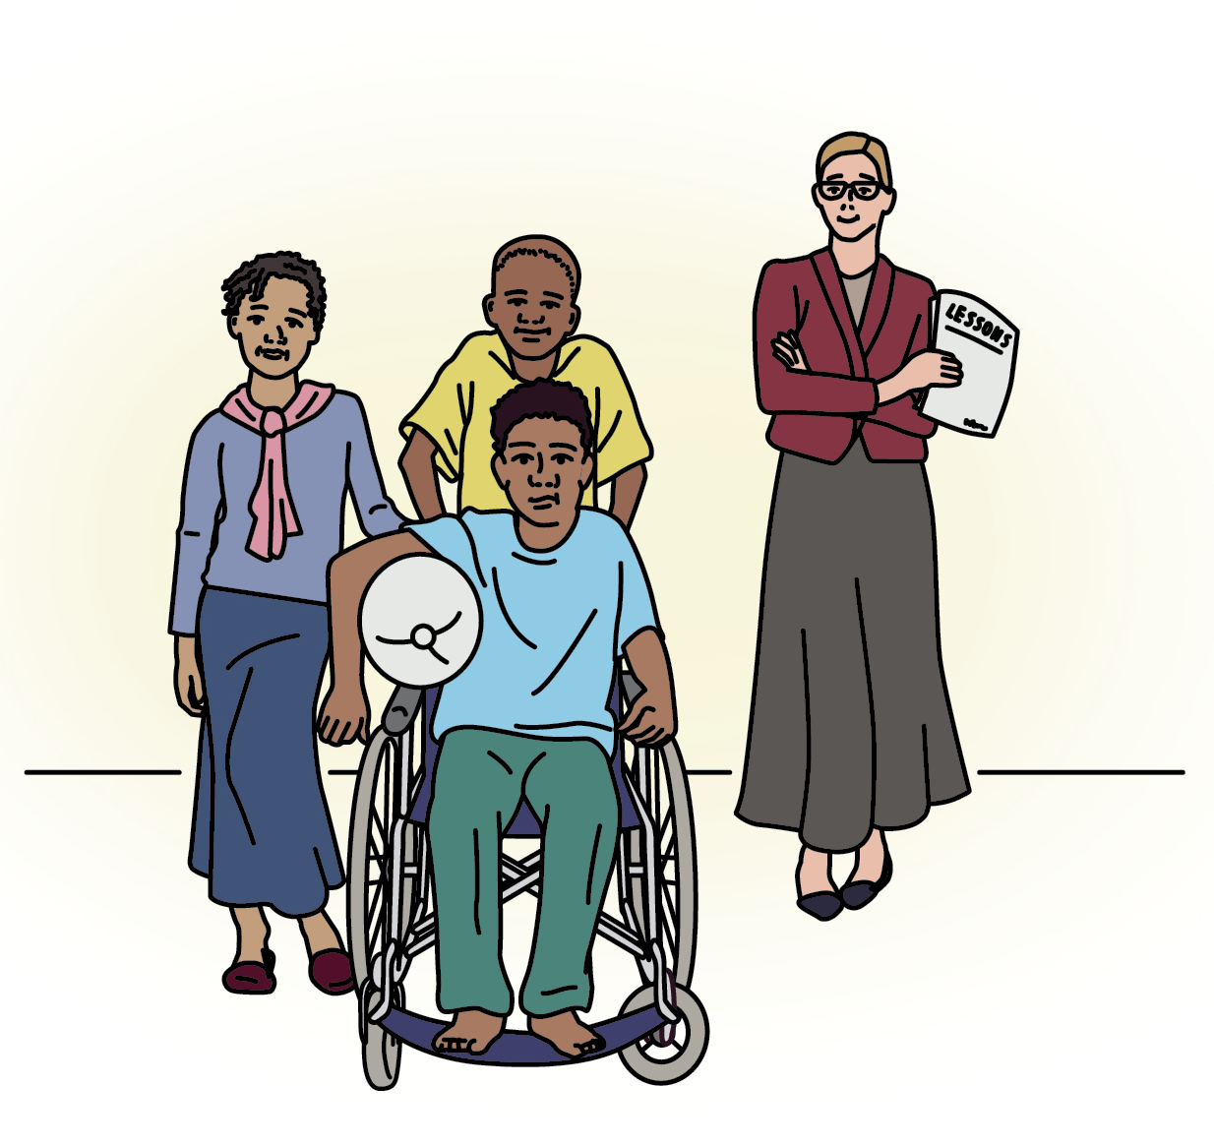
Case study 2 – Jamir
Barrier Card
5
Jamir
physical disability
Jamir has now made a group of friends, but he has fallen so far behind academically, that it is difficult to keep up with lessons.
Notes:
Accessibility: Describe the illustration on the slide. Sample description: Jamir smiling with his friends, his teacher is behind them.
Barrier 5: Jamir has now made a group of friends, but he has fallen so far behind academically, that it is difficult to keep up with lessons.
Ask participants: Which strategy or strategies could be put in place?

Slide 20
Case study 2 – Jamir
Assistive devices. Provide Jamir with a wheelchair.
Individual empowerment. Provide Jamir training on how to use his wheelchair, including how to negotiate difficult terrain and obstacles.
Targeted support. Find a community volunteer or teacher to provide him with additional lessons.
Awareness-raising. Sensitize students on the capacities and skills of children with disabilities. Awareness-raising. Contact organizations of persons with disabilities to provide community awareness-raising on the rights of all children to education.
Skills development. Train teachers on how to foster inclusive learning environments.
Physical accessibility. Construction work to improve the road to school.
Participation. Get children with and without disabilities to identify barriers to accessibility on the way to school and within the school environment.
Physical accessibility. Construction work to adapt school infrastructure (e.g. widen latrine doorways, construct ramps).
Community support. Establish ‘walking groups’- where children with and without disabilities walk together to the school and support each other.
Notes:
Tips for facilitator:
Ask participants to select which strategy(s) would be relevant to help Jamir address the barriers to access school.

Slide 21
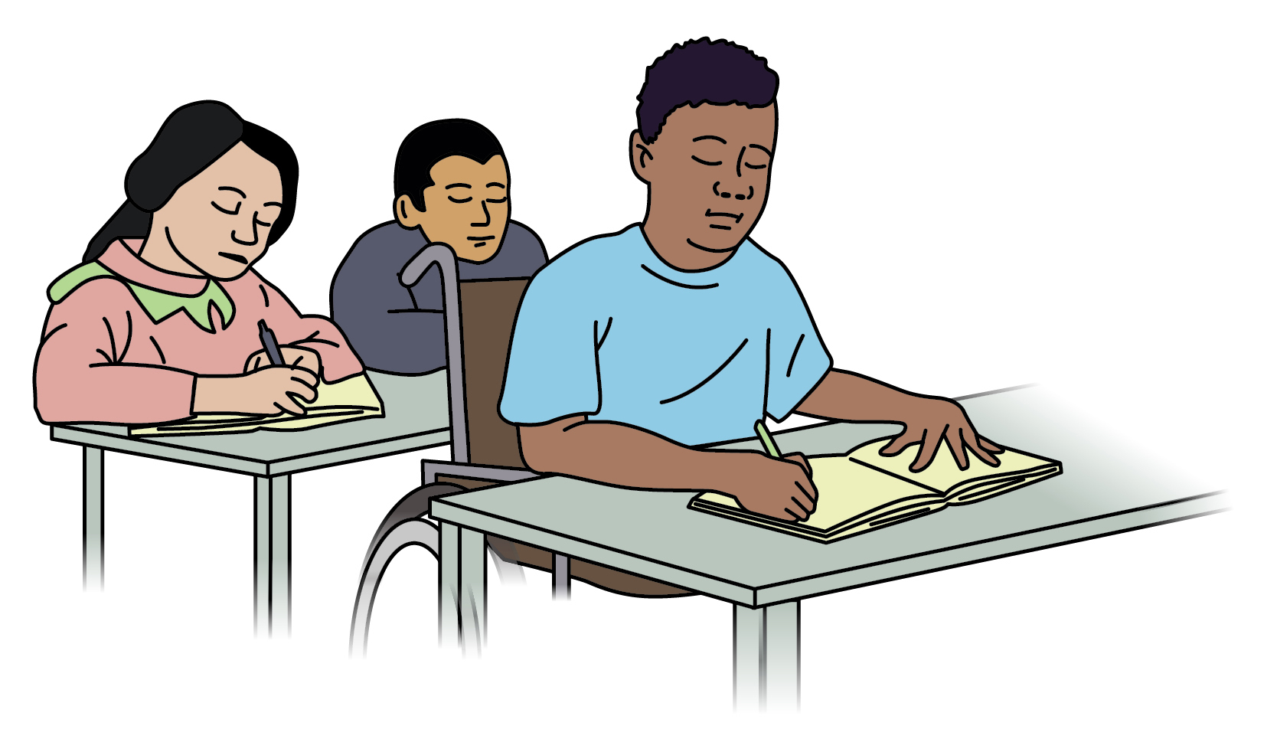
The Twin-track Approach
Empowerment actions
Disability mainstreaming actions
Notes:
Tips for facilitator:
Accessibility. Describe the illustration in the slide. Two arrows in green (disability targeted actions) and yellow colour (disability mainstream actions) point at the centre, where Jamir studies in a classroom. Two of his classmates are sitting a row behind his wheelchair.
The facilitator can use the following questions to facilitate a discussion:
Question: For Jamir to go to the school, was it enough if we only provided a wheelchair? Is it enough if we only run awareness raising activities in the school? Potential answer: It is not just the difficulties Jamir may have while walking and about changing the attitudes in the community. These actions tackle key issues that are roots causes of situations of discrimination, but we will need to address other barriers in the environment. Addressing these barriers will benefit not only Jamir, but many other children.
Question: Do you think that the same organization would be responsible for all these solutions? Potential answer: Multiple stakeholders and individuals will have to work together, with different roles in promoting inclusion. This includes Jamir and the children he interacts with.
Question: Can anybody guess why some actions are in green and some are in yellow? Potential answer: The green actions are targeted at empowering persons with disabilities and tackling root causes of discrimination. The yellow actions relate to actions addressed to bring aspects of disability inclusion to the wider community or our programming, and can have a beneficial impact in other members as well. This is often called the Twin-Track Approach. If only one side of the ‘track’ is addressed, Jamir would not be able to reach full inclusion in school. This approach can enhance the possibilities of success in providing equal opportunities to persons with disabilities in our communities.

Slide 22
Key messages
A “twin-track approach” to inclusion of persons with disabilities means that we should:
  Change the way we run our programs and activities, so they are designed to be inclusive of persons with disabilities (also known as “mainstreaming”); and,
  Plan targeted actions to enable equal participation by persons with disabilities by empowering their capacities and tackling roots of discrimination (also known as “empowerment”).
If only one side of the ‘track’ is used, persons with disabilities will not be able to ‘reach’ full inclusion.
Notes:
Tips for facilitator:
Ask participants which is the key take-away or strategy they have learned during this training, and if there is anything they would change in the way they work or in a particular programme they are working on.

Slide 23
OVERVIEW OF STRATEGIES TO FOSTER DISABILITY INCLUSION
Notes:
Tips for facilitator:
These strategies can be provided as cards to groups of participants, or shared in advance in digital workshops.
After reading its content, the groups can present what they have learned in their own words, and how it may have been applied in their context through an example.

Slide 24
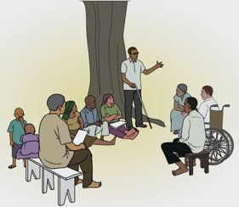
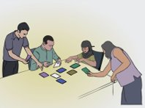
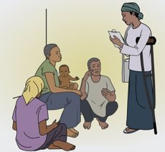
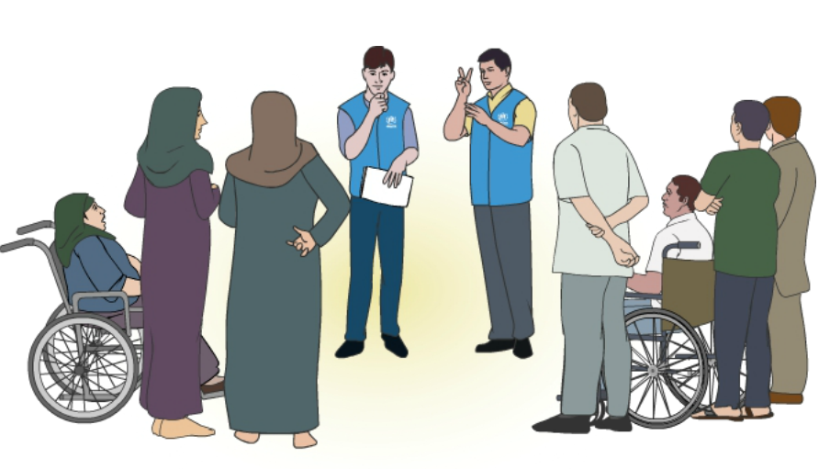
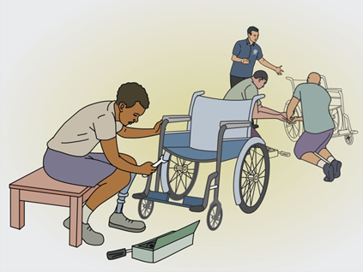
Participation
Informing
Consulting
Involving
Collaborating
Empowering
Notes:
Tips for facilitator:
Accessibility: describe the illustrations in the slide; descriptions are available below, when presenting the degrees of participation presented below.
Participation is both an outcome and a process. It is key for the inclusion of persons with disabilities, and it contributes addressing a historic situation of inequality, where persons with disabilities have been often objects of decisions made by others.
Participation can take many forms, engaging with organizations of persons with disabilities and with women, girls, men and boys with disabilities living in forced displacement as individuals or in Focus Group Discussions.
Participation is not only about asking the opinions of persons with disabilities. It can take many forms, and it should aim at the highest level of ownership possible in both the decision-making process and implementation. The following degrees or modalities of participation can be used to help identifying optimal levels of participation at different stages:
Informing: Information is shared with communities, but they have no authority on decisions and actions taken. E.g. refugees may be told by UNHCR when and where an event or a service takes place, and this information can be provided using accessible ways of communication, like in the first illustration on the left, where a group of persons with a without disabilities access information provided verbally and in sign language. Sometimes, an intermediate degree can include what is called “information transfer”: Information on preferences is gathered from communities, but they are not taking part in discussions leading to informed decisions
Consulting: Communities are asked for their opinions, which may or may not be taken into account. For example, dedicated consultations with persons with disabilities, as the one represented in the top left part of the slide, can be organized, or consultations where persons with disabilities are enabled to participate, ensuring their full and meaningful access (e.g. providing for their accessibility, briefing them in advance when required).
Involving: Communities are involved in one or more activities, but they have limited decision-making power and other partners continue to have a part to play. For example, persons with disabilities can help to collect information on their communities as peer volunteers, as in the illustration at the center of the slide.
Collaborating: Communities are completely involved in decision-making with other partners. For example, persons with disabilities can be part of workshops where decisions are taken, and make part of community committees on a regular basis, like in the top right illustration, where a group of persons with disabilities use cards to assess the information collected from the community and engage in a discussion.
Empowering: Communities control decision-making and other partners facilitate their ability to utilize resources. There is therefore greater ownership and a stronger sense of belonging and responsibility. For example, in the last illustration on the right side of the slide, a workshop to repair assistive devices was chosen as an income generating activity by refugees with disabilities, the activity would support their community by providing a service required, and allow for more autonomy from specialized services, difficult to access in that location.

Slide 25






Universal design
Accessibility of information
Accessibility of communication
Notes:
Tips for facilitator:
Accessibility. Describe the illustrations on the slide. Icons representing hearing and visual disabilities, and icons representing, from left to right, sign language interpretation, subtitles/captioning, audio, and braille formats. Three boxes containing “accessibility of information”, “accessibility of information” and “universal design”.
Accessibility is not only about ramps, handrails and other appliances to facilitate access to the physical space. The concept of accessibility applies as well to means of providing information and facilitating communication, and it follows the principles of Universal Design, where products and services are designed to be usable by the widest part of the population possible, without the need for specialized design.
For example, in the illustration we see that using captioning / subtitles and audio in a video is, in itself, a way of promoting accessibility, as this video will be easier to access for many more people than if it did not have those features: for example, non-native speakers of a language can benefit from subtitles, and having audio as well can help people with visual impairments to still access the messages provided.
In addition, there are other ways of extending even more the accessibility of a message; this can be done by using languages and formats particularly accessible for persons with disabilities, such as sign language or Braille.
When these solutions are planned and provided in advance without a previous request from persons with disabilities, they are part of accessibility solutions. When these are provided in reaction to a request or a situation of inaccessibility, as in the example reviewed with Maryam, these solutions are called adjustments or “reasonable accommodations”, as they are temporary and provided on an individual basis.

Slide 26
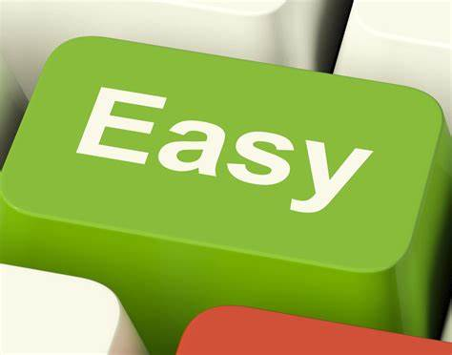
Accessibility of information
Easy-to-read information is clear and easy to understand.
It is written using everyday words and it is supported with pictures.
This is an example of easy-to-read!
Notes:
Tips for facilitator:
Tips for facilitators. Describe the illustrations: an easy-to-read example of text.:
Easy-to-read information is clear and easy to understand.
It is written using everyday words and it is supported by pictures. The illustration represents a key in a keyboard for the word "Easy"
This is an example of easy-to-read! The illustration represents a person reading a report written in easy read
Other formats include easy-to-read text which uses easy words and illustrations.
These formats are also more accessible to people with low literacy, people with intellectual disabilities and people who use minority languages.

Slide 27
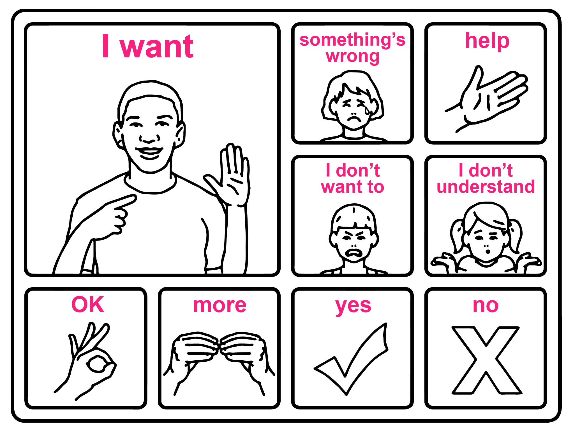
Accessibility of communication
Figure 6: Communication board
Source: UNICEF
Notes:
Tips for facilitator:
Tips for facilitators. Describe the illustrations: a communication board including illustrations and key words to facilitate information and communication, respectively.
Other formats include communication boards, with key words and illustrations.
These formats are also more accessible to people with low literacy, people with intellectual disabilities and people who use minority languages.
Source of communication board: UNICEF (2017), Including children with disabilities in humanitarian action – Protection. Available at: https://sites.unicef.org/disability/emergencies/protection.html

Slide 28
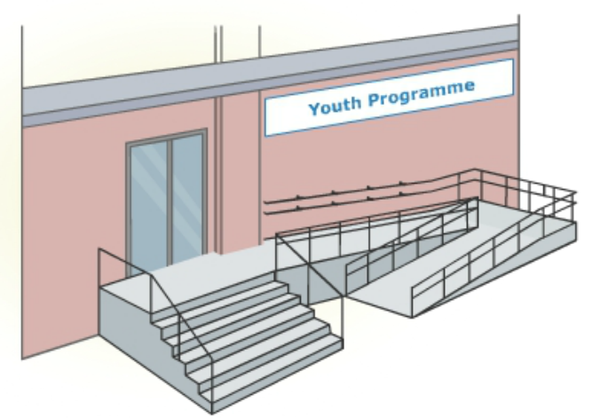
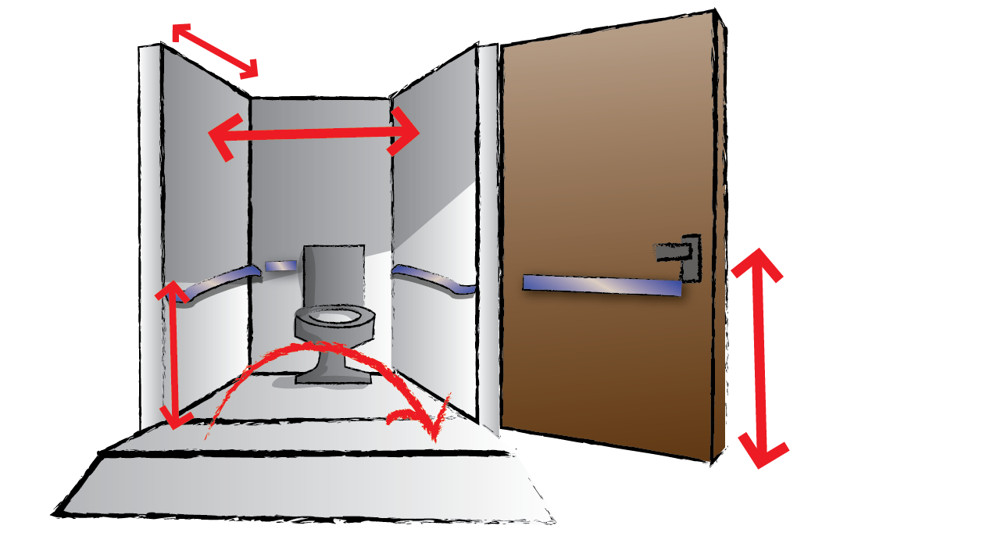
Physical accessibility
Notes:
Tips for facilitator:
Describe the illustrations: on the left, the entrance of a building used for a youth program is made accessible by installing ramps and rails. On the right, an illustration represents an accessible toilet.
As it happens with the accessibility of communication and information, the accessibility of the physical environment is a precondition for the participation of persons with disabilities. If buildings and facilities within them are not accessible, persons with disabilities will not be able to fully access and use them, and the same happens with roads and transportation.
As discussed with information and communication as well, accessible spaces follow the principles of Universal Design, and benefit all in this regards: an accessible building is safer as it has less hazards, and it is easier to evacuate in an emergency as exits are adequately signed, doors are wide and without obstacles, etc.
Accessibility standards are developed and available at national and international level, and very often organizations of persons with disabilities are aware of the accessibility standards applicable in their country.
Building accessible new infrastructure does not require lots of additional costs, it is estimated than only an additional 1% of the overall costs. However, retro-fitting is more expensive.
Accessibility features may require as well time to be implemented; that is why the Convention on the Rights of People with Disabilities proposes an alternative solution, applicable in situations of inaccessibility: reasonable accommodation.

Slide 29
Targeted support/ adjustments
Ask the person
Evaluate options and resources
Offer a solution
Verify with the person
Outreach services / transportation allowances, etc.
Inaccessible situation
Notes:
Tips for facilitator:
Accessibility: describe the illustrations in the slide. A red sign marks an inaccessible situation, for example for a woman with a physical disability requiring access to a health service that cannot be reached by her due to the inaccessibility of public transportation. A process is put in place where a dialogue is undertaken with the person to evaluate options and resources, offer a solution and verify with the person that this solution meets the purpose of the support required.
When persons with disabilities find obstacles to participate or access services and situations on an equal basis with others, a process called “reasonable accommodation”, outlined by the Convention on the Rights of People with Disabilities, should be put in place.
This process requires identifying what the person requires to participate through an interactive dialogue, and providing a solution relevant for the person, and achievable within the resources available (including time, skills, services, financial, etc.). If a solution is not found, a justification should be provided.
In the illustration, a process for the provision of reasonable accommodation is represented; for example a woman with a physical disability finds a physical barrier to access a Sexual and Reproductive Health referral she requires, as the public transportation that connects her community with that hospital is not accessible. In discussions with the Health services providers, a transportation allowance is provided to access the required services; alternative ways of facilitating access could be providing outreach visits.
These solutions facilitate immediate access, but may be less durable in time.

Slide 30
Bridging the gap between accessibility and individual adjustments
Bridging the gap between accessibility and individual adjustments
Accessibility | Reasonable accommodation
Can be implemented over time | Has to be provided immediately, otherwise there is discrimination
Is a general solution | Is an individual solution
Applies regardless of the need of persons with disabilities to access infrastructure, services or information | Applies from the moment that a person requires access to a non-accessible situation
Is guided by general principles of universal design | Is tailored to the person and designed together with the person concerned
Is ruled by accessibility standards (issued in country, or applicable from other countries) | Is ruled by a proportionality test: is it relevant, available or affordable by the project?
Notes:
Tips for facilitator:
Accessibility. Present the contents of the table. This table represents how both accessibility and reasonable accommodation complement each other, and which are the main differences between these two solutions, which may be sometimes overlapping.
While accessibility can be implemented in time, as it requires planning and resources, reasonable adjustments should be provided in a short time to avoid discrimination. They would require planning and flexibility in budgeting as well.
Accessibility benefits wide extents of the population; reasonable adjustments are provided as individual solutions.
Accessibility should be always planned and implemented, in all infrastructures, services or information, as persons with disabilities will be always accessing these places. Adjustments are implemented from the moment that a person requires access to a non-accessible situation, even if that place was made accessible: it is a way of accounting for the wide diversity of experiences within persons with disabilities, and ensuring equal access.
Accessibility is guided by Universal Design principles and national or international standards; reasonable accommodation is built in a dialogue with the person, and should be relevant and affordable for the project.

Slide 31
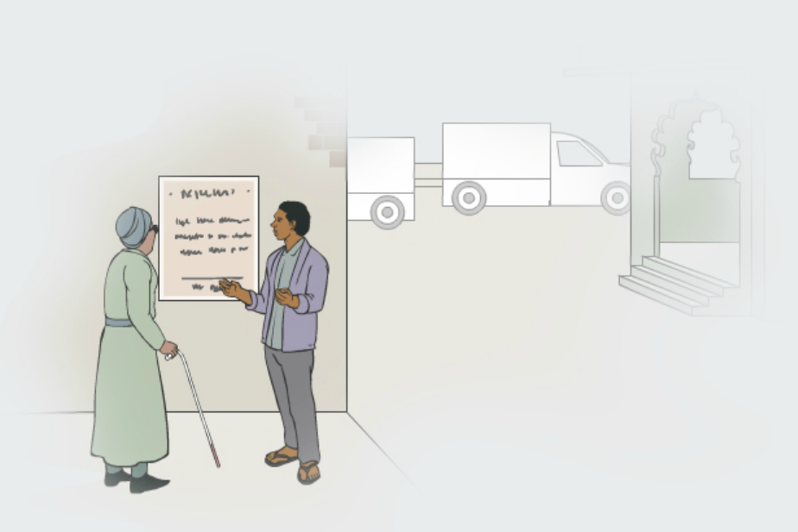

Test: Which strategy is being used?
Accessibility of information
Accessibility of communication
Targeted support/ adjustments
Notes:
Tips for facilitator:
This short test can be used to verify that participants have understood the difference between short term solutions or adjustments, and long term solutions that promote the independency of the individual accessing spaces and information.
Ask participants to shortly describe what is represented: A man is explaining information from the street announcement to a woman with visual impairment.
Ask participants which strategy is being used in this particular situation. While many participants may answer that his represents an action of accessible information, reasonable accommodation would be more adequate, as the information is still not accessible for this woman (or any other person with a visual disability) if the man is not there providing that information.

Slide 32
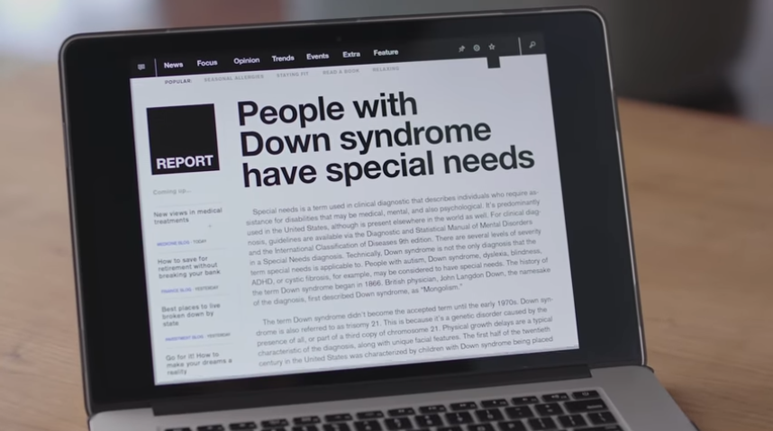
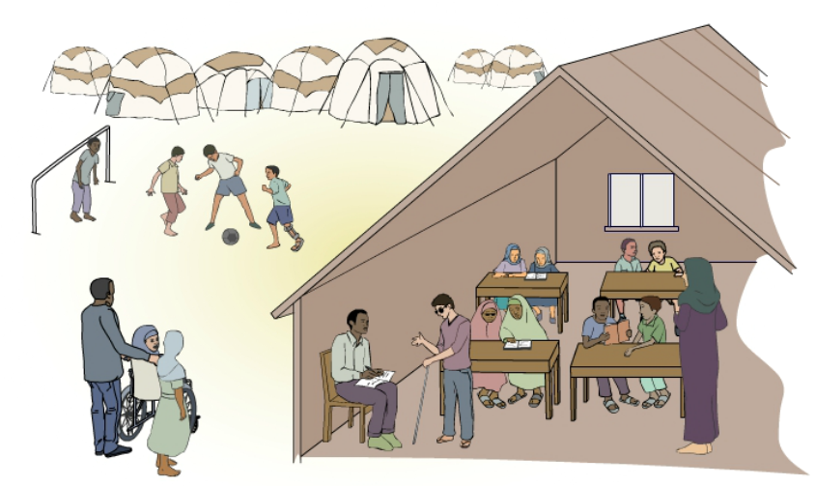
Awareness-raising
Notes:
Tips for facilitator:
Accessibility. Describe the content in the slide: an awareness session happens in a refugee class, where teachers with disabilities work as role models; on the right an awareness-rising video developed by young persons with intellectual disabilities.
Awareness-rising is one of the most important strategies outlined by the Convention on the Rights of Persons with Disabilities and should not be underestimated: information or spaces can be made accessible, but if there are no changes in the attitudes of families, communities and service providers, situations of discrimination will happen again and again.
Awareness-raising can take the shape of informative sessions, sensitization campaigns, role-modelling (for example through teachers with disabilities, such as in the illustration on the right) radio messages, posters, theatre… or even the development of video campaign.
The facilitator could play this video developed by self-advocates with disabilities, and ask participants about what is the key message presented, and how it could be applied to UNHCR’s use of the expression “specific needs”.
The video is available at: https://youtu.be/kNMJaXuFuWQ
Accessibility. Share in advance the accessibility features of the video, and ask participants if they would require any support to access its content: The video includes automated subtitles (activated by clicking the “Subtitles” icon in YouTube’s player), but it does not include sign language or voice over describing the images. A full transcript of the video can be shared with participants.
Playing videos in workshops can always present technical challenges (e.g. low connectivity, YouTube blocked in some offices, problems in sharing video and audio in digital workshops). Always check the video ahead of the session.
Key messages for awareness raising campaigns:
All needs are human needs.
While the expression “specific needs” may be reflected in UNHCR’s data system, ProGres, as a way of identifying additional support needs, human rights terminology recommends avoiding the use of “specific/special needs”.
For operational purposes, it would be more efficient to focus on persons with disabilities, persons who face barriers to access, vulnerable to [a particular risk], at risk of [a particular risk].

Slide 33

Data collection
Notes:
Tips for facilitator:
Data collection requires a dedicated training, given the complexity and richness of content required.
However, two introductory messages important to highlight are:
Not all disabilities are visible, and therefore data collection cannot rely on visual cues. The image on the slide represents this issue: “Not all disabilities look like a person in a wheelchair, some look like this (a person standing up and not showing any characteristic usually employed to depict disability). Not all disabilities are visible, please don’t be so quick to judge.” There are available tools to support the identification of persons with disabilities in demographic data, which are explored below.
There are two types of data that would be important to collect:
Individual / demographic data (e.g. in school registers, in ProGres): The Washington Group Questions on Disability and the module on Child Functioning developed with UNICEF would be the most applicable tools. This data uses non-stigmatizing questions to identify disabilities can be used to monitor access, and sometimes, to identify strategies that could be useful for certain difficulties.
Data on barriers: Qualitative data efforts can collect information on which are the barriers that persons with disabilities face. This type of data can help us to find solutions for these barriers.

Slide 34
Inclusive budgeting
Funds to remove barriers, promote participation and provide targeted activities for persons with disabilities
Physical accessibility, accessible communications, reasonable adjustments, specialized items and assistive devices are often factored in
Notes:
Tips for facilitator:
Tip for facilitator (more information in Handout 11 – Inclusive budgeting tipsheet):
What is inclusive budgeting?
Inclusive budgeting occurs when an organization, during its planning process, allocates funds to remove barriers, promotes participation for persons with disabilities, and provides targeted activities for persons with disabilities.
What can be factored in inclusive budgeting?
Inclusive budgeting factors in costs for:
Physical accessibility;
Accessible communications;
Reasonable accommodations;
Specialized non-food items (NFIs);
Assistive devices and mobility equipment.

Slide 35
Key Messages
Strategies for disability inclusion are built around CRPD principles and inform UNHCR’s policies.
A combination of strategies, timing and resources are needed to address risks.
Notes:
Tips for facilitator:
Strategies for disability inclusion are built around the principles outlined by the Convention on the Rights of People with Disabilities (CRPD), which have also informed UNHCR’s policies and guidance.
A combination of strategies will be required to address immediate risks, including situations of discrimination; addressing all protection risks will require different timing and resources.

Slide 36
Resources - UNHCR
Policy on Age, Gender and Diversity 2018;
Conclusion on refugees with disabilities and other persons with disabilities protected by the UNHCR.
Working with Persons with Disabilities in Forced Displacement (2019);
UNHCR Emergency Handbook - Persons with Disabilities;
Working with Persons with Disabilities in Forced Displacement E-Learning (available in Learn and Connect).

Slide 37
Other resources
UN Disability Inclusion Strategy
IASC Guidelines on inclusion of persons with disabilities in humanitarian action
Guidance on strengthening disability inclusion in Humanitarian Response Plans.
Humanitarian Inclusion Standards for older people and people with disabilities

Slide 38
Other resources – Children with disabilities
UNICEF Publications – Disabilities. Within these pages you will find a wide selection of resources. They include UNICEF publications and videos relating to Children with Disabilities, as well as selected external materials. https://www.unicef.org/disabilities/index_65325.html
GUIDANCE. UNICEF. Including Children with disabilities in humanitarian action. 6 Booklets. http://training.unicef.org/disability/emergencies/index.html
TOOLKIT. Disability Inclusion in Child Protection and Gender-Based Violence Programs https://www.womensrefugeecommission.org/populations/disabilities/research-and-resources/1620-disability-inclusion-in-child-protection-and-gender-based-violence-programs
IFRC. (MHPSS activities) Different, just like you

Slide 39
Other resources – COVID-19
Save the Children tip sheet on disability and Education: https://resourcecentre.savethechildren.net/node/17476/pdf/ext._education_tip_sheet_for_disability_inclusion_during_covid-19_save_the_children_pdf_version.pdf
IFRC Pivoting to Inclusion: Leveraging lessons from the COVID-19 crisis for learners with disabilities: https://resourcecentre.savethechildren.net/library/pivoting-inclusion-leveraging-lessons-covid-19-crisis-learners-disabilities
UNICEF: https://www.unicef.org/disabilities/files/All_means_All_-_Equity_and_Inclusion_in_COVID-19_EiE_Response.pdf

