Slide 1

Module 1
INTRODUCTIONS

Slide 2

What we will cover today
UNHCR’s commitment to the inclusion of persons with disabilities.
Our assumptions and perceptions on diversity.
Actions and behaviour to participate in an accessible training.
Notes:
Tips for facilitator:

Slide 3
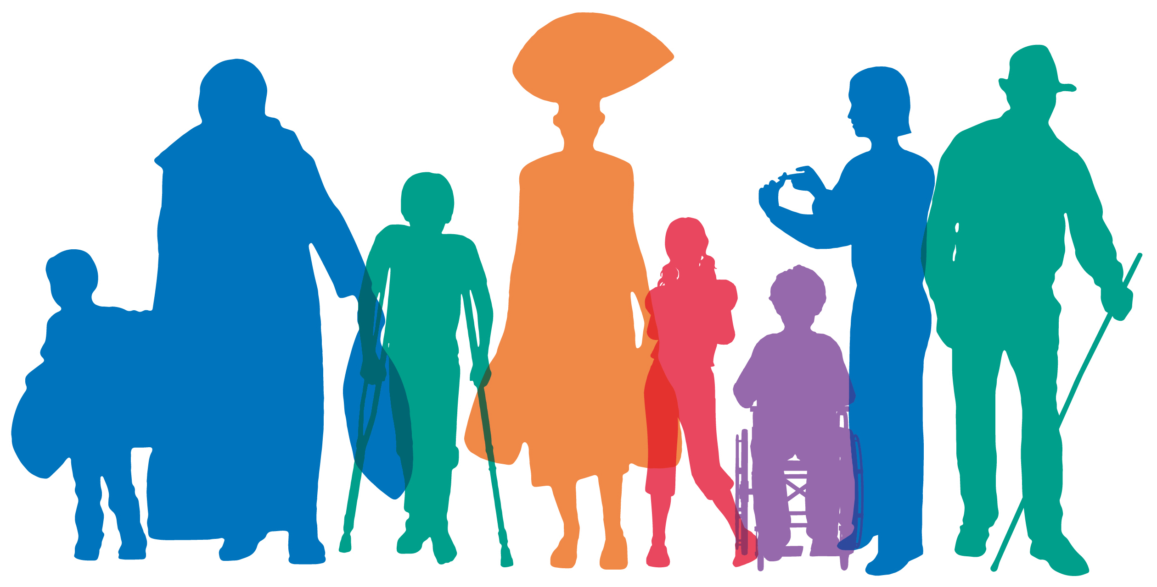
Different. Just like you
Notes:
Tips for facilitator:
Accessibility. Describe the image displayed in the screen: A picture representing diversity: coloured shadows of persons with and without disabilities.
The facilitator will read and display four short statements related to personal experiences and/or preferences. The objective is to show how different and equal we are: we share much more than what makes us different.
In face to face workshops, participants can express agreement by raising their hands, using different color and shaped cards (e.g. green circle for agreement, red square for disagreement), or physically joining the centre of the room when they share one of the experiences or preferences.
If this last option is selected, be sure to clear the centre of the room and its access from any obstacle that may prevent free circulation.
Provide alternative ways of joining the “centre” for those who may not want to physically join it: e.g. raising hands or smiling.
In remote workshops, provide for alternative ways of showing agreement using the features allowed by the platform: e.g. saying “I do/I don’t” in the chat box, using green ticks or red crosses, etc.
Provide time enough for sign language interpreters when reading the statements.
Always describe how many people is in the centre of the room, or agreeing with the statement, to share that content with all.

Slide 4
Different. Just like you
Joint the centre of the room…
… if you had a good sleep last night.
… if you like to eat [insert name of a national dish]
… if you like chocolate.
… if you have smiled to someone today.
Notes:
Tips for facilitator:
Statements can be adapted to local food preferences or activities, with the idea of keeping a focus on daily activities where people can express preferences. E.g.
… if you had a good sleep last night.
… if you like to eat [insert name of a national dish]
… if you like chocolate.
… if you have smiled to someone today. (You are smiling to me now, so come on and join the centre).
The activity can have an additional series of statements that refer more to experiences of discrimination. It is recommended, though, asking participants to stay in their seats or not raise their hands, and instead think that they are joining that centre, so confidentiality on situations of discrimination is kept, and stigma avoided. Statements can include:
Only with your imagination, join the centre of the room if you have felt uncomfortable by how someone has treated you due to a personal characteristic.
… if you have made someone feel uncomfortable, even if it was not your intention, due to a personal characteristic that person had.
The activity can finish with a key messages:
“We are all part of human diversity, and we share similar experiences and preferences with some of our peers.
We share much more than what makes us different.
Some of us may have lived, as well, situations where we may have felt uncomfortable, or made others feel uncomfortable, due to something that defines our identity, even if we are not fully aware of it.
We will learn in this workshop strategies to support the diversity that unifies us all as members of humanity. I hope you will share and learn to contribute to this objective”.

Slide 5
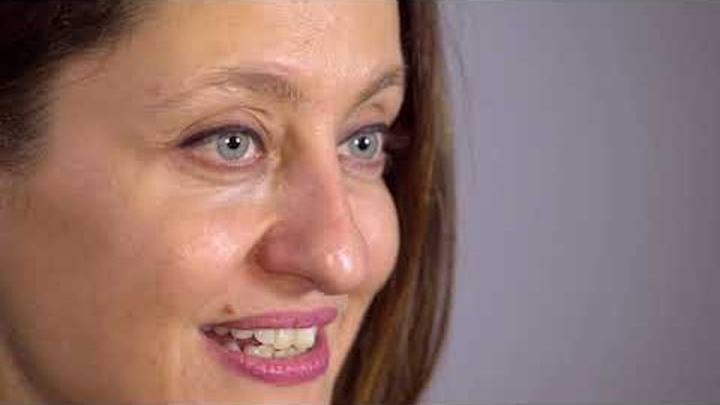
Ms. Safak Pavey
Notes:
Tips for facilitator:
Accessibility:
Share in advance the accessibility features of the video and ask participants if they would require any support to access its content: The video includes automated subtitles as an accessibility feature when played in YouTube (Persons with disabilities – YouTube). The transcript of Ms. Safak's intervention can be shared in advance with sign language interpreters, and in printed and Braille versions.
Playing videos in workshops can always present technical challenges (e.g. low connectivity, YouTube blocked in some offices, problems in sharing video and audio in digital workshops). Always check the video ahead of the session.
Briefly introduce Safak Pavey: Explain that the group is going to watch a video from Ms. Safak Pavey, the former Secretary to the CRPD Committee at the UN Office of the High Commissioner for Human Rights. As a UNHCR colleague, she stresses in this video the importance of training on disability to UNHCR employees. Suggest to participants that they can learn more about Safak Pavey, the first female person with disabilities becoming a parliamentarian in Turkey. There are more inspiring facts in her personal story; participants can also search online for her name.
Discussion: If time allows, the facilitator can ask participants a question to solicit previous experiences in working with persons with disabilities; e.g. “What has been your experience in working with persons with disabilities?”

Slide 6
Objectives of the workshop
Recognize the protection concerns & capacities of refugees with disabilities & other persons with disabilities
Apply the principles reflected in the UN Convention on the Rights of Persons with Disabilities (UNCRPD) and UNHCR Guidance on Working with Persons with Disabilities
Design immediate and long-term strategies to promote the inclusion of persons with disabilities in all activities of programming
Notes:
Tips for facilitator:
Review the objectives of the training as detailed on slide 6. The objectives of the workshop can include the overall objectives of the training package or selected objectives from different modules, in cases where only some of the modules will be used.
Ask participants if they have any other objectives that they would like to add. Write these up on a piece of flip chart paper and clarify which expectations can and can’t be covered in the training.

Slide 7
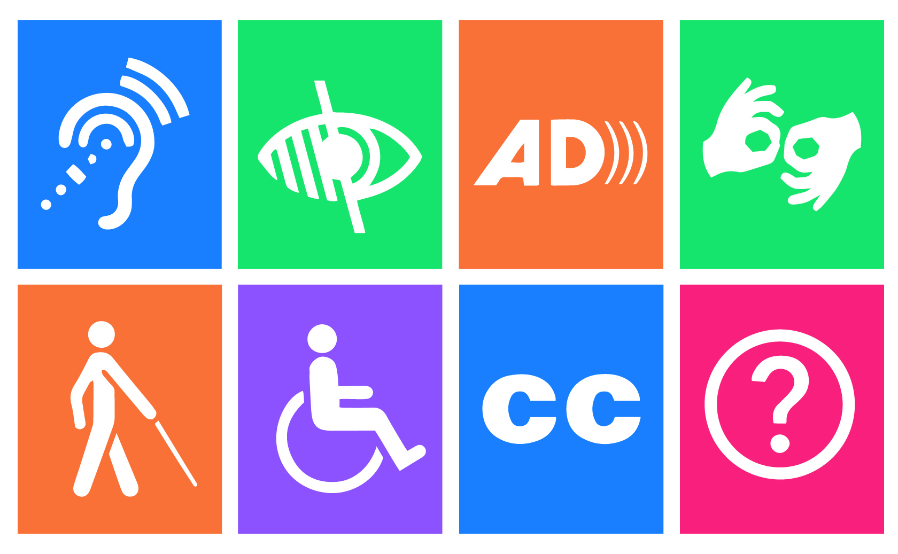
Ground rules and accessibility
Notes:
Tips for facilitator:
Accessibility. Describe the image displayed in the slide: Logos of different types of accessibility features for hearing, visual, cognitive, physical and other disabilities.
Ask participants which ground rules they would like to have during the workshop to make it a conducive learning environment for everyone. Write them down on a flip chart and say them out loud.
If they are not covered, also share a series of minimum accessibility agreements that will ensure that everybody can participate on an equal basis. Some of the requirements can include:
Always say your name before speaking. This will allow everybody to learn to recognize your voice and name.
Speak slowly and clearly, avoiding jargon or acronyms. This will give time to sign language interpreters and other interpreters to convey information in a clear way.
Please leave clear all corridors from bags, so everybody can circulate around the tables without finding obstacles.
Always provide a brief description of images displayed in the screen or a poster, so everybody can access and understand the purpose of using those images.
We will have frequent breaks, including both short breaks (called sensory breaks) and longer breaks. Please respect these breaks.
Reminders will be made about these ground rules when needed. Everybody could have a yellow card in the form of a square –to be recognizable by tact as well- that can be used when they want the presenter to slow down, and a red card in the form of a triangle, when the presenter should stop due to an accessibility issue (e.g. the interpreter needs to stop, or content is being missed). For digital workshops, other codes can be used (emojis, green ticks or red crosses).
Ask participants to share other ground rules and accessibility tips to ensure that everybody can participate in an equal basis. Take note of these and write them on a flip chart posted on the wall somewhere visible in the room to refer to them when required. If the session being delivered is virtual, use a virtual white board to do this exercise.

Slide 8
Inclusive language
Person-first: Persons with / without disabilities; avoid acronyms even in the chat (e.g. PWD)
Age and gender sensitive: Women, girls, men, boys with disabilities
Rights-based: Persons with physical, hearing, visual, intellectual, psychosocial disabilities
Focus on barriers: Physical, information, communication, organizational and attitudinal barriers
Notes:
Tips for facilitator:
The terminology used to address persons with disabilities or to talk about them during the training can diminish or empower them. Inclusive language on disability will be used across the training, following the basic principles highlighted in the slide.
Using persons-first terminology can help to focus on the person first and referring to disability as part of human diversity.
Acronyms will not be used during the training, and will be avoided as well when using the chat, kindly recommending participants to use full words to refer to persons, as using acronyms contribute to dehumanizing
When relevant, it is recommended to make visible as well the gender and age components of the individual, to avoid generalizing “persons with disabilities” as having monolithic identities around their disability; e.g. women, girls, men and boys with disabilities.
Persons with disabilities have identified and agreed words to talk about different types of disabilities following a rights-based approach that will be used during this training: physical hearing, visual, intellectual and psychosocial disabilities. While the expression “mental impairment” was reflected in the Convention on the Rights of Persons with disabilities, this term has been discussed by persons representing this constituency as having potential negative uses, and progressively changed by “psychosocial disability”, which better reflects the social component of this type of disability.
And finally, this training will focus less on classifying types of persons, and more in classifying types of barriers and obstacles they face in realizing their rights. That is why there will be lots of attention to the words used to define types of barriers, which will be explored in Module 2: physical, information, communication, organizational and attitudinal barriers.
Participants interested in learning more about terminology can read pages 5-7 in UNHCR’s Need to Know Guidance on working with persons with disabilities in forced displacement, which includes content as well on persons with albinism.

Slide 9
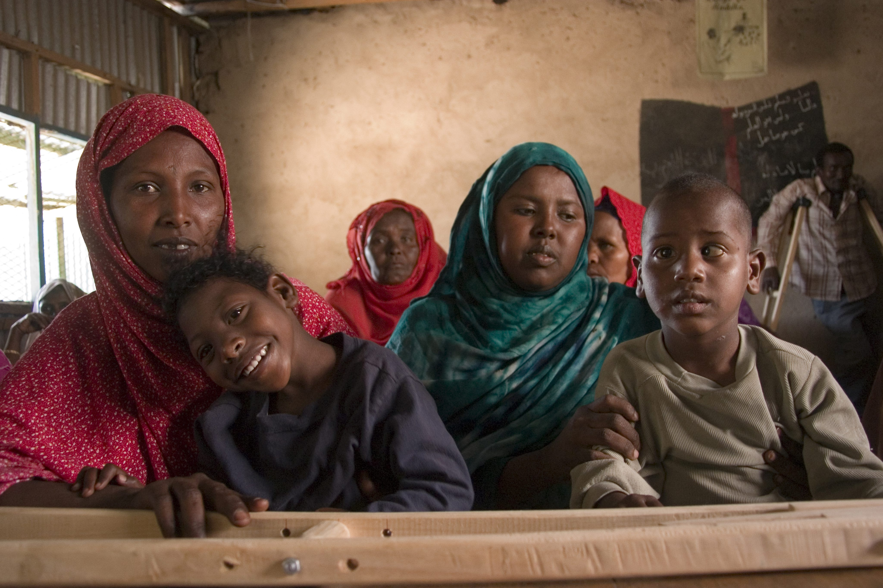
Q&A
Credit ?
Notes:
Tips for facilitator:
Accessibility. Describe the picture displayed in the slide: A group of children with disabilities and their families (Somalia)
Give participants an opportunity to share questions about the training, including learning objectives, methodology, and logistic issues. Address questions as possible, and take note of unanswered questions that may require time to answer.

